Slide 1
The Atmosphere

Slide 2
What is the atmosphere?
The layer of gases that surrounds our planet.
Weather is the condition of the atmosphere at a certain place and time.
Our atmosphere makes life possible on our planet.
Provides us with oxygen.
Keeps surface warm so water can exist as a liquid.
Protects the surface from dangerous radiation from the sun.

Slide 3
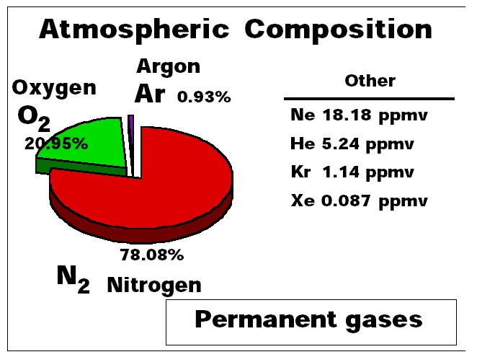
Composition of the Atmosphere
Nitrogen makes up 80% of our atmosphere
Oxygen makes up 21%
Argon makes up almost 1%
All other gases have only trace amounts

Slide 4
Nitrogen
Most abundant element in atmosphere (78%)
Always occurs as N₂
Gas at room temperature
Un-reactive, somewhat inert, does not easily combine with other elements
Vital to life

Slide 5
Oxygen
2nd most abundant element in atmosphere (21%)
Found in nature as O₂
Very reactive, supports combustion
Very vital to most living things

Slide 6
Argon
3rd most abundant element on atmosphere (0.93%)
Completely inert, does not combine with other elements
Used in neon lights

Slide 7
Trace elements/compounds
Carbon dioxide: plants use to produce food. Plants take in CO₂ and give off oxygen as a waste product.
Animals take in oxygen to make energy and give off CO₂ as a waste product.
Fossil fuels (coal, oil, natural gas) give off CO₂ when they are burned. Rising CO₂ levels can cause global warming.

Slide 8
Water Vapor
Water Vapor is water in the form of a gas.
It is invisible, not the same thing as steam. Steam is water vapor condensing back into a liquid.
The amount of water vapor in the air varies, from 0% in an arid environment, to 5% in tropical rain forests.

Slide 9
Ozone
Ozone is a molecule of oxygen with 3 oxygen atoms instead of 2.
Often formed when lightning interacts with oxygen in the air.
Forms a layer in the atmosphere that absorbs ultraviolet radiation from the sun. Without this layer life might not be possible on the surface of the planet.

