Slide 1
Paul Laurence Dunbar Elementary School
Notes:
Good Morning/Afternoon! Today we begin the process of planning our school’s budget for FY23. I know we are all here for the same reason and that is ensuring success for all (enter school name) students. This meeting is to provide an overview of the draft budget and for you to give feedback on the draft budget.

Slide 2
Norms
This is a meeting of the GO Team. Only members of the team may participate in the discussion. Any members of the public present are here to quietly observe.
We will follow the agenda as noticed to the public and stay on task.
We invite and welcome contributions of every member and listen to each other.
We will respect all ideas and assume good intentions.

Slide 3
GO Team Budget Development Process
YOUR SCHOOL STRATEGIC PLAN…
is your roadmap and your role. It is your direction, your priorities, your vision, your present, your future.
Step 1: Data Review
Step 2: Strategic Plan Review
Step 3: Budget Parameters
Step 4: Budget Choices
Notes:
Today I will provide an overview of the budget allocations for FY23. We will begin the work of funding the strategic priorities we agreed upon during our strategic review meeting. (IF YOU HAVE NOT DECIDED ON YOUR PRIORITIES, YOU WILL SAY – WE WILL DECIDE ON OUR PRIORITIES AND THEN DISCUSS ALLOCATING FUNDS TO ADDRESS THOSE PRIORITIES).

Slide 4
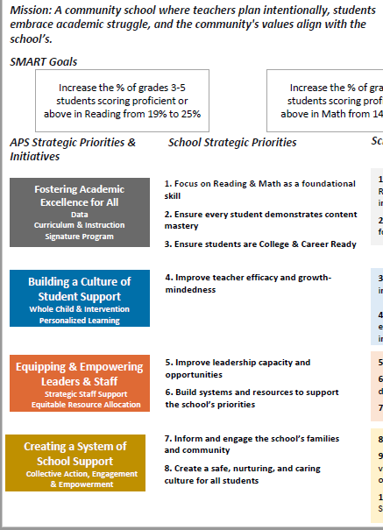
FY23 Budget Development Process
Principal’s Role
Design the budget and propose operational changes that can raise student achievement
Flesh out strategies, implement and manage them at the school level
Focus on the day-to-day operations
Serve as the expert on the school
Hire quality instructional and support personnel
The GO Team’s Role:
Focus on the big picture (positions and resources, not people)
Ensure that the budget is aligned to the school’s mission and vision and that resources are allocated to support key strategic priorities

Slide 5
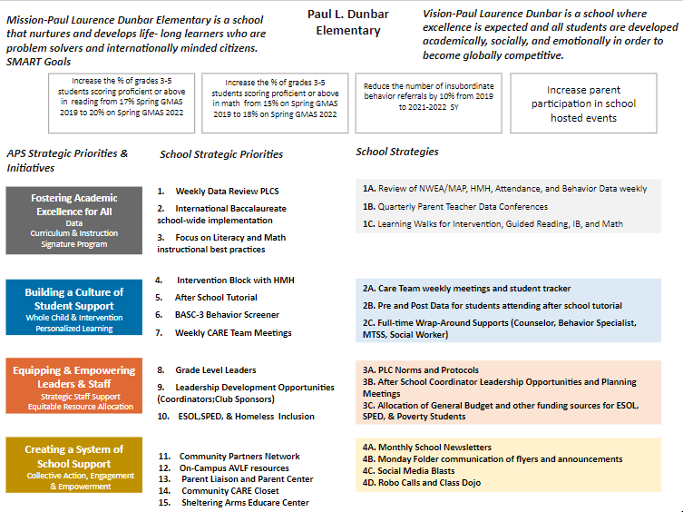
Paul L. Dunbar ES Strategic Plan
(Insert Copy of Approved Strategic Plan Here)
Example
Notes:
You should have a copy of our updated strategic plan (please make copies to be distributed to team).

Slide 6
FY23 Priorities & SMART Goals
(From your Strategic Plan, insert your Top 2 Priorities & SMART Goals for FY23 here)
School Priorities
SMART Goals
Focus on Literacy instructional best practices
Increase the % of grades 3-5 students scoring proficient or above in reading from 17% Spring GMAS 2019 to 20% on Spring GMAS 2022
Focus on Math instructional best practices
Increase the % of grades 3-5 students scoring proficient or above in math from 15% on Spring GMAS 2019 to 18% on Spring GMAS 2022
Notes:
Discuss priorities and rationale

Slide 7
FY23 Priorities & SMART Goals
(From your Strategic Plan, insert your Top 2 Priorities & SMART Goals for FY23 here)
School Priorities
SMART Goals
Based on your data and your existing strategic plan, principals & GO Teams should confirm or craft two priorities for 2022-2023.
Definition:
Key focus areas that address your school needs
Broad enough to address multiple domains (Academics, Talent, System, Culture)
Led with a “continuous improvement” verb
Clear, concise, compelling
Measurable
Provides direction to stakeholders (students, staff, families, community)
Priorities are high-level, whereas, strategies get to the how and individual needs/barriers of a school
Principals & GO Teams should confirm or craft a SMART Goal that will address each of your two priorities (one goal each).
Ensure goals are specific, measurable, achievable, relevant, and time-bound
TBD
TBD
Notes:
Discuss priorities and rationale

Slide 8
FY23 Budget Parameters
FY23 School Priorities | Rationale
Cultivate a literate community in which students read and write with clarity and fluency across the curriculum | Students are showing success in Literacy as evidenced by increased Lexile scores, assessment data, and daily classwork in English Language Arts classes but all other core content areas are not showing evidence of success especially in students showing evidence of knowledge of standards in written explanations
Example
Notes:
Discuss priorities and rationale. After you have gone over the priorities and rationale – ask GO Team if this represents what was agreed upon.
Are there any priorities I left off?
Are there any questions or concerns?
The next time we meet, I will show you how I have allocated resources to support our strategic priorities.

Slide 9
Discussion of Budget Summary
(Step 4: Budget Choices)

Slide 10
Executive Summary
This budget represents an investment plan for our school’s students, employees and the community as a whole.
The budget recommendations are tied directly to the school’s strategic vision and direction.
The proposed budget for the general operations of the school are reflected at $4,137,290 .
This investment plan for FY23 accommodates a student population that is projected to be 276 students, which is a increase/decrease of 20 students from FY22.
Notes:
Here’s a few highlights for our budget this year – read executive summary

Slide 11
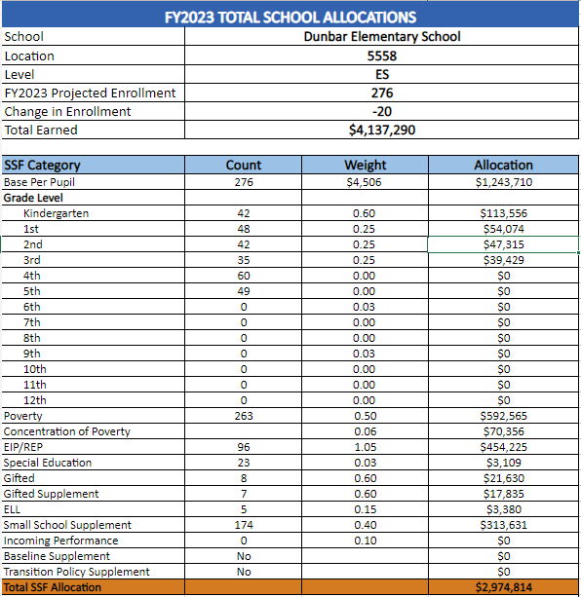
School Allocation
Example
Notes:
For FY23, APS is continuing to increase equity within the District and the flexibility principals have in regards to our schools budgeted funds. The new Student Success Funding Model (SSF) allocates dollars to schools based on the number of enrolled students and receives a funding "weight" based on need. This year, student characteristics were weighted based on:
Grade Level –
K-12
Poverty – Weighted for all Direct Certification enrolled students.
Beginning Performance – Weighted Middle School and High School students entering with beginner’s performance on milestones.
ESOL – Weighted for all ESOL designated students in order to supplement due to ESOL staff being locked.
Special Education - Weighted for all Special Education students.
Gifted – Weighted and measured by number of students in the Gifted Program
Small School Supplement – Weighted for low enrollment schools
ES – 500
MS – 600
HS – 700
As you can see, our projected enrollment for FY23 is _______, we increased/decreased by __________ from last year.
We received the following weights for our student characteristics: (Below is just for the script, principals need to insert their school’s characteristics)
Grade Level
Poverty
Special Education
Gifted
Gifted Supplement
ELL
Small School Supplement

Slide 12
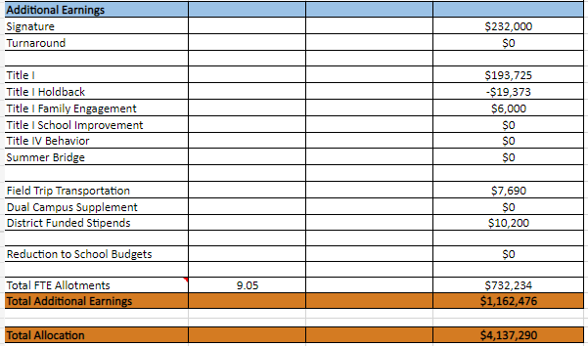
School Allocation
Example
Notes:
Additionally, we received money for signature programming, turnaround, Title I and FTE Allotments.

Slide 13
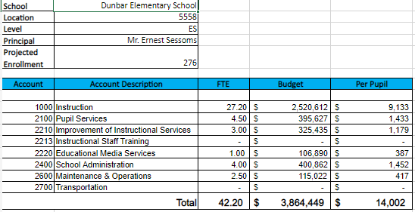
Budget by Function (Required)
Example
Notes:
I am passing out the definitions for these funding categories. You will see what makes up each category. Although the total amount will not change, allocation per function may depending on our conversations and school needs.

Slide 14
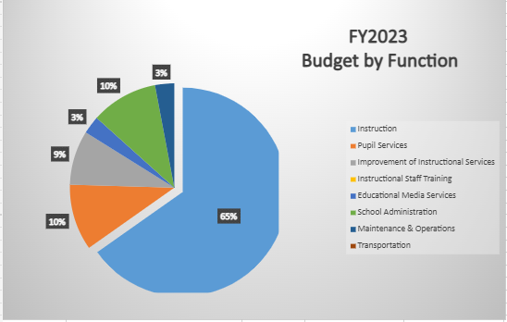
Budget by Function (Required)
Example
Notes:
Explain the pie chart and allocations

Slide 15
What’s Next?
January:
GO Team Initial Budget Session (Jan. 13th-early February)
February:
One-on-one Associate Superintendent discussions
Cluster Planning Session (positions sharing, cluster alignment, etc.)
Program Manager discussions and approvals
GO Team Feedback Session
HR Staffing Conferences (Late February - Early March)
• March:
Final GO Team Approval (AFTER your school’s Staffing Conference- March 18th)
Notes:
In February, we will meet again to discuss how the school’s budget has been allocated to support the programmatic needs and FY23 key strategic priorities.
If think we need to continue our budget conversations, we will schedule additional meetings. My goal is to make sure your voices are reflected in our school’s budget.
I will also be meeting with my Associate Superintendent, program managers and other key leaders to go over our budget and to make sure the school is meeting the standards of service and appropriately staffing.
During the week of Feb. 24th -March 2nd , HR Staffing Conferences will be held. At this meeting, I will present my plan for staff utilization, resource distribution and plan for staffing implications.
We will need to approve the budget at the ________ meeting.

Slide 16
Questions?
Thank you for your time and attention.
Notes:
IF YOU FEEL YOUR TEAM IS READY TO APPROVE THE DRAFT BUDGET, PLEASE DO SO. PLEASE REMIND THEM THAT YOU MAY NEED TO MEET WITH THEM AGAIN, IF THERE ARE CHANGES FROM YOUR MEETINGS WITH DISTRICT LEADERSHIP. LET THEM KNOW YOU WILL KEEP THEM INFORMED!!

Slide 17
Slides to Complete After Initial Meeting and Before You Meet with Associate Supt. And Program Managers

Slide 18
Description of Strategy Categories
Budget Parameters – FY23 funding priorities from the school’s 3-5 year strategic plan, ranked by the order of importance
Strategies – Lays out specific objectives for schools improvement
Request – “The Ask”. What needs to be funded in order to support the strategy?

Slide 19
FY23 Budget Parameters
FY23 School Priorities | Rationale
Maintain lower class sizes in the primary years by funding parapros in 1st and second grade | 47% mobility rate requires a great deal of teacher attention to students who enter our school throughout the year – many of which are below level.
Maximize wrap around services ie: Nurse, SSW, Counseling | This continues to be a need for our students, but we need to look closely at maximizing our budget to make this work.
Increase Reading/Lexiles and writing of 3rd – 5th grade students. How can we restructure our program to achieve this? | Data indicates that students who have been with us for more than one year have greater performance levels than students who are transient. With 47% of our students coming and going, there is a need to target these students.
Maximize the intervention block daily | Dedicated time for students to receive specific interventions and/or enrichment.
Example
Notes:
Review the priorities that the GO Team has developed and the rationale for these priorities

Slide 20
FY23 Budget Parameters
FY23 School Priorities | Rationale
Maximize the intervention block daily | Dedicated time for students to receive specific interventions and/or enrichment.
Utilize data to meet the individual needs of students. | Ensure that students are receiving maximized opportunities for achievement and remediation daily
Example
Notes:
Discuss priorities and rationale. After you have gone over the priorities and rationale – ask GO Team if this represents what was agreed upon.
Are there any priorities I left off?
Are there any questions or concerns?
The next time we meet, I will show you how I have allocated resources to support our strategic priorities.

Slide 21
FY23 Strategic Plan Break-out
Priorities | APS FIVE Focus Area | Strategies | Requests | Amount
Increase level of rigor and relevance (example- please remove) | Fostering Academic Excellence for All (example- please remove) | Implementation of guided reading (Writers Workshop training for all staff) (example- please remove) | Purchase an additional Teacher (example- please remove) | $84, 134 (example- please remove)
Notes:
For the next few slides, I will show you how I have allocated the budget to support our strategic priorities.
Based on our strategic priorities and funds we received, here is a break-out of the priorities, which focus area it addresses, the strategies that will be implemented, the purchase request, which funding source was used and the amount.

Slide 22
FY23 Strategic Plan Break-out
Priorities | APS Five Focus Area | Strategies | Requests | Amount
Increase level of rigor and relevance (example- please remove) | Fostering Academic Excellence for All (example- please remove) | Implementation of guided reading (Writers Workshop training for all staff) (example- please remove) | Purchase an additional Teacher (example- please remove) | $84, 134 (example- please remove)
Notes:
Based on our strategic priorities and funds we received, here is a break-out of the priorities, which focus area it addresses, the strategies that will be implemented, the purchase request, which funding source was used and the amount.

Slide 23
Plan for FY23 Leveling Reserve
Priorities | APS Five Focus Area | Strategies | Requests | Amount
Increase level of rigor and relevance (example- please remove) | Fostering Academic Excellence for All (example- please remove) | Implementation of guided reading (Writers Workshop training for all staff) (example- please remove) | Purchase an additional Teacher (example- please remove) | $84, 134 (example- please remove)
Notes:
This slides represent the priorities we will fund if we receive additional money from Title I and the Leveling Reserve. When we approve the budget we will approve both so that we will not have to schedule another meeting if the funds are made available.
Before I turn it back over to the Chair for the next slide, I want to thank you for your hard work and support this year. I will keep you informed as we move through the budget process. (Please inform Chair that they will facilitate the discussion for the last slide)

Slide 24
Plan for FY23 Title I Holdback and Family Engagement Funds
Priorities | APS Five Focus Area | Strategies | Requests | Amount
Increase level of rigor and relevance (example- please remove) | Fostering Academic Excellence for All (example- please remove) | Implementation of guided reading (Writers Workshop training for all staff) (example- please remove) | Purchase an additional Teacher (example- please remove) | $84, 134 (example- please remove)
Notes:
This slides represent the priorities we will fund if we receive additional money from Title I and the Leveling Reserve. When we approve the budget we will approve both so that we will not have to schedule another meeting if the funds are made available.
Before I turn it back over to the Chair for the next slide, I want to thank you for your hard work and support this year. I will keep you informed as we move through the budget process. (Please inform Chair that they will facilitate the discussion for the last slide)

Slide 25
Plan for FY23 CARES Act and ARP Funds
Priorities | APS Five Focus Area | Strategies | Requests | Amount
Increase level of rigor and relevance (example- please remove) | Fostering Academic Excellence for All (example- please remove) | Implementation of guided reading (Writers Workshop training for all staff) (example- please remove) | Purchase an additional Teacher (example- please remove) | $84, 134 (example- please remove)
Notes:
This slides represent the priorities we will fund if we receive additional money from Title I and the Leveling Reserve. When we approve the budget we will approve both so that we will not have to schedule another meeting if the funds are made available.
Before I turn it back over to the Chair for the next slide, I want to thank you for your hard work and support this year. I will keep you informed as we move through the budget process. (Please inform Chair that they will facilitate the discussion for the last slide)

Slide 26
Questions to Consider
Are our school’s priorities (from your strategic plan) reflected in this budget?
Are new positions and/or resources included in the budget to address our major priorities?
Do we know (as a team) the plan to support implementation of these priorities beyond the budget (ex. What strategies will be implemented)?
What tradeoffs are being made in order to support these priorities?
2. How are district and cluster priorities reflected in our budget?
Cluster priorities- what staff, materials, etc. are dedicated to supporting our cluster’s priorities?
Signature programs- what staff, materials, etc. are dedicated to supporting our signature program?
Are there positions our school will share with another school, i.e. nurse, counselor?
Notes:
CHAIR - Our final task for today! Here are questions that we need to consider to ensure we have a good working draft budget. Let’s walk through them together.

