Slide 1
Paul Laurence Dunbar Elementary School
Notes:
Good Morning/Afternoon! Today we begin the process of planning our school’s budget for FY23. I know we are all here for the same reason and that is ensuring success for all (enter school name) students. This meeting is to provide an overview of the draft budget and for you to give feedback on the draft budget.

Slide 2
Norms
This is a meeting of the GO Team. Only members of the team may participate in the discussion. Any members of the public present are here to quietly observe.
We will follow the agenda as noticed to the public and stay on task.
We invite and welcome contributions of every member and listen to each other.
We will respect all ideas and assume good intentions.

Slide 3
GO Team Budget Development Process
YOUR SCHOOL STRATEGIC PLAN…
is your roadmap and your role. It is your direction, your priorities, your vision, your present, your future.
Step 1: Data Review
Step 2: Strategic Plan Review
Step 3: Budget Parameters
Step 4: Budget Choices
Notes:
Today I will provide an overview of the budget allocations for FY23. We will begin the work of funding the strategic priorities we agreed upon during our strategic review meeting. (IF YOU HAVE NOT DECIDED ON YOUR PRIORITIES, YOU WILL SAY – WE WILL DECIDE ON OUR PRIORITIES AND THEN DISCUSS ALLOCATING FUNDS TO ADDRESS THOSE PRIORITIES).

Slide 4
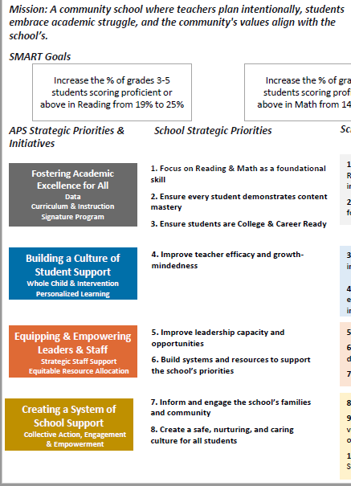
FY23 Budget Development Process
Principal’s Role
Design the budget and propose operational changes that can raise student achievement
Flesh out strategies, implement and manage them at the school level
Focus on the day-to-day operations
Serve as the expert on the school
Hire quality instructional and support personnel
The GO Team’s Role:
Focus on the big picture (positions and resources, not people)
Ensure that the budget is aligned to the school’s mission and vision and that resources are allocated to support key strategic priorities

Slide 5
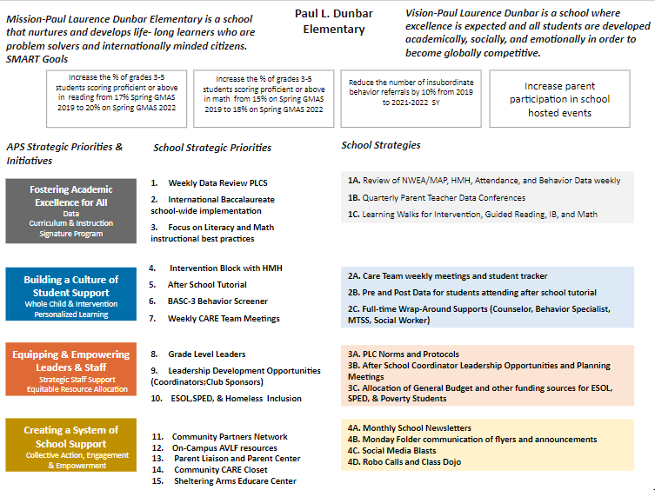
Paul L. Dunbar ES Strategic Plan
(Insert Copy of Approved Strategic Plan Here)
Example
Notes:
You should have a copy of our updated strategic plan (please make copies to be distributed to team).

Slide 6
FY23 Priorities & SMART Goals
(From your Strategic Plan, insert your Top 2 Priorities & SMART Goals for FY23 here)
School Priorities
SMART Goals
Focus on Literacy instructional best practices
Increase the % of grades 3-5 students scoring proficient or above in reading from 17% Spring GMAS 2019 to 20% on Spring GMAS 2022
Focus on Math instructional best practices
Increase the % of grades 3-5 students scoring proficient or above in math from 15% on Spring GMAS 2019 to 18% on Spring GMAS 2022
Notes:
Discuss priorities and rationale

Slide 7
Discussion of Budget Summary
(Step 4: Budget Choices)

Slide 8
Executive Summary
This budget represents an investment plan for our school’s students, employees and the community as a whole.
The budget recommendations are tied directly to the school’s strategic vision and direction.
The proposed budget for the general operations of the school are reflected at $4,107,550.
This investment plan for FY23 accommodates a student population that is projected to be 276 students, which is a increase/decrease of 20 students from FY22.
Notes:
Here’s a few highlights for our budget this year – read executive summary

Slide 9
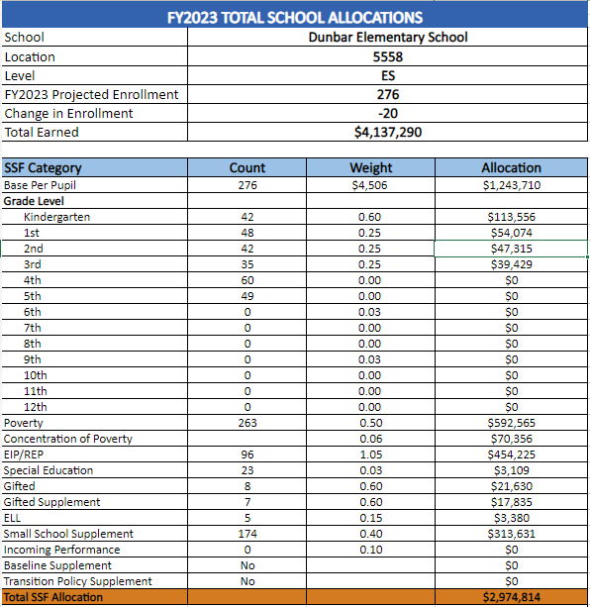
School Allocation
Example
Notes:
For FY23, APS is continuing to increase equity within the District and the flexibility principals have in regards to our schools budgeted funds. The new Student Success Funding Model (SSF) allocates dollars to schools based on the number of enrolled students and receives a funding "weight" based on need. This year, student characteristics were weighted based on:
Grade Level –
K-12
Poverty – Weighted for all Direct Certification enrolled students.
Beginning Performance – Weighted Middle School and High School students entering with beginner’s performance on milestones.
ESOL – Weighted for all ESOL designated students in order to supplement due to ESOL staff being locked.
Special Education - Weighted for all Special Education students.
Gifted – Weighted and measured by number of students in the Gifted Program
Small School Supplement – Weighted for low enrollment schools
ES – 500
MS – 600
HS – 700
As you can see, our projected enrollment for FY23 is _______, we increased/decreased by __________ from last year.
We received the following weights for our student characteristics: (Below is just for the script, principals need to insert their school’s characteristics)
Grade Level
Poverty
Special Education
Gifted
Gifted Supplement
ELL
Small School Supplement

Slide 10
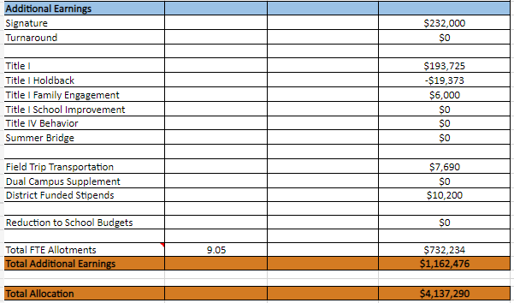
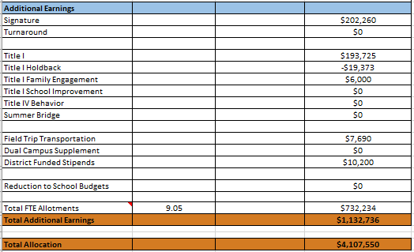
School Allocation
Notes:
Additionally, we received money for signature programming, turnaround, Title I and FTE Allotments.

Slide 11
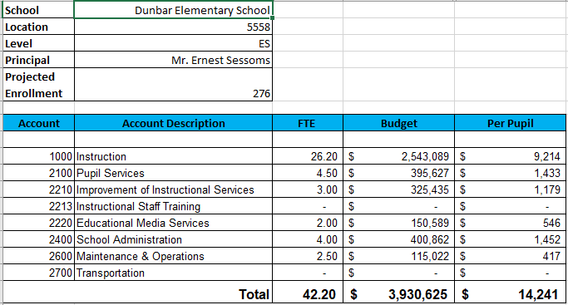
Budget by Function (Required)
Notes:
I am passing out the definitions for these funding categories. You will see what makes up each category. Although the total amount will not change, allocation per function may depending on our conversations and school needs.

Slide 12
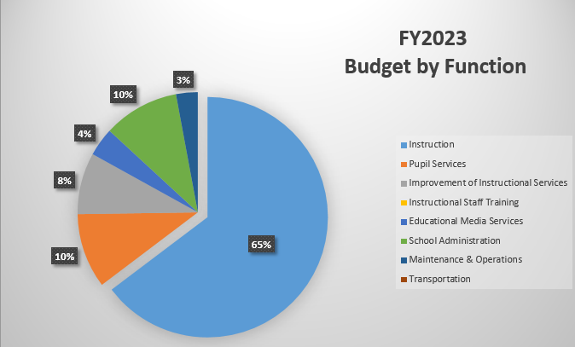
Budget by Function (Required)
Notes:
Explain the pie chart and allocations

Slide 13
What’s Next?
January:
GO Team Initial Budget Session (Jan. 13th-early February)
February:
One-on-one Associate Superintendent discussions
Cluster Planning Session (positions sharing, cluster alignment, etc.)
Program Manager discussions and approvals
GO Team Feedback Session
HR Staffing Conferences (February 22,2022)
• March:
Final GO Team Approval (AFTER your school’s Staffing Conference- March 17th)
Notes:
In February, we will meet again to discuss how the school’s budget has been allocated to support the programmatic needs and FY23 key strategic priorities.
If think we need to continue our budget conversations, we will schedule additional meetings. My goal is to make sure your voices are reflected in our school’s budget.
I will also be meeting with my Associate Superintendent, program managers and other key leaders to go over our budget and to make sure the school is meeting the standards of service and appropriately staffing.
During the week of Feb. 24th -March 2nd , HR Staffing Conferences will be held. At this meeting, I will present my plan for staff utilization, resource distribution and plan for staffing implications.
We will need to approve the budget at the ________ meeting.

Slide 14
Questions?
Thank you for your time and attention.
Notes:
IF YOU FEEL YOUR TEAM IS READY TO APPROVE THE DRAFT BUDGET, PLEASE DO SO. PLEASE REMIND THEM THAT YOU MAY NEED TO MEET WITH THEM AGAIN, IF THERE ARE CHANGES FROM YOUR MEETINGS WITH DISTRICT LEADERSHIP. LET THEM KNOW YOU WILL KEEP THEM INFORMED!!

Slide 15
Slides to Complete After Initial Meeting and Before You Meet with Associate Supt. And Program Managers

Slide 16
Description of Strategy Categories
Budget Parameters – FY23 funding priorities from the school’s 3-5 year strategic plan, ranked by the order of importance
Strategies – Lays out specific objectives for schools improvement
Request – “The Ask”. What needs to be funded in order to support the strategy?

Slide 17
FY23 Budget Parameters
FY23 School Priorities | Rationale
Cultivate a culture of learning where students are resilient and adaptive through the application of SEL Competencies. | Research shows students that are more engaged and provided positive social emotional supports, perform better academically.
Data-Driven Instruction: Increase student achievement in reading and math. | Increasing the numbers of students in the proficient and above categories have been a challenge at Dunbar Elementary. Shifts in pedagogy, professional development, and best practices are needed to maximize student achievement.
Foster a culture that values punctuality by providing recognition and incentives to students and parents that attend school daily and on-time as well as keeping parents consistently informed of their child's attendance. | Dunbar must increase attendance and punctuality to maximize classroom instruction for students.
Notes:
Review the priorities that the GO Team has developed and the rationale for these priorities

Slide 18
FY23 Budget Parameters
FY23 School Priorities | Rationale
Improve teacher efficacy in IB, Literacy Development, Gifted and other Core Content Areas. | Provide professional development for staff to ensure competence and confidence in implementing strategies for IB, literacy, and differentiated instruction.
Develop a family oriented culture of trust, expectations, and communication to strengthen the relationship between the administration, school partners, parents, and staff members. | Provide parent engagement efforts to educate and involve parents to better support their child’s education as well as bridge the gap for support and partnerships with the community.
Notes:
Discuss priorities and rationale. After you have gone over the priorities and rationale – ask GO Team if this represents what was agreed upon.
Are there any priorities I left off?
Are there any questions or concerns?
The next time we meet, I will show you how I have allocated resources to support our strategic priorities.

Slide 19
FY23 Strategic Plan Break-out
Priorities | APS FIVE Focus Area | Strategies | Requests | Amount
Maintain a strong climate & culture that supports social emotional learning that impacts high student achievement and growth. | *Whole Child & Intervention | Integration of SEL FT Behavior Specialist FT Counselor After School Clubs and Coordinator | FT Behavior Specialist & Counselor Incentives/Awards SEL Materials | $214,580.00 $2,000.00
Increase overall academic performance in math, and ELA/Reading as well as Science and Social Studies for 5th grades. | *Curriculum & Instruction *Personalized Learning *Data | Intervention Supports After School Tutorial Online Software Manipulatives and Hands-On Resources | Online Software Math Manipulatives Materials and Supplies Teachers/Staff Stipends | $10,000 $32,176.00 $30,000.00
Improve teacher efficacy in IB, Literacy Development, Gifted and other Core Content Areas. | *Curriculum & Instruction *Signature Programming | IB Training Core Content Training | Purchase professional learning for literacy, IB, and other Core Content areas. | $9,500.00
Develop a family oriented culture of trust, expectations, and communication to strengthen the relationship between the administration, school partners, parents, and staff members. | *Whole Child & Intervention | Parent Center Resources Parent Development Workshops and Trainings | Purchase materials and supplies for the Parent Center as well as for trainings and workshops. | $6,000.00
Notes:
For the next few slides, I will show you how I have allocated the budget to support our strategic priorities.
Based on our strategic priorities and funds we received, here is a break-out of the priorities, which focus area it addresses, the strategies that will be implemented, the purchase request, which funding source was used and the amount.

Slide 20
Plan for FY23 Leveling Reserve
Priorities | APS Five Focus Area | Strategies | Requests | Amount
Increase mastery in ELA, Math, Science, and Social Studies | *Curriculum & Instruction *Personalized Learning *Fostering Academic Excellence for All | Supplemental Materials/Supplies & Technology | Supplemental technology for students such as headphones replacements, devices, chargers, and IB supplies. | $59,496
Notes:
This slides represent the priorities we will fund if we receive additional money from Title I and the Leveling Reserve. When we approve the budget we will approve both so that we will not have to schedule another meeting if the funds are made available.
Before I turn it back over to the Chair for the next slide, I want to thank you for your hard work and support this year. I will keep you informed as we move through the budget process. (Please inform Chair that they will facilitate the discussion for the last slide)

Slide 21
Plan for FY23 Title I Holdback and Family Engagement Funds
Priorities | APS Five Focus Area | Strategies | Requests | Amount
Provide Family Engagement Resources for Attendance, Academic support, and incentives | *Whole Child & Intervention Parent and Student Engagement | Provide incentives and rewards for parents and students motivating good attendance and parent participation. | Purchase parent wellness, career resources as well as awards and incentives for parents and students. | $6,000.00
Notes:
This slides represent the priorities we will fund if we receive additional money from Title I and the Leveling Reserve. When we approve the budget we will approve both so that we will not have to schedule another meeting if the funds are made available.
Before I turn it back over to the Chair for the next slide, I want to thank you for your hard work and support this year. I will keep you informed as we move through the budget process. (Please inform Chair that they will facilitate the discussion for the last slide)

Slide 22
Plan for FY23 CARES Act and ARP Funds-$185,219.78
Priorities | APS Five Focus Area | Strategies | Requests | Amount
Academic Support and replacement of abolished teacher | Fostering Academic Excellence for All | Implementation of quality and rigorous instruction. | Full-Time Teacher | $92,690.00
Academic Support and replacement of abolished teacher | Fostering Academic Excellence for All | Implementation of quality and rigorous instruction. | Full-Time Paraprofessional | $44,543.00
Provide non-instructional support coupled with safety and supervision supports | Building a Culture of Student Support | Student Lunch Safety and Supervision | Cafeteria Monitors | $17,898.75
Provide supplemental tutorial services for students | Fostering Academic Excellence for All | Implementation of After School Tutorial Services | After School Tutorial Staff | $20,000.00
Provide online software to supplement the reading, math, science and social studies curriculum | Fostering Academic Excellence for All | Online software learning programs | Programs such as IXL Math, Study Island Science/SS | $10,088
Notes:
This slides represent the priorities we will fund if we receive additional money from Title I and the Leveling Reserve. When we approve the budget we will approve both so that we will not have to schedule another meeting if the funds are made available.
Before I turn it back over to the Chair for the next slide, I want to thank you for your hard work and support this year. I will keep you informed as we move through the budget process. (Please inform Chair that they will facilitate the discussion for the last slide)

Slide 23
Questions to Consider
Are our school’s priorities (from your strategic plan) reflected in this budget?
Are new positions and/or resources included in the budget to address our major priorities?
Do we know (as a team) the plan to support implementation of these priorities beyond the budget (ex. What strategies will be implemented)?
What tradeoffs are being made in order to support these priorities?
2. How are district and cluster priorities reflected in our budget?
Cluster priorities- what staff, materials, etc. are dedicated to supporting our cluster’s priorities?
Signature programs- what staff, materials, etc. are dedicated to supporting our signature program?
Are there positions our school will share with another school, i.e. nurse, counselor?
Notes:
CHAIR - Our final task for today! Here are questions that we need to consider to ensure we have a good working draft budget. Let’s walk through them together.

