Slide 1
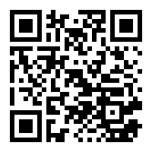
BEST Academy Welcomes Donations
Here’s How to Donate to BEST
Donations to BEST Academy can supply items and services for students that our budget can’t stretch to cover – and are always welcomed.
To donate money: Mail or deliver a check or money order to the BEST Academy or click on the following links:
https://tinyurl.com/donationsbest or
School Address
BEST Academy
1190 Northwest Drive, NW
Atlanta, Georgia 30318
Please include with your donation: How you want the money spent, or indicate the school may spend it as needed. Name of the person, business or organization donating the funds.
To donate school supplies: Contact our principal or Ms. Hardeman, Secretary to determine our specific needs.
Thank you to Our Donors

