Slide 1
Partnership Luncheon
Dr. T. Wilson, CEO/principal
Thank you for joining us. We will begin shortly.
Notes:
Good morning everyone. I am Tasharah Wilson, Principal/CEO of the Atlanta College and Career Academy. Thank you for joining us this morning for our annual partnership luncheon.

Slide 2
Notes:
We want each of you to know how much we appreciate you and the difference that you’re making to help mold and prepare Atlanta’s future workforce. One of the things that the Metro Atlanta Chamber called out as a Bright Spot in their recent Talent Supply Report is that the state should incentivize schools and institutions to regularly include employers in the development of curriculum, skill building activities, career exploration, and work-based learning opportunities. We are excited to share that we are already engaged in that work and we are so proud to have your ongoing support.

Slide 3
Agenda
Partnership Awards
Program Overview
Partnership Opportunities for 2024-25 SY
Tour
Notes:
Here is our agenda for this morning. We want to first begin by celebrating you and showing appreciation for your amazing partnership. Next we will share a high level overview of our program and then share some continuing and new ways to support ACCA. We will end today’s program by taking everyone on a tour that wants to participate.

Slide 4
Notes:
In an effort to say thank you for your amazing support, everyone should have received certificates and a token of appreciation upon your arrival this morning. The gift you received was custom made by our Graphic Design students. To further show our appreciation, the Culinary Arts students prepared lunch for you this afternoon. So at this time, we will pause and ask for everyone to help yourselves to lunch in the back. We will reconvene in 15 minutes and begin the presentation.

Slide 5
Distinguished Partnership Awards
Notes:
We have two partners that we want to give special recognition to this afternoon, for going above and beyond to support our program. When your name is called, if you would please come forward to receive your award.

Slide 6
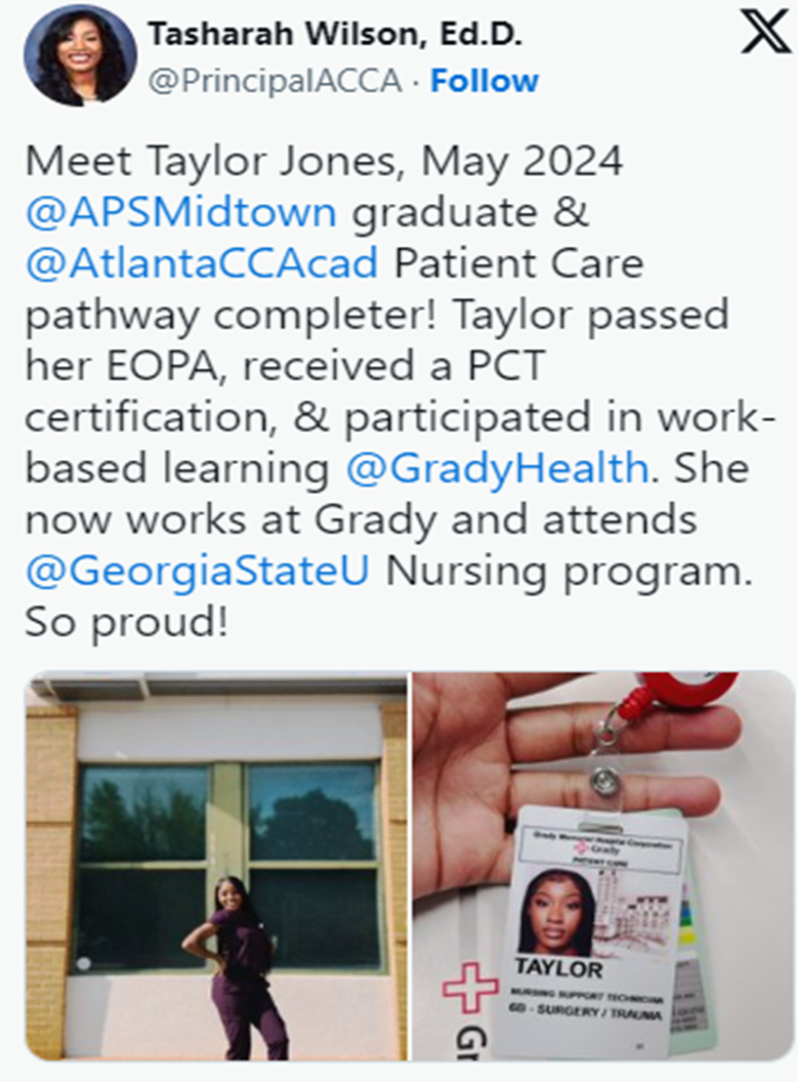
Distinguished Partnership for Work-Based Learning
Notes:
The first distinguished partnership award goes to Grady Health System for going above and beyond providing work-based learning opportunities for scholars.
Grady Health has been an extraordinary partner to the ACCA Patient Care Pathway, providing extensive training and real-world experience that bridges classroom learning with professional practice. Through their robust partnership, Grady Health offers our students the unique opportunity to apply their simulated classroom skills to real-life situations. Every spring, students participate in a four-and-a-half-week shadowing program at Grady Health, where they engage directly with patients and healthcare professionals, gaining invaluable hands-on experience in a hospital setting. Additionally, Grady Health further enhances our students' education by sending their education nurse to our classes throughout the year, allowing students to learn specialized skills tailored to Grady's high standards of care. We are proud to share that this partnership does not end with the internship. Grady Health has taken a further step by hiring our students as full-time Patient Care Technicians (PCTs), demonstrating their commitment to nurturing and retaining local talent. We sincerely thank Grady Health for their unwavering support of our program and for their dedication to teaching skills that extend far beyond the classroom.

Slide 7
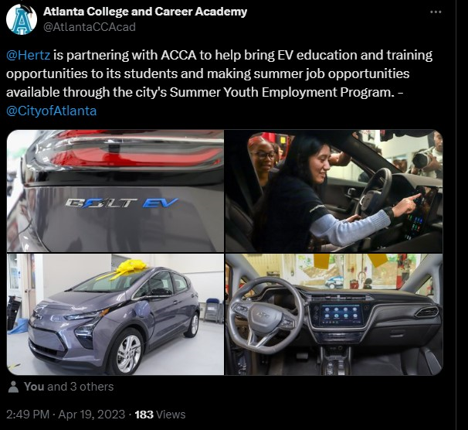
Distinguished Partnership Award for Curriculum Enhancement
Notes:
The next distinguished award goes to an amazing partner that has dedicated time, treasure and talent to our program. Hertz chair and CEO, Stephen Scherr, and Mayor of Atlanta, Andre Dickens, launched Hertz Electrifies Atlanta, a public private partnership aimed at accelerating the adoption of electric vehicles and expanding the environmental and economic benefits of electrification throughout Atlanta.
The initiative aligns with Mayor Dickens’s pledge to put Atlanta on track to meet City of Atlanta Historic Clean Energy Plan goals to transition to 100% clean energy by 2035. In addition, Hertz’s partnership with Atlanta College and Career Academy and participation in the Youth Employment Program underscores the Mayor’s Year of the Youth initiative.
As part of its work with Atlanta College and Career Academy, Hertz donated a Chevy Bolt and provides EV educational and training materials to enable the school to incorporate EV technology into our auto servicing curriculum. Further, the partnership has focused on providing students with access to cutting-edge electric vehicle (EV) technology and industry experience. Through their partnership with TechForce, Hertz provides ACCA students vouchers to take the ASE EV-1 certification test after completing the 40-hour Electude EV Curriculum; a valuable credential demonstrating their
expertise in electric vehicle repair. Finally, we appreciate Hertz sponsoring a fieldtrip to their maintenance center which offered students a firsthand look at real-world
industry operations.
To conclude, our partnership with Hertz has been invaluable. Not only are students learning technical skills, but the partnership provides scholars with an inside look at current industry operations and maintenance practices. Through these collaborative efforts, students have received real world experiences that better prepare them for the future of automotive technology and a comprehensive understanding of the electric vehicle industry.

Slide 8
Program Overview
Notes:
We will now transition to a program overview. To assist in sharing the great work happening at ACCA, we are excited to share with you a promotional video that highlights some our amazing students and what they have to say about their experience at ACCA.

Slide 10
Teaching as a Profession
Dara Tekolu
Automotive
Andrea Strommen
Carpentry
Harry Morgan
Criminal Investigation
Chirre Barron
Culinary Arts
Shernett Wheatle
Cybersecurity
Amber Williamson
Dental Science
Shante' Mosley
Infant/Toddler Childcare
Keiah Moreno
Graphic Design
Jason Stubbs
HVACR
Charles Strickland
Hospitality, Recreational & Tourism
Nicole Champion
Patient Care
Tamika Latham
Programming
Mishun Miller
Early College Essentials
Atlanta Technical College
Notes:
This slide highlights all of the amazing opportunities offered on ACCA’s campus. Those that are in blue are GaDOE high school CTAE pathways. Those that are in orange are post-secondary or dual enrollment programs.

Slide 11
Atlanta Technical College
Aviation Maintenance
Emergency Medical Responder
Natural Gas Technician
Diesel Technology
Welding
Notes:
Here are additional post secondary training opportunities students can take advantage of that are offered on Atlanta Tech’s campus.

Slide 12
Notes:
We are excited to share that our board of education recently passed a new policy regarding Accelerated Career. Accelerated Career pathways offer qualified students a unique path to high school graduation. Students choose to simultaneously earn a high school diploma and a college Associate of Applied Science Degree, Technical Diploma, an approved program that leads to licensure, or two (2) approved Technical Certificates of Credit (TCC’s) in a specific career pathway. Accelerated Career students will utilize the “ACE” Grant to cover their pathway of choice, and must be enrolled in a TCSG institution. Thanks to our partnership with Atlanta Technical College, we were able to begin offering accelerated career opportunities on ACCA’s campus this school year. Specifically, our carpentry, automotive, Cybersecurity, and infant/toddler childcare pathways are all accelerated career opportunities. Next year we will expand accelerated career opportunities by offering Programming. Students will also be able to participate in the following Accelerated Career opportunities on Atlanta Tech’s campus next year

Slide 13
Accelerated Career
Atlanta tech
acca
Emergency Medical Responder
Natural Gas Technician
Diesel Technology
Welding
Carpentry
Automotive Technology
Infant/Toddler
Cybersecurity
Programming
Notes:
Diesel, Welding, EMR, and HVAC/Natural Gas Technician

Slide 14
Your Pathway to College, Career, and Life!
Pathway Completer
Industry Credentials aligned to in-demand Metro-Atlanta careers
Diploma Seals
Georgia Best – Employability Skills
College Credit
Work-Based Learning
Job/Apprenticeship/Internship
Notes:
Our mission is to graduate all scholars ready for College, Career and Life. This slide highlights all of the various things students can accomplish in one year at ACCA!

Slide 15
Partnership Opportunities
Time
Talent
Treasure
Notes:
Now that you’ve learned more information about ACCA, we are excited to share that there are a variety of ways that you can help by dedicating your time, your talent or treasure.

Slide 16
Time
Industry Mentor
Teacher Externship
Notes:
Let’s begin with time. Here are two opportunities where you can volunteer your time this school year. And those opportunities are serving as an Industry Mentor and/or hosting a teacher externship.

Slide 17
Industry Mentor
Aligned to student pathway
Focus: Technical and Employability Skills
Mentor Meeting dates
October 25, 2024
November 22, 2024
December 20, 2024
January 17, 2025
February 28, 2025
March 21, 2025
AM Session 10:45 a.m. – 11:15 a.m.
PM Session 2:15 p.m. – 2:45 p.m.
**Requires a Level 2 Background Check**
Notes:
Lets begin with Industry Mentors. Each student will be assigned an industry mentor that is aligned to their chosen career path. For example, HVAC students will be connected to HVAC professionals. We encourage professionals from all levels of the profession (from Technician to Upper Level Management) to volunteer for this opportunity. Our goal is for all students to have a minimum of three meetings with their mentors. All meetings will take place during the school day and teachers will work with you to establish days/times that work with your schedule. If possible, we prefer for all meetings to take place on the dates listed; however, feel free to negotiate the dates/times with individual teachers. Per APS Policy, all volunteers must complete a Level 2 Background Check with the APS Police Department before volunteering.

Slide 18
Teacher Externship Design
The ACCA Teacher Externship is designed to provide both the participating educators and host business sites with information and documents that frame the experience. Components have been adapted from several national models that include the
Nebraska Work-based Learning Manual (http://nlcs1.nlc.state.ne.us/epubs/E2400/H039- 2001.pdf),
Nashville Tennessee Externship Project (http://www.mnps.org/Page74440.aspx)
Licking County Educational Service Center (http://www.lcesc.org/STEP/STEP.html),
Career Academy Support Network, University of California at Berkeley (http://casn.berkeley.edu/resources.php?r=251)
Georgia Department of Education CTAE Externship Guidelines
Notes:
The second opportunity to dedicate your time is by hosting a teacher externship. Each year we pay teachers to spend two days with a partner to learn about new trending skills students need to meet industry workforce needs. Components of ACCA’s externship were adopted from several national models and follows the guidelines of the Georgia Department of Education

Slide 19
Benefits of Teacher Externships
Business partners will have the opportunity to:
Make a positive impact on classroom curriculum and instructional practices.
Aid in preparing students with the skills they need to enter the workforce.
Gain a realistic perspective about teaching and learning in schools today.
Develop personal connections with educators and students.
Discuss project-based learning opportunities
Understand ways to connect with instructors to setup shadowing, mentorships, and Work Based Learning
Have direct contact with educators, and increased ability to influence the future workforce.
Educators will have an opportunity to:
Gain an understanding of the skills needed in today's workplace.
Develop personal connections with business professionals.
Increase knowledge of changing workplace competencies and attitudes.
Obtain a better understanding of the post-secondary requirements students need.
Examine new teaching strategies reflected in business organization structures (i.e. team approach, project management).
Understand the application of soft-skills in the workplace and employer challenges
Increase collaboration opportunities for real-world project based learning
Compare and contrast the management/leadership styles in industry to K-12 – strengthening ability to better prepare students for the future workforce
Understand dual enrollment programs to increase enrollment in certification programs and/or college prep courses
Develop a “Student Career Tool Box” of information for classroom instruction
Students will have an opportunity to:
Understand and experience how school learning relates to the workplace.
Identify the skills and competencies required in the workplace and in post-secondary education.
Participate in an active and content-relevant learning environment.
Experience a curriculum and projects that employs real world applications.
Interact with employers, participate in shadowing, mentoring and Work Based Learning experiences
Notes:
Teacher Externships benefit the hosting business partner, the teacher and their students. For business partners, you have an opportunity to aid in preparing students with the skills they need to enter the workforce and due to the direct contact with teachers, you have increased ability to influence the future workforce.

Slide 20
Teacher Externship Overview
Teachers will complete externships during non-contractual hours.
Teachers will spend 7.5 hours on your job site (in-person) each day
Teachers can spend 2 days participating in externships
Notes:
Teachers will participate in Teacher Externships during non-contractual hours. Teachers will spend 7.5 hours at the hosting partner’s work site participating in the Externship. Teachers are allotted two days to participate in externships.

Slide 21
Talent
Career Fair
Work-Based Learning
Notes:
We will now share how you can volunteer your talent. There are two opportunities for this category. The Career Fair and Work-Based Learning.

Slide 22
Career Fair April 24, 2025
Industry volunteers will interview students for work-based learning, internship, and job opportunities
Students will engage in pre-interview activities
Notes:
ACCA will host our annual Career Fair on April 24, 2025. Now…this is not your typical Career Fair, we are inviting companies from across metro-Atlanta to come and interview graduating seniors for vacancies that they need filled or for internship/apprenticeship opportunities. We are also inviting companies to interview 10th and 11th grade students for work-based learning opportunities…or even summer jobs.

Slide 23
Awards Day Signing Day May 9, 2025
Receive Job/Internship/Work-Based Learning opportunity from Career Fair
Industry volunteers that award jobs/internships/work-based learning opportunities are asked to return on Signing Day and help congratulate students
Pathway Completers
Industry Credentials
Acceptance into a college/university to continue post-secondary training/stacking credentials
Scholarships
Diploma Seals (Ex. Employability)
Notes:
Following the career fair, we will have Awards Day and Signing Day. The purpose of this celebration is for employers to announce who they will hire from the Career Fair. We will also celebrate students that are pathway completers, earned industry credentials, and students receiving work-based learning opportunities and diploma seals.

Slide 24
Work-Based Learning
Businesses provide students with a high-quality work-based learning opportunity that is aligned to their pathway on the following dates/times:
Dates
March 18, 2025 – May 16, 2025
Times
Morning Session: 9: 15 – 11:30 a.m.
Afternoon Session: 12:30 – 2:45 p.m.
Times above reflect when ACCA classes are held. Work-based learning times may be longer to accommodate business and/or student scheduling needs.
Notes:
The most critical partnership ask we have this afternoon is providing work-based learning opportunities for students during the last quarter of the school year, March 18 – May 16. Please note that ACCA offers two training sessions each day. Half of APS high schools participate in a morning session from 9:15 – 11:30 a.m. And the other half of APS high schools participate in an afternoon session from 12:30 – 2:45 p.m. Companies that opt to offer work-based learning are encouraged to offer placements for both the am session and pm session. Please note that work-based learning times can be adjusted depending on your needs and logistics. For example, a morning session student could begin a morning work-based learning opportunity at 8:30 a.m. if transportation needs are met. This will allow for a full half day experience opposed to only 2 hours and 15 minutes. At this time, I’ll invite Dr. Dwionne Freeman, APS CTAE Director to the podium to share more information regarding WBL.

Slide 25
Work-Based Learning @ ACCA
ACCA Partnership Luncheon
September 24, 2024

Slide 26
Employer Benefits
Students have completed three courses in their pathway and have demonstrated knowledge of the industry through a competency assessment
Students are assigned a teacher that supports students in the school to work transition
Students earn course credit for their participation in the program so they have a vested interest in their success
Students receive evaluations from their employer that count as their grade in the course.

Slide 27
Employer Responsibilities
Hire
Applications
Train
Employer Orientation
Expose
Guide students in acquiring/mastering new skills
Evaluate
Interviews
Recommendations
Educational Training Agreement
Mentor Assignment
Simulate industry standards & experiences
Training Plan Skills
Employability Skills

Slide 28
Interested?
http://tinyAPS.com/?ACCAWBL

Slide 29
Treasure
Professional Clothing Closet
Student/Staff Incentives
Donors Choose
https://www.donorschoose.org/schools/georgia/atlanta-public-schools/atlanta-college-and-career-academy/126478
Peach Education Tax Credit
Notes:
The final way to help ACCA is by donating treasure. There are three ways you can support ACCA for this category. I’ll begin with the Professional Clothing closet. We need gently used professional attire for students to wear during interviews or other school events. Whatever the student selects from the professional clothing closet, they keep for future use. Another need we have is incentives for students and staff that meet school goals. Incentives can be anything, from snacks, to gift cards or any small token of appreciation. Another great way to help is to check out Donors Choose. Several of our teachers have posted wish list items and/or class projects that donors can review and fund.
The final way to donate treasure is through the Peach Education Tax Credit. At this time, we will invite our Business Manager, Ms. LaShica Howard, to share more information about how you can help ACCA with this great new initiative.

Slide 30
Treasure
Peach Education Tax Credit
Student Professional Clothing Closet
Donate gently used professional attire (students keep selected items)
Provide incentives for students and teachers that meet program goals
Notes:
The final way to help ACCA is by donating treasure. There are three ways you can support ACCA for this category. I’ll begin with the Professional Clothing closet. We need gently used professional attire for students to wear during interviews or other school events. Whatever the student selects from the professional clothing closet, they keep for future use. Another need we have is incentives for students and staff that meet school goals. Incentives can be anything, from snacks, to gift cards or any small token of appreciation.
New this year is an opportunity to donate treasure to ACCA via the Peach Education Tax Credit. At this time, we will invite our Business Manager, Ms. LaShica Howard, to share more information about how you can help ACCA with this opportunity.

Slide 31
WHAT IS THE
PEACH EDUCATION
TAX CREDIT
Georgia individuals and corporations can donate to public education via the PEACH Education Tax Credit and receive a dollar-for-dollar tax credit on their Georgia state income taxes.
The tax credit is capped at $5 million and is approved on a first-come, first-serve basis.
PEACH funds may be awarded to local education agencies, public schools, charter schools, and 501(c)(3) organizations partnering with these entities implementing programs with an innovative focus.
Priority is given to schools identified in the bottom 5% of performance.

Slide 32
MAXIMUM CONTRIBUTIONS
1
Single Individual or Head of Household: UP TO $1,000
2
Married couple filing separate: UP TO $1,250
Individuals and businesses can donate up to the following amounts to the Georgia Foundation for Public Education in exchange for a PEACH Education tax credit as long as tax credits remain available.
4
S Corporation Shareholder, LLC Member or Partnership: UP TO $10,000
5
Corporation or Fiduciary Taxpayer: UP TO 75% of annual Georgia income tax liability
3
Married couple filing jointly: UP TO $2,500

Slide 33
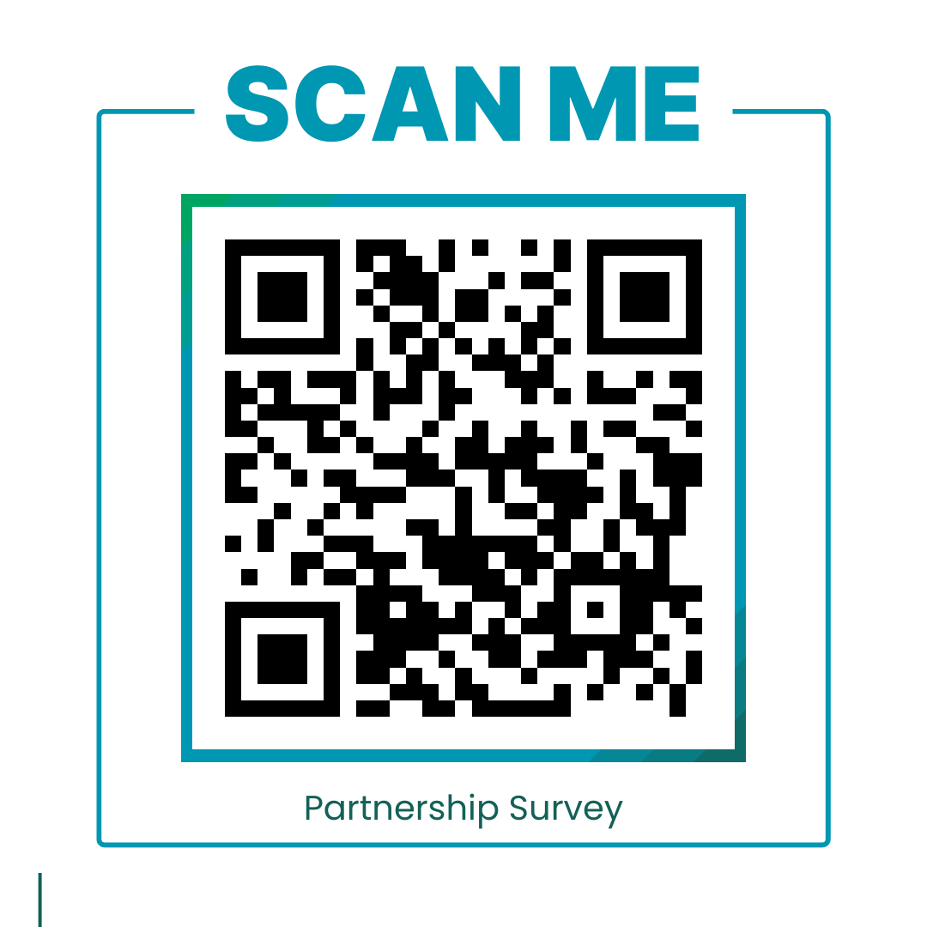
Next Steps
Partnership Survey
Contact information
Pathways you’re interested in supporting
Volunteer opportunities you want to participate in
Background check requirements
APS Board Policy requires individuals that work with students to complete a Level 2 background check.
All background checks must be completed by the APS Security Department
Scan QR Code for the Partnership Survey
ACCA Partnership Website
One stop shop for all your needs!
https://sites.google.com/apsk12.org/accapartnershipconnect/home
Notes:
Here are our next steps! Please complete the partnership interest form.
ACCA Partnership Interest Form
https://forms.gle/GKFpCDc5CYeYPKFf7
We will follow up with you based upon the areas of interest you share in the survey.

Slide 34
Notes:
A huge thank you to all for taking time out of your busy schedules to learn more about our program. We are excited to partner with you so that together we can better prepare your future workforce.
Up next, we will take you on a tour of the facility. If you want, feel free to leave your items.
Thanks again!

