Slide 1
Board of Directors Meeting Good evening, everyone! Thank you for joining us. We will begin shortly.
May 16, 2024
4 P.M.

Slide 2
Welcome Board Members & Visitors!

Slide 3
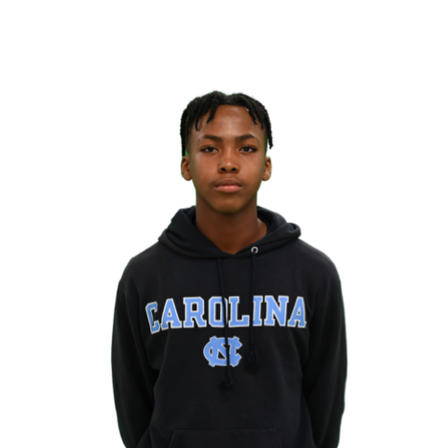
Welcome ACCA Board Members & Visitors!
Presiding
Wesley Gilliard, Jr.
Vice-Chair, ACCA Board of Directors
Student

Slide 4
Public Comment
Thank you for joining us!
Interested in addressing the board today? Please sign up at the entry table and you will have the opportunity to address the board at the end of today’s meeting. Each participant will be given two minutes to address the board during Public Comment.

Slide 5
Virtual Meeting Norms
Mics on Mute
Actively Engage
Cameras On
Non-ACCA Board Members:
Thank you for taking time out of your schedules to support the great work happening at ACCA. We appreciate you!

Slide 6
Atlanta College and Career Academy
Date: May 16, 2024
Time: 4 p.m.
Location: 1090 Windsor Street S.W.
Call to Order
Roll Call; Establish Quorum
Action Items
Approval of Agenda
Approval of Previous Minutes
Information Items
Board Training
Announcements
Adjournment

Slide 7
Roll Call
Role | Name (or Vacant) | Present or Absent
Parent/Guardian | Alexandria Robinson
Business | Sharyl Chatman
Business | William Smith
Business | Dayna Vidal
Business | Jon Lewis
Business | Patricia Horton
Metro RESA | Tim Cairl
Secondary | Dwionne Freeman
Secondary | Shelly Goodrum
Post-Secondary Representative | Sonya McCoy-Wilson
Post-Secondary Representative | Niya Eady
Ex-Officio | Katie Howard
Ex-Officio | Tasharah Wilson
Student | Wesley Gilliard
Student | Kyla Moore

Slide 8
Atlanta College and Career Academy
Date: May 16, 2024
Time: 4 p.m.
Location: 1090 Windsor Street S.W.
Call to Order
Roll Call; Establish Quorum
Action Items
Approval of Agenda
Approval of Previous Minutes
Information Items
Board Training
Announcements
Adjournment

Slide 9
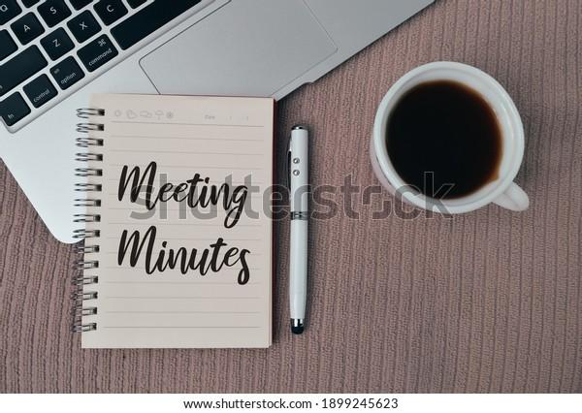
Meeting Minutes 02/29/2024

Slide 10
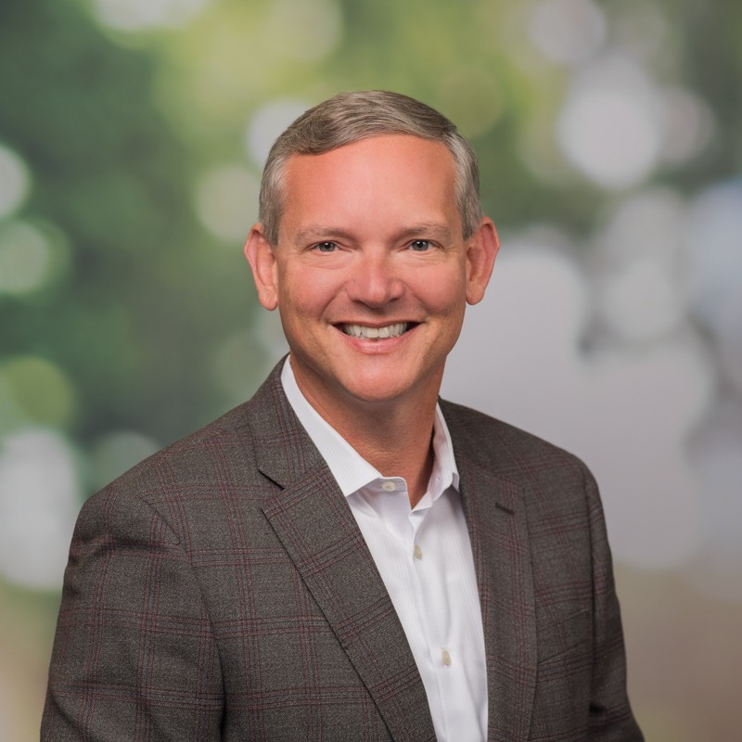
Board Training
Presenter:
Paul Sabin
Program Manager
Technical College System of Georgia

Slide 11
Announcements
Notes:
Before we end today’s meeting we have a very special announcement to make. We want to acknowledge our two student representatives, Kyla Moore and Wesley Gilliard, Jr., for their outstanding leadership this year. Thank you Kyla for serving as our board secretary and recording minutes during each meeting. Thank you Wesley for serving as Vice-Chair and doing an amazing job facilitating meetings (like today) when the chair is unable to join us. We are very proud of the both of you. On behalf of the entire board, we present you with these certificates of student leadership for your outstanding service on ACCA’s Board of Directors. Congratulations!!! Please stop by my office tomorrow to pick them up.

Slide 12
First Meeting Date (Fall Semester)
Thursday, 9/26/24 4 p.m.
Notes:
Please mark your calendars! Our first meeting will be held on September 26th at 4 p.m. We will vote to establish our entire year’s meeting calendar during this meeting.

Slide 13
Complete your GO Team Training
Remember to complete your required GO Team trainings so your team will remain in compliance (see below for current status). At this time, all members will need to ensure they have completed their New Member Orientation (both parts: online and live) and the annual Ethics trainings (APS Staff will complete the District's training and non-staff will complete the GO Team Ethics course).
We're excited that all GO Team members have access to our learning and resource platform, ELiS! This is where GO Team members will find required trainings, resources, and other items to help you with your governance work. ELiS automatically sends reminders until the trainings are completed. Non APS staff members have been sent an email with their credentials; if you need your login information, please email us. APS staff members will use their APS credentials to access the platform.
Be sure to check the site often, as we will continue to add support items and training opportunities!
Notes:
One final announcement, The GO Team office wants to remind everyone of required training for all GO Teams. If you haven’t done so, please complete all required trainings before Memorial Day (May 27). I will now turn it back over to Mr. Gilliard for Public Comment.

Slide 14
Public Comment
The Public Comment period is designed to gain input from the public and not for immediate responses by the Board to the public comment presented.
Each member of the public will have 2 minutes to speak.
At the end of 20 minutes, we will close public comment and move on to the next agenda item.
If there are questions or information that you have for the Board, you may contact one or more Board members after this meeting. You can find Board member contact information, meeting dates and agendas on ACCA’s website https://www.atlantapublicschools.us/domain/10250

Slide 15
Thank you!

