Slide 1
Board of Directors Meeting
May 22, 2023
1 p.m.
Thank you for joining us.
We will begin soon.

Slide 2
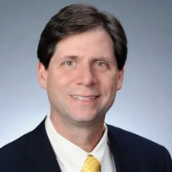
Welcome ACCA Board Members & Visitors!
Presiding
William F. Smith
Chair, ACCA Board of Directors
Director of TechOps Training and Development
Delta Air Lines

Slide 3
Public Comment
Thank you for joining us!
Interested in addressing the board today? Please sign up at the entry table and you will have the opportunity to address the board at the end of today’s meeting. Each participant will be given two minutes to address the board during Public Comment.

Slide 4
Virtual Meeting Norms
Mics on Mute
Actively Engage
Cameras On

Slide 5
Agenda
Call to order
Roll Call; Establish Quorum
Action Items
Approval of Agenda
Approval of Previous Minutes
Discussion Items
Aviation Maintenance
Announcements
Public Comment
Adjournment

Slide 6
Announcements

Slide 7
Public Comment
The Public Comment period is designed to gain input from the public and not for immediate responses by the Board to the public comment presented.
Each member of the public will have 2 minutes to speak.
At the end of 20 minutes, we will close public comment and move on to the next agenda item.
If there are questions or information that you have for the Board, you may contact one or more Board members after this meeting. You can find Board member contact information, meeting dates and agendas on ACCA’s website https://www.atlantapublicschools.us/domain/10250

Slide 8
Adjournment

