Slide 1
ACCA Updates
ACCA Current Enrollment
Maze Campus – 243 students
ATC Dual Enrollment Students (Fall and Spring) – 81 students
Fifteen Students earned TCCs from ATC Spring 2020 in the areas listed below:
Automotive Chassis Technician Specialist
CISCO
Design and Media Production
Emergency Medical Responder
Infant/Toddler Childcare Specialist
Shampoo Technician
ACCA is presently recruiting for the 2021-2022 school year
Application for the lottery is open January 25 – March 5, 2021
Currently hiring for
Early Childhood Pathway
HVAC-Refrigeration
Return to Learn
Students who opted to return for face/face instruction begin Feb. 16, 2021
ACCA students returning for face/face learning: 91

Slide 2
ACCA Shout-Outs
Thank you, Amy Lancaster-King, Metro-Atlanta Chamber of Commerce, for helping recruit and nominate two great members for ACCA’s Board of Directors!
IT/Cyber | Luke Scanlon | Talent Advisor, Salesforce | Luke is a Senior Technical Recruiter for Salesforce in the Atlanta office charged with recruiting Full Stack, Front & Back-End Software Engineers and Data Scientists. He has been with Salesforce since June 2018. Prior to Salesforce, Luke was with Kaiser Permanente for over 15 years as Principal Talent Advisor, focused on technical recruiting. Luke has been actively involved in Year Up serving as a mentor. He and his family live in the Atlanta and his three children attend Toomer Elementary.
Small/Medium Business | Chris McLaughlin | Director of Unreal Engine and 3D Design at Tempus Digital Media Group | Chris McLaughlin is a multidisciplinary 3D artist currently working as Lead 3D Environment Artist at Floyd County Productions for the Emmy award winning show Archer. Originally graduating with a BFA in Interactive Design and Game Development from SCAD, Chris has contributed a wide range of 3D production art, concept art, and game design skills to a number of studios. He has worked professionally as an organic medical modeling specialist and junior developer for AR applications using Unity, lead hard-surface modeler and junior developer for VR arch-viz applications using Unreal 4, and as an adjunct professor of Character Art and Technical Modeling at the Art Institute of Atlanta. In his free time he continues to pursue indie game development as co-founder of One-Sided Die, an Atlanta based indie studio.

Slide 3
ACCA Shout-Outs
Thank you APS BOE Vice-Chair Eshe Collins for promoting ACCA!
Return to Learn
Big shout out to our Vice-Chair/CTAE Director Dr. Freeman and CTAE Department and LaShica Howard for an EXCELLENT job getting us ready for students that opted to return to face/face learning
Steps to Your Career – February 3rd
Big shout out to Atlanta Technical College for helping to plan a wonderful virtual event for APS students Feb. 3rd!
Registration Kick-Off – Lunch & Learn
Big shout out to the ACCA Leadership Team (Fears, Fortson, Anastal) for a great job planning and executing

Slide 4
Join Us for New Member Orientation Have you attended a new member orientation?
Join Us for New Member Orientation
Have you attended a new member orientation?
According to our records, you have not yet attended a new member orientation session; this is a requirement for ALL GO Team members. Please join us for this on-line version of our new member orientation. There will be 4 opportunities to attend in the coming weeks. Monday, February 8: 1 PM - 3 PM
Wednesday, February 17: 11 AM - 1 PM
Monday, February 22: 4 PM - 6 PM
Wednesday, March 3: 12 PM - 2 PM
You only need to attend one session - please register for the one which best fits your schedule. You can register by clicking on the date (link) above or on the button below. NOTE: you will need to be on a device to participate in this orientation.

Slide 5
Strategic Plan Timeline
Nov. 2019
Strategic Planning
Feb. 2020
Pre-Certification Visit
Feb. 2020
We decided to hold off confirming the plan until we received the official feedback from certification team
Mar. 2020
Pandemic
Dec. 2020
Dr. Plunkett reviewed observations from pre-certification and shared that we must address all observations. Our next certification visit is in five years

Slide 6
5 years
Certification Visit –
Requirement for district charter renewal
Strategic Plan –
Roadmap for next five years

Slide 7
College and Career Academy Certification Process
A College and Career Academy must meet full certification as one component for the district performance contract approval
5 Standards and Several Assurances
Standard 4: Economic and Workforce Development
S4-A3
Collaborate with business and industry to ensure program offerings and curriculum are customized to meet their needs
S4-A5
Collaborate with employers to develop work-based learning opportunities for students and GCCA faculty and staff.

Slide 8
Lets look at the strategic plan…

Slide 9
We need your input!
Break – Out Groups – You choose!!!
Mission Statement (Missing the “How”)
Priority 1: Economic Development
Priority 2: Teaching and Assessing for Learning
Priority 3: Strategic Planning and Sustainability
Priority 4: Governance and Leadership
Guiding Questions
Do you agree with the priority? If not, what do you think the priority should be?
What modifications should we make to the SMART Goal?

Slide 10
Thank you for your feedback!
We will now turn it back over to the Board Chair for a vote to approve/not approve strategic plan.

Slide 11
Recommendation for Ranking of Priorities
Teaching and Assessing for Learning
Governance and Leadership
Strategic Planning and Sustainability
Economic Development

Slide 12
Atlanta College and Career Academy
Notes:
Good Morning/Afternoon! Today we begin the process of planning our school’s budget for FY21. I know we are all here for the same reason and that is ensuring success for all ACCA students. This meeting is to provide an overview of the draft budget and for you to give feedback on the draft budget.

Slide 13
GO Team Budget Development Process
YOUR SCHOOL STRATEGIC PLAN…
is your roadmap and your role. It is your direction, your priorities, your vision, your present, your future.
Step 1: Data Review
Step 2: Strategic Plan Review
Step 3: Budget Parameters
Step 4: Budget Choices
Notes:
Today I will provide an overview of the budget allocations for FY21. We will begin the work of funding the strategic priorities we agreed upon during the first half of the meeting.

Slide 14
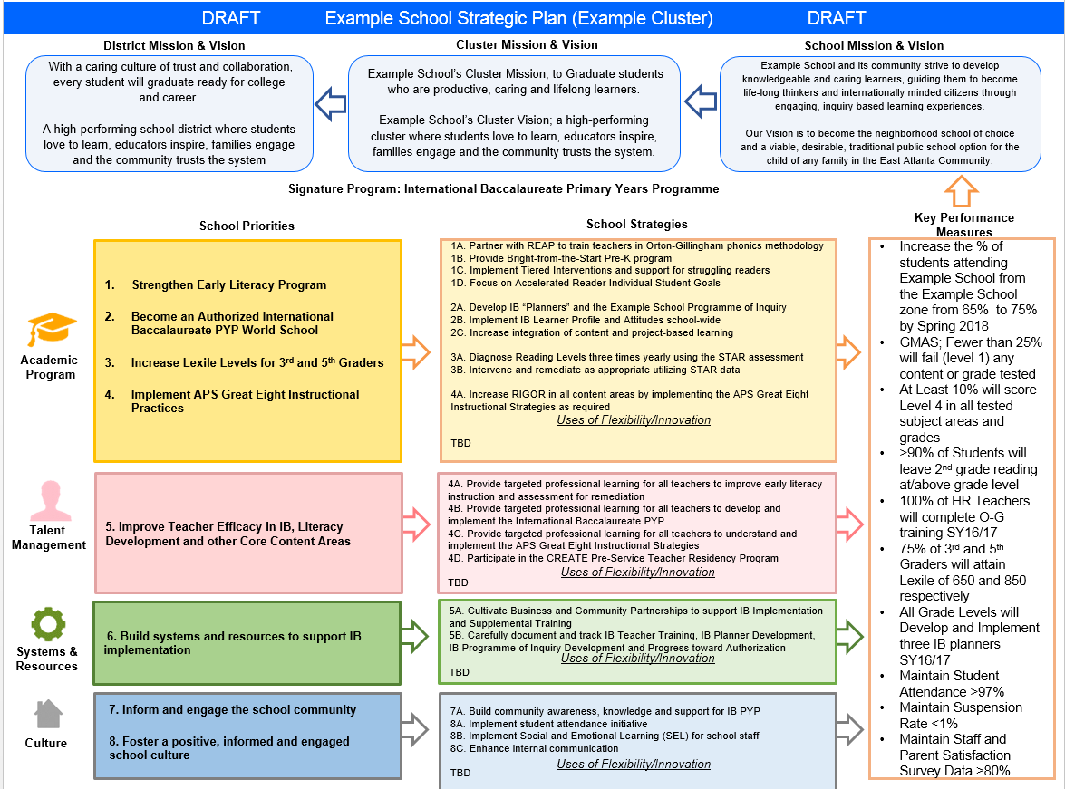
Draft FY22 Principal Budget
School Priorities =
Budget Parameters
Budget parameters guide the budget development process.

Slide 15
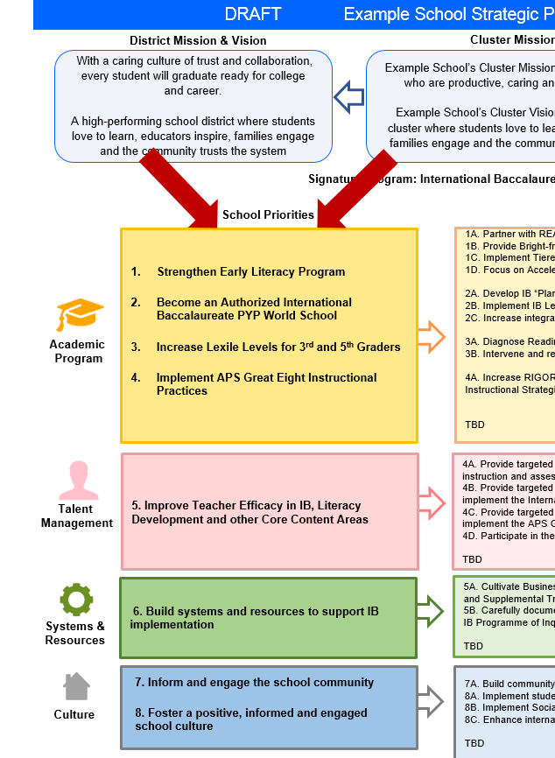
FY21 Budget Development Process
Principal’s Role
Design the budget and propose operational changes that can raise student achievement
Flesh out strategies, implement and manage them at the school level
Focus on the day-to-day operations
Serve as the expert on the school
Hire quality instructional and support personnel
The Board of Directors Role:
Focus on the big picture (positions and resources, not people)
Ensure that the budget is aligned to the school’s mission and that resources are allocated to support key strategic priorities

Slide 16
ACCA Strategic Plan
Notes:
All were emailed a copy of the updated strategic plan last week.

Slide 17
FY22 Priorities & SMART Goals
School Priorities
SMART Goals
Teaching and
Assessing for Learning
Purchase MARTA transportation cards for 120 students to participate in dual enrollment classes on Atlanta Technical College’s campus during the 2021-22 SY
Purchase instructional supplies for 120 students participating in dual enrollment classes on Atlanta Tech’s campus during the 2021-22 SY
Notes:
Discuss priorities and rationale

Slide 18
FY21 Budget Parameters
FY22 School Priorities | Rationale
Teaching and Assessing for Learning | Funding this priority will 1. Provide transportation for students participating in dual enrollment (MARTA cards) 2. Cover student supplies needed to participate in dual enrollment that legislation doesn’t cover
Notes:
Discuss priorities and rationale. After you have gone over the priorities and rationale – ask GO Team if this represents what was agreed upon.
Are there any priorities I left off?
Are there any questions or concerns?
The next time we meet, I will show you how I have allocated resources to support our strategic priorities.

Slide 19
Discussion of Budget Summary

Slide 20
Executive Summary
This budget represents an investment plan for our school’s students, employees and the community as a whole.
The budget recommendations are tied directly to the school’s strategic mission and direction.
The proposed budget for the general operations of the school are reflected at $2,414,298
Notes:
Here’s a few highlights for our budget this year – read executive summary

Slide 21
FY2022 TOTAL SCHOOL ALLOCATIONS
School | ACCA
Location | 6097
Level | HS
FY2022 Projected Enrollment | 0
Change in Enrollment | 0
Total Earned | $2,414,298
Additional Earnings
Signature |  |  | $0
Turnaround |  |  | $0
Title I |  |  | $0
Title I Holdback |  |  | $0
Title I Family Engagement |  |  | $0
Title I School Improvement |  |  | $0
Title IV Behavior |  |  | $0
Summer Bridge |  |  | $0
Field Trip Transportation |  |  | $21,000
Dual Campus Supplement |  |  | $0
District Funded Stipends |  |  | $0
Substitute Teachers |  |  | $0
Textbooks |  |  | $0
Per Pupil |  |  | $108,284
Flex |  |  | $0
Additional Flex |  |  | $0
Cluster |  |  | $0
Reduction to School Budgets |  |  | $0
Total FTE Allotments | 27.00 |  | $2,285,014
Total Additional Earnings |  |  | $2,414,298
Total Allocation |  |  | $2,414,298
School Allocation
Notes:
For CTAE, positions (FTEs) are assigned to schools depending on the pathways offered by each school and the number of students enrolled in each pathway. Schools may earn .2, .4, .5, .8 or a full FTE, given the number of students enrolled in the pathway. Additional positions are assigned to schools when the total number of students enrolled in a pathway exceeds 220+ students. Schools may earn an additional FTEs, given the number of students enrolled in the pathway. Our current enrollment is 243. Our target enrollment is 720 for 2021-22 SY (Dr. Maze campus)

Slide 22
Description of Strategy Categories
Budget Parameters – FY22 funding priorities from the school’s 3-5 year strategic plan, ranked by the order of importance
Strategies – Lays out specific objectives for school improvement
Request – “The Ask”. What needs to be funded in order to support the strategy?

Slide 23
FY22 Strategic Plan Break-out
Priorities | Focus Area | Strategies | Requests | Amount
Teaching and Assessing for Learning | Academics | Purchase MARTA cards for students to participate in dual enrollment classes on Atlanta Technical College’s campus during the 2021-22 SY Cover student supplies needed to participate in dual enrollment that legislation doesn’t cover | Provide 120 students 16 ten trip cards $14.40/card Purchase blood pressure kits, culinary arts kitchen supplies, cosmetology and barbering supplies, CPR resources and uniforms | $27,684 $20,000
Notes:
For the next few slides, I will show you how I have allocated the budget to support our strategic priorities.
Based on our strategic priorities and funds we received, here is a break-out of the priorities, which focus area it addresses, the strategies that will be implemented, the purchase request, which funding source was used and the amount.

Slide 24
Questions to Consider
Are our school’s priorities (from your strategic plan) reflected in this budget?
Are new positions and/or resources included in the budget to address our major priorities?
Do we know (as a team) the plan to support implementation of these priorities beyond the budget (ex. What strategies will be implemented)?
What tradeoffs are being made in order to support these priorities?
2. How are district and cluster priorities reflected in our budget?
Cluster priorities- what staff, materials, etc. are dedicated to supporting our cluster’s priorities?
Signature programs- what staff, materials, etc. are dedicated to supporting our signature program?
Are there positions our school will share with another school, i.e. nurse, counselor?
Notes:
CHAIR - Our final task for today! Here are questions that we need to consider to ensure we have a good working draft budget. Let’s walk through them together.

Slide 25
Next Steps
Set a date for the Budget Approval Meeting
District deadline: March 19
Will send a Doodle Poll to meet between 3/01-3/19

Slide 26
Atlanta College and Career Academy Budget Approval Meeting Date: March 18, 2021 Time: 5:30 p.m. Location: Zoom
Call to order
Roll Call; Establish Quorum
Action Items
Approval of Agenda
Approval of Previous Minutes
Budget Approval
Information Items
Principal’s Report
Announcements
Public Comment
Adjournment

Slide 27
Budget Approval Meeting
March 18, 2021

Slide 28
Approved/Ranked Priorities
Teaching and Assessing for Learning
Governance and Leadership
Strategic Planning and Sustainability
Economic Development

Slide 29
FY2022 TOTAL SCHOOL ALLOCATIONS
School | ACCA
Location | 6097
Level | HS
FY2022 Projected Enrollment | 0
Change in Enrollment | 0
Total Earned | $2,414,298
Additional Earnings
Signature |  |  | $0
Turnaround |  |  | $0
Title I |  |  | $0
Title I Holdback |  |  | $0
Title I Family Engagement |  |  | $0
Title I School Improvement |  |  | $0
Title IV Behavior |  |  | $0
Summer Bridge |  |  | $0
Field Trip Transportation |  |  | $21,000
Dual Campus Supplement |  |  | $0
District Funded Stipends |  |  | $0
Substitute Teachers |  |  | $0
Textbooks |  |  | $0
Per Pupil |  |  | $108,284
Flex |  |  | $0
Additional Flex |  |  | $0
Cluster |  |  | $0
Reduction to School Budgets |  |  | $0
Total FTE Allotments | 27.00 |  | $2,285,014
Total Additional Earnings |  |  | $2,414,298
Total Allocation |  |  | $2,414,298
School Allocation
Notes:
For CTAE, positions (FTEs) are assigned to schools depending on the pathways offered by each school and the number of students enrolled in each pathway. Schools may earn .2, .4, .5, .8 or a full FTE, given the number of students enrolled in the pathway. Additional positions are assigned to schools when the total number of students enrolled in a pathway exceeds 220+ students. Schools may earn an additional FTEs, given the number of students enrolled in the pathway. Our current enrollment is 243. Our target enrollment is 720 for 2021-22 SY (Dr. Maze campus)

Slide 30
FY22 Strategic Plan Break-out
Priorities | Focus Area | Strategies | Requests | Amount
Teaching and Assessing for Learning | Academics | Purchase MARTA cards for students to participate in dual enrollment classes on Atlanta Technical College’s campus during the 2021-22 SY Cover student supplies needed to participate in dual enrollment that legislation doesn’t cover | Provide 120 students 16 ten trip cards $14.40/card Purchase blood pressure kits, culinary arts kitchen supplies, cosmetology and barbering supplies, CPR resources and uniforms | $27,684 $20,000
Notes:
For the next few slides, I will show you how I have allocated the budget to support our strategic priorities.
Based on our strategic priorities and funds we received, here is a break-out of the priorities, which focus area it addresses, the strategies that will be implemented, the purchase request, which funding source was used and the amount.

Slide 31
Revised Allocations
FY2022 TOTAL SCHOOL ALLOCATIONS
School | ACCA
Location | 6097
Level | HS
FY2022 Projected Enrollment | 0
Change in Enrollment | 0
Total Earned | $2,414,298
Additional Earnings
Signature |  |  | $0
Turnaround |  |  | $0
Title I |  |  | $0
Title I Holdback |  |  | $0
Title I Family Engagement |  |  | $0
Title I School Improvement |  |  | $0
Title IV Behavior |  |  | $0
Summer Bridge |  |  | $0
Field Trip Transportation |  |  | $21,000
Dual Campus Supplement |  |  | $0
District Funded Stipends |  |  | $0
Substitute Teachers |  |  | $0
Textbooks |  |  | $0
Per Pupil |  |  | $108,284
Flex |  |  | $0
Additional Flex |  |  | $0
Cluster |  |  | $0
Reduction to School Budgets |  |  | $0
Total FTE Allotments | 27.00 |  | $2,285,014
Total Additional Earnings |  |  | $2,414,298
Total Allocation |  |  | $2,414,298
FY2022 TOTAL SCHOOL ALLOCATIONS
School | ACCA
Location | 6097
Level | HS
FY2022 Projected Enrollment | 0
Change in Enrollment | 0
Total Earned | $2,691,962
Additional Earnings
Signature |  |  | $0
Turnaround |  |  | $0
Title I |  |  | $0
Title I Holdback |  |  | $0
Title I Family Engagement |  |  | $0
Title I School Improvement |  |  | $0
Title IV Behavior |  |  | $0
Summer Bridge |  |  | $0
Field Trip Transportation |  |  | $21,000
Dual Campus Supplement |  |  | $0
District Funded Stipends |  |  | $0
Substitute Teachers |  |  | $0
Textbooks |  |  | $0
Per Pupil |  |  | $108,284
Flex |  |  | $0
Additional Flex |  |  | $0
Cluster |  |  | $0
Reduction to School Budgets |  |  | $0
Total FTE Allotments | 30.50 |  | $2,562,678
Total Additional Earnings |  |  | $2,691,962
Total Allocation |  |  | $2,691,962

Slide 32
School Allocation Update
Since we last met
One staff member retired (1 FTE)
Update to cover existing staff (1 FTE)
Update to reallocate one staff to a different budget (1 FTE)
Update adding additional ESOL support (.5)
Notes:
For CTAE, positions (FTEs) are assigned to schools depending on the pathways offered by each school and the number of students enrolled in each pathway. Schools may earn .2, .4, .5, .8 or a full FTE, given the number of students enrolled in the pathway. Additional positions are assigned to schools when the total number of students enrolled in a pathway exceeds 220+ students. Schools may earn an additional FTEs, given the number of students enrolled in the pathway. Our current enrollment is 243. Our target enrollment is 720 for 2021-22 SY (Dr. Maze campus)

Slide 33
Approved/Ranked Priorities
Teaching and Assessing for Learning
Governance and Leadership
Strategic Planning and Sustainability
Economic Development

Slide 34
Additional Asks
Priorities | Strategies | Requests | Amount
Teaching and Assessing for Learning | Purchase MARTA cards for students to participate in dual enrollment classes on Atlanta Technical College’s campus during the 2021-22 SY Cover student supplies needed to participate in dual enrollment that legislation doesn’t cover | Provide 120 students 16 ten trip cards $14.40/card Purchase blood pressure kits, culinary arts kitchen supplies, cosmetology and barbering supplies, CPR resources and uniforms | $27,684 $20,000
Governance and Leadership | Address Pre-Certification Report Observation #3 : The team observes that the structure of the Academy leadership positions could be a barrier to the growth and sustainability of the Academy partnerships. | Hire one Assistant Principal | $132,467 (salary and benefits)
Strategic Planning and Sustainability & Economic Development | Address Pre-Certification Report Observation #7 The team observes that while ACCA has some marketing strategies in place in the community, it does not have a comprehensive marketing plan. Observation #10 The team observes that historically the ACCA Board has collaborated with business, industry, and post-secondary partners to develop career pathways, dual enrollment, and postsecondary certifications which align to the economic and workforce needs of the community. However, going forward into Phase 2 of the ACCA, there is no definite plan to ensure this collaboration continues to strengthen as a means of ensuring success of the ACCA. | Hire one School Communications Liaison | $61,683 (salary and benefits)

Slide 35
Student Applications 2021-22 SY
Goal: 720
ACCA Application Count
 | Wednesday 2/24 | Friday 2/26 |  | Friday 3/5 | Friday 3/12
BEST | 3 | 11 |  | 14 | 14
Carver EC | 4 | 5 |  | 12 | 17
Carver Steam | 8 | 8 |  | 12 | 14
CSKYWLA | 2 | 3 |  | 4 | 6
Douglass | 14 | 14 |  | 27 | 32
Grady | 8 | 8 |  | 12 | 15
Jackson | 8 | 15 |  | 40 | 51
KIPP | 3 | 8 |  | 37 | 63
Mays | 11 | 12 |  | 23 | 28
NATL | 45 | 46 |  | 62 | 62
SATL | 11 | 15 |  | 18 | 21
Therrell | 34 | 37 |  | 43 | 47
BTW | 1 | 4 |  | 40 | 44
Total | 152 | 186 |  | 344 | 414

Slide 36
Mock Interview Day
Thursday, April 22
High Level Summary
Purpose: Provide students with real world experience interviewing with employers and application of Employability Skills
Industry Professionals will interview students and provide them feedback based on a rubric outlining key skills students are expected to master
ACCA staff are helping students create e-Portfolios, resumes, etc.
You’re invited! Great opportunity to engage with students!

