Slide 1
(Cascade Elementary)
Notes:
Good Morning/Afternoon! Today we begin the process of planning our school’s budget for FY20. I know we are all here for the same reason and that is ensuring success for all (enter school name) students. This meeting is to provide an overview of the draft budget and for you to give feedback on the draft budget.

Slide 2
Norms
This is a meeting of the GO Team. Only members of the team may participate in the discussion. Any members of the public present are here to quietly observe.
We will follow the agenda as noticed to the public and stay on task.
We invite and welcome contributions of every member and listen to each other.
We will respect all ideas and assume good intentions.

Slide 3
GO Team Budget Development Process
YOUR SCHOOL STRATEGIC PLAN…
is your roadmap and your role. It is your direction, your priorities, your vision, your present, your future.
Step 1: Data Review
Step 2: Strategic Plan Review
Step 3: Budget Parameters
Step 4: Budget Choices
Notes:
Today I will provide an overview of the budget allocations for FY20. We will begin the work of funding the strategic priorities we agreed upon during our strategic review meeting. (IF YOU HAVE NOT DECIDED ON YOUR PRIORITIES, YOU WILL SAY – WE WILL DECIDE ON OUR PRIORITIES AND THEN DISCUSS ALLOCATING FUNDS TO ADDRESS THOSE PRIORITIES).

Slide 4
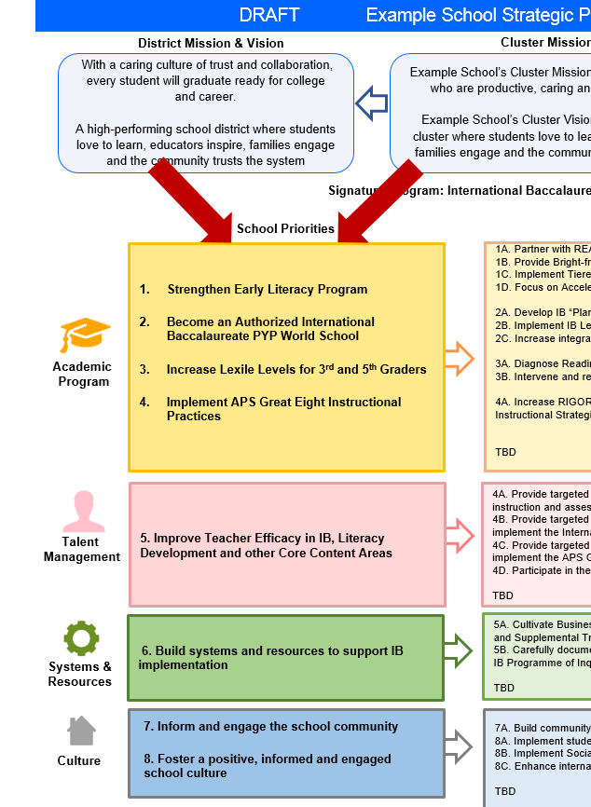
FY20 Budget Development Process
Principal’s Role
Design the budget and propose operational changes that can raise student achievement
Flesh out strategies, implement and manage them at the school level
Focus on the day-to-day operations
Serve as the expert on the school
Hire quality instructional and support personnel
The GO Team’s Role:
Focus on the big picture (positions and resources, not people)
Ensure that the budget is aligned to the school’s mission and vision and that resources are allocated to support key strategic priorities

Slide 5
DRAFT Cascade School Strategic Plan (Mays Cluster) DRAFT
District Mission & Vision
Cluster Mission & Vision
School Mission & Vision
With a caring culture of trust and collaboration, every student will graduate ready for college and career.
A high-performing school district where students love to learn, educators inspire, families engage and the community trusts the system
Provide instruction that is standards based, integrated and rigorous focusing on the whole child while collaborating with all constituents to prepare all students for graduation and beyond.
Vision: Prepare students to be come 21st century learners who are ready for college, career and beyond.
Cascade Elementary School will prepare students for College and Career Readiness through rigorous, relevant, and real world learning experiences in order to become global learners in the 21st Century.
Our Vision is to become the neighborhood school of choice and a viable, desirable, traditional public school option for the child of any family in Southwest Atlanta that provide students with a broad and balanced education; working within a global context to expose them to various languages, cultures and global understandings.
Signature Program: International Baccalaureate Primary Years Programme
School Priorities
School Strategies
Key Performance
Measures
1. Improve percent of students achieving at proficient and distinguished levels on the GA Milestones Assessment in ELA and Mathematics.
2. Improve Tier 1 instructional strategies in ELA and Mathematics
3. Improve early identification procedures for Tier 2 and above.
4. Become an Authorized International Baccalaureate PYP World School by 2021
5. Build teacher capacity using effective instructional coaching strategies
1A. Provide early identification of student performance levels
1B. Monitor and track students by performance bands throughout the school year
1C. Conduct quarterly target update sessions with teacher and students
1D. Adopt and implement comprehensive ELA and Math curriculums aligned to the GA Standards of Excellence
1E. Provide adequate instructional coaching for teachers of high leverage instructional strategies
2A. Implement professional development sessions aligned to the standards and curriculum resources
2B. Assess target students monthly using STAR Assessment System
2C. Provide frequent feedback to teachers on the implementation of strategies
3A. Integrate early detection mechanisms for struggling students
3B. Provide training opportunities for teachers to understand the RTI process
4A. Plan, create, and implement at least two transdisciplinary IB units
4B. Retain a school based IB specialist to oversee the authorization phases of the programme
Increase ELA and Math performance in Proficient and Distinguished categories on GMAS by 15%.
Increase Progress (percent of student meeting typical or high growth on STAR and Milestones EOGs) by more than 40 SGP.
Results of student’s perception surveys on School climate surveys.
Feedback from classroom observations.
Increase number of school partnerships.
Maintain Student Attendance >94%
Maintain Suspension Rate <2%
Maintain CCRPI Climate rating >4 diamond and improve parent satisfaction rating
Increased participation at parent workshops
Academic
Program
Uses of Flexibility/Innovation
5A. Provide targeted and professional learning opportunities focused on the implementation of Standards based instruction
5B. Provide collaborative/vertical planning time each week
5C. Provide professional development opportunities led by teachers according to observable strengths
5D.Particiapte in district/IB capacity building professional learning opportunities.
Talent
Management
Uses of Flexibility/Innovation
6. . Improve data tracking systems that include student goal setting opportunities
6A. Vet and determine data efficiency tracking system tools to monitor student progress .
6B. Provide professional development sessions focused on student goal setting.
Systems &
Resources
Uses of Flexibility/Innovation
7. Create a positive and healthy school environment where students thrive, teachers enjoy coming to work, and the community trusts
7A. Build community awareness, knowledge and support for school wide initiatives by removing barriers
7B. Provide workshops to build parent capacity to understand student needs
7C. Continue the implementation of Social Emotional Learning for students and school staff
7D. Create engaging opportunities throughout the year for students and families to enjoy
Culture
Uses of Flexibility/Innovation

Slide 6
FY20 Priorities & SMART Goals
(From your Strategic Plan, insert your Top 2 Priorities & SMART Goals for FY20 here)
School Priorities
SMART Goals
Improve the percent of students achieving at the proficient and distinguished levels on the GA Milestone Assessment in ELA and Math
By June 2020, students in grades 3-5 will increase 10% points in ELA and Mathematics on the GA Milestones Assessment from the previous school year.
Create a positive and healthy school environment where students thrive, teachers enjoy coming to work, and the community trusts
By June 2020, Cascade Elementary will maintain its 5 Star Climate rating as determined on the GA State Climate Survey.
Notes:
Discuss priorities and rationale

Slide 7
FY20 Budget Parameters
FY20 School Priorities | Rationale
Cultivate a literate community in which students read and write with clarity and fluency across the curriculum | Students are showing success in Literacy as evidenced by increased Lexile scores, assessment data, and daily classwork in English Language Arts classes but all other core content areas are not showing evidence of success especially in students showing evidence of knowledge of standards in written explanations
Example
Notes:
Discuss priorities and rationale. After you have gone over the priorities and rationale – ask GO Team if this represents what was agreed upon.
Are there any priorities I left off?
Are there any questions or concerns?
The next time we meet, I will show you how I have allocated resources to support our strategic priorities.

Slide 8
Discussion of Budget Summary
(Step 4: Budget Choices)

Slide 9
Executive Summary
This budget represents an investment plan for our school’s students, employees and the community as a whole.
The budget recommendations are tied directly to the school’s strategic vision and direction.
The proposed budget for the general operations of the school are reflected at $ 5, 168, 574___
This investment plan for FY20 accommodates a student population that is projected to be 413_ students, which is a increase/decrease of _29__ students from FY19.
Notes:
Here’s a few highlights for our budget this year – read executive summary

Slide 10
School Allocation
FY2020 TOTAL SCHOOL ALLOCATIONS
School | Cascade Elementary School
Location | 0196
Level | ES
FY2020 Projected Enrollment | 413
Change in Enrollment from FY2019 | 29
Total Earned | $ 5,168,574
SSF Category | Count | Weight | Allocation
Base Per Pupil | 413 | $4,420 | $ 1,825,340
Grade Level
Kindergarten | 62 | 0.65 | $ 178,114
1st | 61 | 0.30 | $ 80,881
2nd | 65 | 0.30 | $ 86,184
3rd | 79 | 0.30 | $ 104,747
6th | 0 | 0.05 | $ -
9th | 0 | 0.00 | $ -
Poverty | 290 | 0.55 | $ 704,944
EIP/REP | 123 | 1.05 | $ 570,805
Special Education | 57 | 0.03 | $ 7,558
Gifted | 7 | 0.60 | $ 18,563
Gifted Supplement | 15 | 0.60 | $ 38,475
ELL | 18 | 0.15 | $ 11,933
Small School Supplement | 37 | 0.40 | $ 65,412
Incoming Performance | 57 | 0.10 | $ -
Baseline Supplement | No |  | $ -
Transition Policy Supplement | No |  | $ -
Total SSF Allocation |  |  | $ 3,757,483
Example
Notes:
For FY20, APS is continuing to increase equity within the District and the flexibility principals have in regards to our schools budgeted funds. The new Student Success Funding Model (SSF) allocates dollars to schools based on the number of enrolled students and receives a funding "weight" based on need. This year, student characteristics were weighted based on:
Grade Level –
K
1st through 3rd
6th
9th
Poverty – Weighted for all Direct Certification enrolled students.
Beginning Performance – Weighted Middle School and High School students entering with beginner’s performance on milestones.
ESOL – Weighted for all ESOL designated students in order to supplement due to ESOL staff being locked.
Special Education - Weighted for all Special Education students.
Gifted – Weighted and measured by number of students in the Gifted Program
Small School Supplement – Weighted for low enrollment schools
ES – 500
MS – 600
HS – 700
As you can see, our projected enrollment for FY19 is _______, we increased/decreased by __________ from last year.
We received the following weights for our student characteristics: (Below is just for the script, principals need to insert their school’s characteristics)
Grade Level
Poverty
Special Education
Gifted
Gifted Supplement
ELL
Small School Supplement

Slide 11
School Allocation
Additional Earnings
Signature |  |  | $ 232,000
Turnaround |  |  | $ -
Title I |  |  | $ 243,000
Title I Holdback |  |  | $ (24,300)
Field Trip Transportation |  |  | $ 10,864
Dual Campus Supplement |  |  | $ -
District Funded Stipends |  |  | $ 7,200
Total FTE Allotments | 13.55 |  | $ 942,326
Total Additional Earnings |  |  | $ 1,411,091
Total Allocation |  |  | $ 5,168,574
Notes:
Additionally, we received money for signature programming, turnaround, Title I and FTE Allotments.

Slide 12
Budget by Function (Required)
School | Sample Elementary School
Location | 1111
Level | ES
Principal | A. Principal
Projected Enrollment | 632
Account | Account Description | FTE | Budget
1000 | Instruction | 28.80 | $ 4,607,007
2100 | Pupil Services | 4.45 | $ 349,974
2210 | Improvement of Instructional Services | 2.00 | $ 206,987
2213 | Instructional Staff Training | - | $ -
2220 | Educational Media Services | 1.00 | $ 99,381
2400 | School Administration | 5.00 | $ 506,300
2600 | Maintenance & Operations | 2.50 | $ 122,994
2700 | Transportation | - | $ -
Total |  | 43.75 | $ 5,892,643
Example
Notes:
I am passing out the definitions for these funding categories. You will see what makes up each category. Although the total amount will not change, allocation per function may depending on our conversations and school needs.

Slide 13
Budget by Function (Required)
Example
Notes:
Explain the pie chart and allocations

Slide 14
What’s Next?
February:
GO Team Initial Budget Session (Feb. 27th)
One-on-one Associate Superintendent discussions
Cluster Planning Session (positions sharing, cluster alignment, etc.)
Program Manager discussions and approvals
GO Team Feedback Session
HR Staffing Conferences (February 25th - March 1st)
• March:
Final GO Team Approval (March 1st - March 15th)
March 6th for Cascade
Notes:
In February, we will meet again to discuss how the school’s budget has been allocated to support the programmatic needs and FY20 key strategic priorities.
If think we need to continue our budget conversations, we will schedule additional meetings. My goal is to make sure your voices are reflected in our school’s budget.
I will also be meeting with my Associate Superintendent, program managers and other key leaders to go over our budget and to make sure the school is meeting the standards of service and appropriately staffing.
During the week of Feb. 25th -March 1st , HR Staffing Conferences will be held. At this meeting, I will present my plan for staff utilization, resource distribution and plan for staffing implications.
We will need to approve the budget at the ________ meeting.

Slide 15
Questions?
Thank you for your time and attention.
Notes:
IF YOU FEEL YOUR TEAM IS READY TO APPROVE THE DRAFT BUDGET, PLEASE DO SO. PLEASE REMIND THEM THAT YOU MAY NEED TO MEET WITH THEM AGAIN, IF THERE ARE CHANGES FROM YOUR MEETINGS WITH DISTRICT LEADERSHIP. LET THEM KNOW YOU WILL KEEP THEM INFORMED!!

