Slide 1
(Cleveland Avenue Elementary)
Notes:
Good Morning/Afternoon! Today we begin the process of planning our school’s budget for FY19. I know we are all here for the same reason and that is ensuring success for all (enter school name) students. This meeting is to provide an overview of the draft budget and for you to give feedback on the draft budget.

Slide 2
Norms
This is a meeting of the GO Team. Only members of the team may participate in the discussion. Any members of the public present are here to quietly observe.
We will follow the agenda as noticed to the public and stay on task.
We invite and welcome contributions of every member and listen to each other.
We will respect all ideas and assume good intentions.

Slide 3
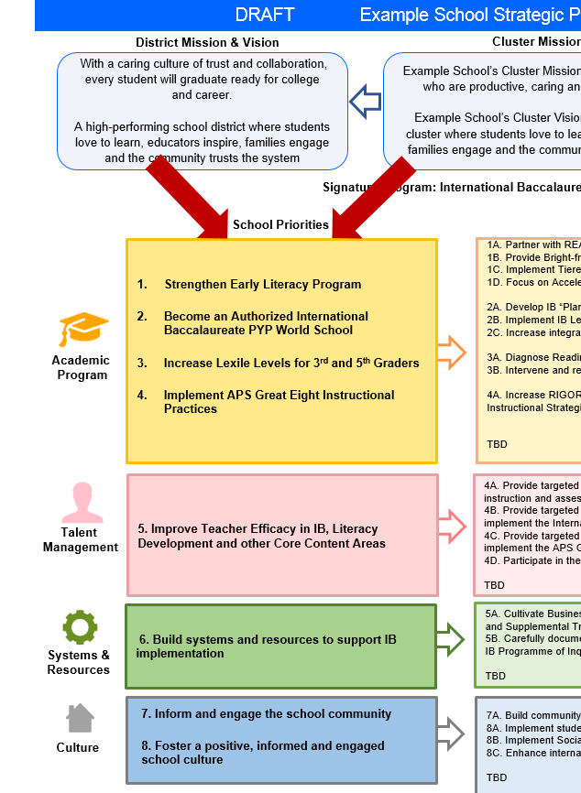
FY19 Budget Development Process
Principal’s Role
Design the budget and propose operational changes that can raise student achievement
Flesh out strategies, implement and manage them at the school level
Focus on the day-to-day operations
Serve as the expert on the school
Hire quality instructional and support personnel
The GO Team’s Role:
Focus on the big picture (positions and resources, not people)
Ensure that the budget is aligned to the school’s mission and vision and that resources are allocated to support key strategic priorities

Slide 4
GO Team Budget Development Process
YOUR SCHOOL STRATEGIC PLAN…
is your roadmap and your role. It is your direction, your priorities, your vision, your present, your future.
Step 1: Data Review
Step 2: Strategic Plan Review
Step 3: Comparison
Step 4: Budget Parameters
Step 5: Budget Choices
Notes:
Today I will provide an overview of the budget allocations for FY19. We will begin the work of funding the strategic priorities we agreed upon during our strategic review meeting. (IF YOU HAVE NOT DECIDED ON YOUR PRIORITIES, YOU WILL SAY – WE WILL DECIDE ON OUR PRIORITIES AND THEN DISCUSS ALLOCATING FUNDS TO ADDRESS THOSE PRIORITIES).

Slide 5
Focus Area Descriptors
Strategic Plan Categories | District Descriptions of Categories
Academic Program | Our students will be well-rounded individuals who possess the necessary academic skills and knowledge and are excited about learning.
Talent Management | We will retain an energized and inspired team of employees who are capable of advancing ever-increasing levels of achievement for students of all backgrounds.
Systems & Resources | We will improve efficiency (productivity, cost, etc.) while also making decisions (including resource allocations) that are grounded in a strategic academic direction and data.
Culture | We will build trust with the community, and we will have engaged stakeholders (employees, students, parents, community members, partners, etc.) who are invested in the mission and vision and who support the creation of student-centered learning communities.
Notes:
I have printed the terms on the next two slides for your convenience. I want to just go over them so we will all be on the same page as we move forward in this process. If you have any questions, please don’t hesitate to ask.

Slide 6
Description of Strategy Categories
Budget Parameters – FY19 funding priorities from the school’s 3-5 year strategic plan, ranked by the order of importance
Strategies – Lays out specific objectives for schools improvement
Request – “The Ask”. What needs to be funded in order to support the strategy?

Slide 7
Cleveland Avenue Elementary Strategic Plan
Notes:
You should have a copy of our updated strategic plan (please make copies to be distributed to team). The next slide(s), you will see where I have taken our priorities that we agreed to focus on next year and added a rationale for each priority. This will be very important as we move forward in the budget process. (IF YOU HAVE NOT DONE THIS, THIS WILL BE THE TIME YOU DISCUSS YOUR PRIORITIES FOR SCHOOL YEAR 18-19 AND THEN WRITE A RATIONALE).

Slide 8
FY19 Budget Parameters
FY19 School Priorities | Rationale
Improve student mastery in all content areas Increase Reading Lexile levels Develop a robust intervention plan for Reading & Math | 47% mobility rate requires a great deal of teacher attention to students who enter our school throughout the year – many of which are below level.
Build teacher capacity of K-2 teachers’ foundational reading skills Build teacher capacity of K-5 teachers in the area of technology | This continues to be a need for our students, but we need to look closely at maximizing our budget to make this work.
Provide increased learning time for struggling scholars Build foundation for STEM implementation | Data indicates that students who have been with us for more than one year have greater performance levels than students who are transient. With 47% of our students coming and going, there is a need to target these students.
Improve school culture | Dedicated time for students to receive specific interventions and/or enrichment.
Notes:
Discuss priorities and rationale

Slide 9
Discussion of Budget Summary
(Step 5: Budget Choices)

Slide 10
Executive Summary
This budget represents an investment plan for our school’s students, employees and the community as a whole.
The budget recommendations are tied directly to the school’s strategic vision and direction.
The proposed budget for the general operations of the school are reflected at $______
This investment plan for FY19 accommodates a student population that is projected to be 300_____ students, which is a increase/decrease of _decrease 50_____ students from FY18.
Notes:
Here’s a few highlights for our budget this year – read executive summary

Slide 11
School Allocations (Optional)
FY2019 TOTAL SCHOOL ALLOCATIONS
School | ABC Elementary School
Location | 5066
Level | ES
FY2019 Projected Enrollment | 236
Change in Enrollment from FY2018 | -10
Total Earned | $ 3,635,774
SSF Category | Count | Weight | Allocation
Base Per Pupil | 236 | $4,341 | $ 1,024,569
Grade Level
Kindergarten | 45 | 0.60 | $ 117,218
1st | 45 | 0.25 | $ 48,841
2nd | 45 | 0.25 | $ 48,841
3rd | 29 | 0.25 | $ 31,475
6th | 0 | 0.05 | $ -
9th | 0 | 0.05 | $ -
Poverty | 189 | 0.50 | $ 410,262
Special Education | 37 | 0.03 | $ 4,819
Gifted | 7 | 0.60 | $ 18,234
Gifted Supplement | 5 | 0.60 | $ 12,590
ELL | 0 | 0.10 | $ -
Small School Supplement | 264 | 0.40 | $ 458,451
Incoming Performance | 0 | 0.10 | $ -
Baseline Supplement |  |  | $ -
Transition Policy Supplement |  |  | $ (134,795)
Dual Campus Supplement |  |  | $ -
Holdback |  |  | $ (38,591)
Total SSF Allocation |  |  | $ 2,001,913
Example
Notes:
For FY19, APS is continuing to increase equity within the District and the flexibility principals have in regards to our schools budgeted funds. The new Student Success Funding Model (SSF) allocates dollars to schools based on the number of enrolled students and receives a funding "weight" based on need. This year, student characteristics were weighted based on:
Grade Level –
K
1st through 3rd
6th
9th
Poverty – Weighted for all Direct Certification enrolled students.
Beginning Performance – Weighted Middle School and High School students entering with beginner’s performance on milestones.
ESOL – Weighted for all ESOL designated students in order to supplement due to ESOL staff being locked.
Special Education - Weighted for all Special Education students.
Gifted – Weighted and measured by number of students in the Gifted Program
Small School Supplement – Weighted for low enrollment schools
ES – 500
MS – 600
HS – 700
As you can see, our projected enrollment for FY19 is _______, we increased/decreased by __________ from last year.
We received the following weights for our student characteristics: (Below is just for the script, principals need to insert their school’s characteristics)
Grade Level
Poverty
Special Education
Gifted
Gifted Supplement
ELL
Small School Supplement

Slide 12
School Allocations (Optional)
Additional Earnings
Signature |  |  | $ 98,000
Turnaround |  |  | $ 270,000
Title I |  |  | $ 132,000
Total FTE Allotments | 14 |  | $ 1,133,862
Total Additional Earnings |  |  | $ 1,633,862
Total Allocation |  |  | $ 3,635,774
Notes:
Additionally, we received money for signature programming, turnaround, Title I and FTE Allotments.

Slide 13
Budget by Function (Required)
School | ABC Academy
Location | 5066
Level | ES
Principal | Ms. Christian Peterson
Projected Enrollment | 236
 |  | Used
 |  | FTE | Budget
1000 | Instruction | 29.14 | $ 2,378,025
2100 | Pupil Services | 4.50 | $ 511,946
2210 | Improvement of Instructional Services | - | $ 604,374
2213 | Instructional Staff Training | - | $ -
2220 | Educational Media Services | - | $ 99,914
2400 | School Administration | 5.00 | $ 372,533
2600 | Maintenance & Operations | - | $ 157,727
2700 | Transportation | - | $ -
Total |  |  | $ 4,124,518
Example
Notes:
I am passing out the definitions for these funding categories. You will see what makes up each category. Although the total amount will not change, allocation per function may depending on our conversations and school needs.

Slide 14
Budget by Function (Required)
Example
Notes:
Explain the pie chart and allocations

Slide 15
What’s Next?
• February:
One-on-one Associate Superintendent discussions
Cluster Planning Session (positions sharing, cluster alignment, etc.)
Program Manager discussions and approvals
Academic and Staffing Resource Planning Meeting (February 26th - March 2nd)
• March:
Final GO Team Approval (March 5th - March 9th)
Notes:
In February, we will meet again to discuss how the school’s budget has been allocated to support the programmatic needs and FY19 key strategic priorities.
If think we need to continue our budget conversations, we will schedule additional meetings. My goal is to make sure your voices are reflected in our school’s budget.
I will also be meeting with my Associate Superintendent, program managers and other key leaders to go over our budget and to make sure the school is meeting the standards of service and appropriately staffing.
During the week of Feb. 26-March 2nd, Academic and Staffing Resource Planning Conferences will be held. At this meeting, I will present my plan for staff utilization, resource distribution and plan for staffing implications.
We will need to approve the budget at the ________ meeting.

Slide 16
Questions?
Thank you for your time and attention.
Notes:
IF YOU FEEL YOUR TEAM IS READY TO APPROVE THE DRAFT BUDGET, PLEASE DO SO. PLEASE REMIND THEM THAT YOU MAY NEED TO MEET WITH THEM AGAIN, IF THERE ARE CHANGES FROM YOUR MEETINGS WITH DISTRICT LEADERSHIP. LET THEM KNOW YOU WILL KEEP THEM INFORMED!!

Slide 17
Slides to Complete After Initial Meeting and Before You Meet with Associate Supt. And Program Managers

Slide 18
FY19 Strategic Plan Break-out
Priorities | Focus Area | Strategies | Requests | Amount
Increase level of rigor and relevance (example- please remove) | Academics (example- please remove) | Implementation of guided reading (Writers Workshop training for all staff) (example- please remove) | Purchase an additional Teacher (example- please remove) | $84, 134 (example- please remove)
Notes:
For the next few slides, I will show you where I have budgeted for our strategic priorities.
Based on our strategic priorities and funds we received, here is a break-out of the priorities, which focus area it addresses, the strategies that will be implemented, the purchase request, which funding source was used and the amount.

Slide 19
FY19 Strategic Plan Break-out
Priorities | Focus Area | Strategies | Requests | Amount
Increase level of rigor and relevance (example- please remove) | Academics (example- please remove) | Implementation of guided reading (Writers Workshop training for all staff) (example- please remove) | Purchase an additional Teacher (example- please remove) | $84, 134 (example- please remove)
Notes:
Based on our strategic priorities and funds we received, here is a break-out of the priorities, which focus area it addresses, the strategies that will be implemented, the purchase request, which funding source was used and the amount.

Slide 20
Plan for Title I Holdback and Austerity Restoration
Priorities | Focus Area | Strategies | Requests | Amount
Increase level of rigor and relevance (example- please remove) | Academics (example- please remove) | Implementation of guided reading (Writers Workshop training for all staff) (example- please remove) | Purchase an additional Teacher (example- please remove) | $84, 134 (example- please remove)
Notes:
This slides represent the priorities we will fund if we receive additional money from Title I and Austerity. When we approve the budget we will approve both so that we will not have to schedule another meeting if the funds are made available.
Before I turn it back over to the Chair for the next slide, I want to thank you for your hard work and support this year. I will keep you informed as we move through the budget process. (Please inform Chair that they will facilitate the discussion for the last slide)

Slide 21
Questions to Consider
Are our school’s priorities (from your strategic plan) reflected in this budget?
Are new positions and/or resources included in the budget to address our major priorities?
Do we know (as a team) the plan to support implementation of these priorities beyond the budget (ex. What strategies will be implemented)?
What tradeoffs are being made in order to support these priorities?
2. How are district and cluster priorities reflected in our budget?
Cluster priorities- what staff, materials, etc. are dedicated to supporting our cluster’s priorities?
Signature programs- what staff, materials, etc. are dedicated to supporting our signature program?
Are there positions our school will share with another school, i.e. nurse, counselor?
Notes:
CHAIR - Our final task for today! Here are questions that we need to consider to ensure we have a good working draft budget. Let’s walk through them together.

