Slide 1

(West Manor Elementary)
Notes:
Good Morning/Afternoon! Today we begin the process of planning our school’s budget for FY19. I know we are all here for the same reason and that is ensuring success for all (enter school name) students. This meeting is to provide an overview of the draft budget and for you to give feedback on the draft budget.

Slide 2
Norms
This is a meeting of the GO Team. Only members of the team may participate in the discussion. Any members of the public present are here to quietly observe.
We will follow the agenda as noticed to the public and stay on task.
We invite and welcome contributions of every member and listen to each other.
We will respect all ideas and assume good intentions.

Slide 3
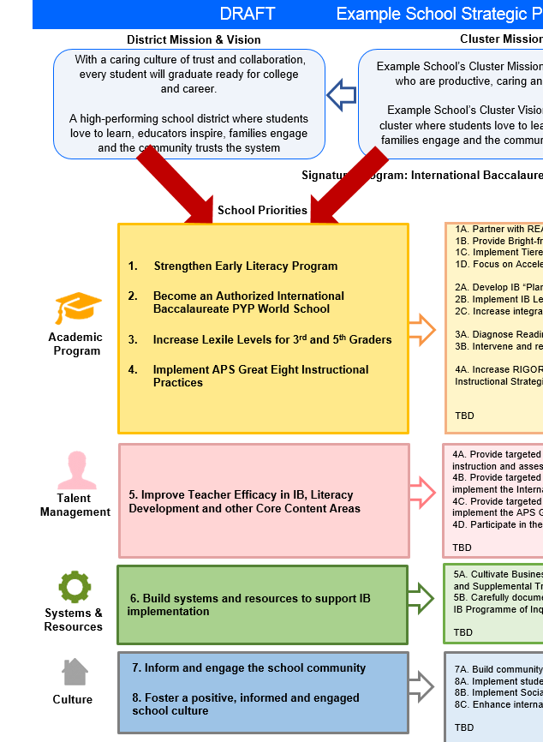
FY19 Budget Development Process
Principal’s Role
Design the budget and propose operational changes that can raise student achievement
Flesh out strategies, implement and manage them at the school level
Focus on the day-to-day operations
Serve as the expert on the school
Hire quality instructional and support personnel
The GO Team’s Role:
Focus on the big picture (positions and resources, not people)
Ensure that the budget is aligned to the school’s mission and vision and that resources are allocated to support key strategic priorities

Slide 4

GO Team Budget Development Process
YOUR SCHOOL STRATEGIC PLAN…
is your roadmap and your role. It is your direction, your priorities, your vision, your present, your future.
Step 1: Data Review
Step 2: Strategic Plan Review
Step 3: Comparison
Step 4: Budget Parameters
Step 5: Budget Choices
Notes:
Today I will provide an overview of the budget allocations for FY19. We will begin the work of funding the strategic priorities we agreed upon during our strategic review meeting. (IF YOU HAVE NOT DECIDED ON YOUR PRIORITIES, YOU WILL SAY – WE WILL DECIDE ON OUR PRIORITIES AND THEN DISCUSS ALLOCATING FUNDS TO ADDRESS THOSE PRIORITIES).

Slide 5
Focus Area Descriptors
Strategic Plan Categories | District Descriptions of Categories
Academic Program | Our students will be well-rounded individuals who possess the necessary academic skills and knowledge and are excited about learning.
Talent Management | We will retain an energized and inspired team of employees who are capable of advancing ever-increasing levels of achievement for students of all backgrounds.
Systems & Resources | We will improve efficiency (productivity, cost, etc.) while also making decisions (including resource allocations) that are grounded in a strategic academic direction and data.
Culture | We will build trust with the community, and we will have engaged stakeholders (employees, students, parents, community members, partners, etc.) who are invested in the mission and vision and who support the creation of student-centered learning communities.
Notes:
I have printed the terms on the next two slides for your convenience. I want to just go over them so we will all be on the same page as we move forward in this process. If you have any questions, please don’t hesitate to ask.

Slide 6

Description of Strategy Categories
Budget Parameters – FY19 funding priorities from the school’s 3-5 year strategic plan, ranked by the order of importance
Strategies – Lays out specific objectives for schools improvement
Request – “The Ask”. What needs to be funded in order to support the strategy?

Slide 7
FY19 Funding Rationale
FY’ 19 Funded School Priority | Rationale
Improve percent of students achieving at proficient level on Milestones assessment | Prepare our students for the next level of education
Implement International Baccalaureate program model | Provide rigor and ensure our students think globally
Ensure teachers are proficient with the districts eight instructional practices | Teachers will provide solid instruction daily surpassing district expectations
Ensure a welcoming parent friendly environment | Increase parent involvement to strengthen the partnership between school and home

Slide 8
Executive Summary
This budget represents an investment plan for our school’s students, employees and the community as a whole.
The budget recommendations are tied directly to the school’s strategic vision and direction.
The proposed budget for the general operations of the school are reflected at $_3576364_____
This investment plan for FY19 accommodates a student population that is projected to be 301 students, which is a decrease of 10 students from FY18.
Notes:
Here’s a few highlights for our budget this year – read executive summary

Slide 11
What’s Next?
• February:
  One-on-one Associate Superintendent discussions
  Cluster Planning Session (positions sharing, cluster alignment, etc.)
  Program Manager discussions and approvals
  Academic and Staffing Resource Planning Meeting (February 26th - March 2nd)
• March:
  Final GO Team Approval (March 5th - March 9th)
Notes:
In February, we will meet again to discuss how the school’s budget has been allocated to support the programmatic needs and FY19 key strategic priorities.
If think we need to continue our budget conversations, we will schedule additional meetings. My goal is to make sure your voices are reflected in our school’s budget.
I will also be meeting with my Associate Superintendent, program managers and other key leaders to go over our budget and to make sure the school is meeting the standards of service and appropriately staffing.
During the week of Feb. 26-March 2nd, Academic and Staffing Resource Planning Conferences will be held. At this meeting, I will present my plan for staff utilization, resource distribution and plan for staffing implications.
We will need to approve the budget at the ________ meeting.

Slide 12

Questions?
Thank you for your time and attention.
Notes:
IF YOU FEEL YOUR TEAM IS READY TO APPROVE THE DRAFT BUDGET, PLEASE DO SO. PLEASE REMIND THEM THAT YOU MAY NEED TO MEET WITH THEM AGAIN, IF THERE ARE CHANGES FROM YOUR MEETINGS WITH DISTRICT LEADERSHIP. LET THEM KNOW YOU WILL KEEP THEM INFORMED!!

Slide 13
FY19 Strategic Plan Break-out
Priorities | Focus Area | Strategies | Requests | Amount
Improve percent of students achieving at proficient level on Milestones assessment | Academics | Provide remediation and acceleration as indicated by data Ensure district curriculum is followed through unit plans Implement Early literacy Plan Implement a common instructional framework Implement a literacy model based on best practices | Purchase an intervention teacher to conduct progress monitoring and provide remediation to students. Purchase staff to allow for class size below district average and meet APS Standards of Service for Elementary Schools | 2490239
Implement International Baccalaureate program model | Academics Talent Management Systems and Resources | Implement integrated, project- and problem-based learning projects Implement rigorous and real-world interdisciplinary projects and units Integrate technology throughout the curriculum | Hire IB Coordinator Begin International Baccalaureate training for teachers Begin International Baccalaureate unit planning | 226000
Increase the number of students meeting and exceeding yearly growth targets | Academic Talent Management Systems and Resources | Integrate technology throughout the school Provide resources for daily instruction Provide Extended day tutorials | Provide Instructional Coach Provide Student Support Team Coach Provide tutors for extended day program | 255000
Ensure a welcoming parent friendly environment Increase parent participation in school functions | Culture | Improve communication with parents through Parent Liaison Increase PTA membership Implement Positive Behavior Intervention Supports and Social Emotional Learning | Provide a Parent Liaison Provide Social Emotional Learning Coordinator, Social Worker, Nurse | 245000
Notes:
Based on our strategic priorities and funds we received, here is a break-out of the priorities, which focus area it addresses, the strategies that will be implemented, the purchase request, which funding source was used and the amount.

Slide 14
Plan for
Title I Holdback and Austerity Restoration
Priorities | Focus Area | Strategies | Requests | Amount
Increase the number of students scoring at the proficient level on GA Milestones | Academics | Student will receive remediation in small groups are school We will add technology to classrooms and programs for students to improve math and reading | Extended Day tutorial Chrome book carts computer programs | 44996
Notes:
This slides represent the priorities we will fund if we receive additional money from Title I and Austerity. When we approve the budget we will approve both so that we will not have to schedule another meeting if the funds are made available.
Before I turn it back over to the Chair for the next slide, I want to thank you for your hard work and support this year. I will keep you informed as we move through the budget process. (Please inform Chair that they will facilitate the discussion for the last slide)

Slide 15
Questions to Consider
Are our school’s priorities (from your strategic plan) reflected in this budget?
  Are new positions and/or resources included in the budget to address our major priorities?
  Do we know (as a team) the plan to support implementation of these priorities beyond the budget (ex. What strategies will be implemented)?
  What tradeoffs are being made in order to support these priorities?
2. How are district and cluster priorities reflected in our budget?
  Cluster priorities- what staff, materials, etc. are dedicated to supporting our cluster’s priorities?
  Signature programs- what staff, materials, etc. are dedicated to supporting our signature program?
  Are there positions our school will share with another school, i.e. nurse, counselor?
Notes:
CHAIR - Our final task for today! Here are questions that we need to consider to ensure we have a good working draft budget. Let’s walk through them together.

