Slide 1
Sylvan Hills Middle
Notes:
Good Afternoon! Today we begin the process of planning our school’s budget for FY19. I know we are all here for the same reason and that is ensuring success for all SYLVAN students. This meeting is to provide an overview of the draft budget and for you to give feedback on the draft budget.

Slide 2
Norms
This is a meeting of the GO Team. Only members of the team may participate in the discussion. Any members of the public present are here to quietly observe.
We will follow the agenda as noticed to the public and stay on task.
We invite and welcome contributions of every member and listen to each other.
We will respect all ideas and assume good intentions.

Slide 3
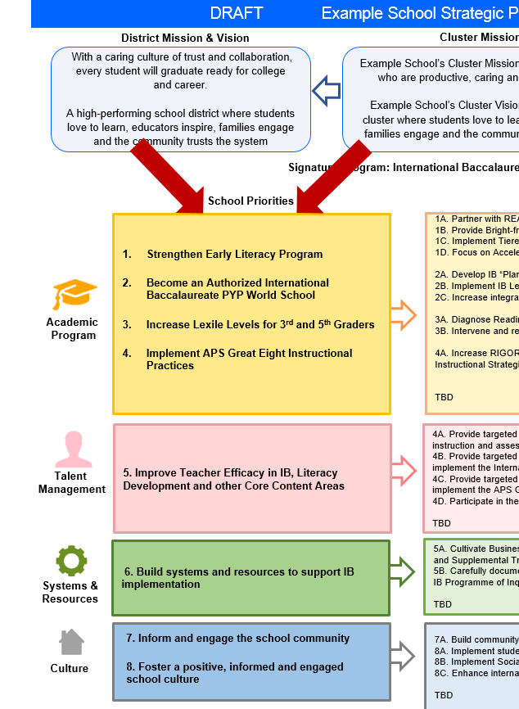
FY19 Budget Development Process
Principal’s Role
Design the budget and propose operational changes that can raise student achievement
Flesh out strategies, implement and manage them at the school level
Focus on the day-to-day operations
Serve as the expert on the school
Hire quality instructional and support personnel
The GO Team’s Role:
Focus on the big picture (positions and resources, not people)
Ensure that the budget is aligned to the school’s mission and vision and that resources are allocated to support key strategic priorities

Slide 4
GO Team Budget Development Process
OUR STRATEGIC PLAN…
is the roadmap and your role. It is our direction, our priorities, our vision, our present, our future.
Step 1: Data Review
Step 2: Strategic Plan Review
Step 3: Comparison
Step 4: Budget Parameters
Step 5: Budget Choices
Notes:
Today I will provide an overview of the budget allocations for FY19. We will begin the work of funding the strategic priorities we agreed upon during our strategic review meeting.

Slide 5
APS School Comparison Data: READING

Slide 6
STAR: 6th Grade Reading

Slide 7
STAR: 7th Grade Reading

Slide 8
STAR: 8th Grade Reading

Slide 9
APS School Comparison Data : MATH

Slide 10
STAR: 6th Grade Math

Slide 11
STAR: 7th Grade Math

Slide 12
STAR: 8th Grade Math

Slide 13
Description of Strategy Categories
Budget Parameters – FY19 funding priorities from the school’s 3-5 year strategic plan, ranked by the order of importance
Strategies – Lays out specific objectives for schools improvement
Request – “The Ask”. What needs to be funded in order to support the strategy?

Slide 14
Focus Area Descriptors
Strategic Plan Categories | District Descriptions of Categories
Academic Program | Our students will be well-rounded individuals who possess the necessary academic skills and knowledge and are excited about learning.
Talent Management | We will retain an energized and inspired team of employees who are capable of advancing ever-increasing levels of achievement for students of all backgrounds.
Systems & Resources | We will improve efficiency (productivity, cost, etc.) while also making decisions (including resource allocations) that are grounded in a strategic academic direction and data.
Culture | We will build trust with the community, and we will have engaged stakeholders (employees, students, parents, community members, partners, etc.) who are invested in the mission and vision and who support the creation of student-centered learning communities.
Notes:
I have printed the terms on the next two slides for your convenience. I want to just go over them so we will all be on the same page as we move forward in this process. If you have any questions, please don’t hesitate to ask.

Slide 15
Sylvan Hills Middle (Carver Cluster)
District Mission & Vision
School Mission & Vision
With a caring culture of trust and collaboration, every student will graduate ready for
college and career.
A high-performing school district where students love to learn, educators inspire, families engage and the community trusts the system
It is our mission to provide a learning environment that ensures high expectations for all of our scholars through quality instruction, real-world applications and technology that promotes and fosters knowledge and skills.
Sylvan Hills Middle School will provide a nurturing and safe environment where scholars become critical thinkers, problem solvers, lifelong learners, and productive citizens.
Signature Program: College And Career Prep
School Priorities
School Strategies
Key Performance
Measures
Improve students’ reading/language arts/writing performance
Improve students’ mathematics performance
Improve students’ enrollment and success in higher-level classes
1A. Implement a meaningful literacy/math block (SFA) that includes whole group instruction, flexible small group instruction and literacy work stations.
1B. Develop and implement a Response to Intervention (RTI) plan, beginning with strong first teaching and targeted intervention.
1C. Identify target students for additional academic support beyond regularly scheduled classes
1D. Implement APS instructional practices and other research-based best practices.
1E. Implement weekly common assessments
1F. Focus on unit assessment performance
2A-E. Same as 1B-1F
3A. Develop master schedule aligned with student data, needs, and high school course offerings
3B. Offer more courses that will earn high school credits
Increase students performance on GA Milestones in Reading, Writing, and Math.
Increase student performance on STAR Assessment.
Increase students performance on 4sight reading assessment (quarterly).
Improve performance on district benchmark assessment
Improve NAEP scores (8th grade only)
Increase the number of parents and community members that participate in local and state administered surveys.
Increase TKES evaluation scores
Increase overall CCRPI rating
Improve students’ attendance
Improve culture and climate ratings
Academic
Program
Recruit and maintain highly talented faculty/staff trained in researched-based best for developing the total middle school student (academically, socially, and emotionally)
Provide ongoing professional learning and development opportunities for all faculty/staff.
4A. Consistently implement standards and expectations for high quality performance for faculty/staff.
4B. Consistently implement revised teacher induction program for staff new to Sylvan.
4C. Establish and maintain incentive program to reward faculty and staff who consistently demonstrate the highest standards of professionalism.
5A. Provide ongoing valuable staff development designed to help staff elevate the rigor in the classroom and help students utilize higher order thinking, reading and writing skills.
Talent
Management
Engage all facets of the community as partners and align people and resource to maximize impact.
6A. Build relationships between school leadership/staff and partner leadership in order to better serve the needs of the Sylvan Hills community.
6B. Strengthen family and community support to increase parent involvement.
6C. Establish and maintain communication with the community about formal and diverse engagement opportunities at Sylvan Hills.
6D. Offer ongoing surveys to students, staff, and parents to determine needs and current awareness of existing programs and community resources.
Systems &
Resources
Provide increased teaching and learning time opportunities for all staff and students.
7A. Implement Social Emotional Learning (SEL) daily.
7B. Utilize the services of the Northstar Psychological Services and other providers to assist students/families.
7C. Create a culture to support and encourage our students to behave in a positive manner where they all can learn and feel protected in a safe and orderly environment

Slide 16
FY19 Budget Parameters
FY19 School Priorities | Rationale
Improve students’ literacy & mathematics performance | Improved performance increases chances and opportunities at exceling in life.
Recruit and maintain highly talented faculty/staff trained in researched-based skills best for developing the total middle school student (academically, socially, and emotionally) | Having talented & quality staff improves the overall school culture. Makes learning engaging & fun for kids.
Engage all facets of the community as partners and align people and resources to maximize their impact. | Cross role groups as stakeholders being included it expands the possibilities for becoming a high quality school. Resources aligned to priorities maximizes efficacy (effort to be proficient).
Provide increased teaching and learning time & opportunities for all staff and students. | Allows for school to teach to the whole child because developmentally students learn at various levels.

Slide 17
FY19 Budget Parameters
FY19 School Priorities | Rationale
Improve students’ enrollment and success in higher-level classes | Increases equity and creates a seamless transition to the next grade level.
Provide ongoing professional learning and development opportunities for all staff. | It builds staff strength and stamina for teaching and support the whole child.
Notes:
Are there any priorities I left off
Are there any questions or concerns
The next time we meet, I will show you where I have budgeted for our strategic priorities.

Slide 18
Discussion of Budget Summary
(Step 5: Budget Choices)

Slide 19
Executive Summary
This budget represents an investment plan for our school’s students, employees and the community as a whole.
The budget recommendations are tied directly to the school’s strategic vision and direction.
The proposed budget for the general operations of the school are reflected at $ 5,898,084
This investment plan for FY19 accommodates a student population that is projected to be 570 students, which is a decrease of 82 students from FY18.
Notes:
Here’s a few highlights for our budget this year.

Slide 20
School Allocations
FY2019 TOTAL SCHOOL ALLOCATIONS
School | Sylvan
Location | 1461 Sylvan Rd
Level | MS
FY2019 Projected Enrollment | 570
Change in Enrollment from FY2018 | -82
Total Earned | $ 5,898,084
SSF Category | Count | Weight | Allocation
Base Per Pupil | 570 | $4,339 | $ 2,473,330
Grade Level
Kindergarten |  | 0.60
1st |  | 0.25
2nd |  | 0.25
3rd |  | 0.25
6th | 0 | 0.05 | $ 42968
9th | 0 | 0.05 | $ -
Poverty | 408 | 0.45 | $ 796,673
Special Education | 92 | 0.03 | $ 11,976
Gifted | 36 | 0.60 | $ 93,726
Gifted Supplement | 5 | 0.60
ELL | 0 | 0.10 | $ -
Small School Supplement | 30 | 0.40 | $ 52,070
Incoming Performance | 365 | 0.10 | $ 158,380
Baseline Supplement |  |  | $ -
Transition Policy Supplement |  |  | $ (134,795)
Dual Campus Supplement |  |  | $ -
Holdback |  |  | $ (64,426)
Total SSF Allocation |  |  | $ 3,565,555
Notes:
For FY19, APS is continuing to increase equity within the District and the flexibility principals have in regards to our schools budgeted funds. The new Student Success Funding Model (SSF) allocates dollars to schools based on the number of enrolled students and receives a funding "weight" based on need. This year, student characteristics were weighted based on:
Grade Level –
K
1st through 3rd
6th
9th
Poverty – Weighted for all Direct Certification enrolled students.
Beginning Performance – Weighted Middle School and High School students entering with beginner’s performance on milestones.
ESOL – Weighted for all ESOL designated students in order to supplement due to ESOL staff being locked.
Special Education - Weighted for all Special Education students.
Gifted – Weighted and measured by number of students in the Gifted Program
Small School Supplement – Weighted for low enrollment schools
ES – 500
MS – 600
HS – 700
As you can see, our projected enrollment for FY19 is 570, we decreased by 82 from last year.
We received the following weights for our student characteristics:
Grade Level 6TH - .05
Poverty - .45
Special Education -.03
Gifted - .60
Gifted Supplement -.60
ELL -.10
Small School Supplement -.40

Slide 21
School Allocations
Additional Earnings
Signature |  |  | $ 133,000
Turnaround
Title I |  |  | $ 321,750
Title I Holdback |  |  | $ 58,500
Total FTE Allotments | 24.45 |  | $ 1,936,279
Total Additional Earnings |  |  | $ 2,332,529
Total Allocation |  |  | $ 5,898,084
Notes:
Additionally, we received money for signature programming, turnaround, Title I and FTE Allotments.

Slide 22
Budget by Function (Required)
School | Sylvan Hills Middle School
Location | 1461 Sylvan Rd
Level | MS
Principal | Mr. Artesza Portee
Projected Enrollment | 570
 |  | Used
 |  | FTE | Budget
1000 | Instruction | $52.20 | $ 4,456,370
2100 | Pupil Services | 2.85 | $ 163,911
2210 | Improvement of Instructional Services | 1.20 | $ 169,857
2213 | Instructional Staff Training | - | $ 12,500
2220 | Educational Media Services | 1.00 | $ 102,414
2400 | School Administration | 6.00 | $ 696,604
2600 | Maintenance & Operations | 5.00 | $ 284,429
2700 | Transportation | - | $ 12,000
Total |  |  | $ 5,989,084
Notes:
I am passing out the definitions for these funding categories. You will see what makes up each category. Although the total amount will not change, allocation per function may depending on our conversations and school needs.

Slide 23
Budget by Function

Slide 24
What’s Next?
• February:
One-on-one Associate Superintendent discussions
Cluster Planning Session (positions sharing, cluster alignment, etc.)
Program Manager discussions and approvals
Academic and Staffing Resource Planning Meeting (February 26th - March 2nd)
• March:
Final GO Team Approval (March 5th - March 9th)
Notes:
During the week of Feb. 26-March 2nd, Academic and Staffing Resource Planning Conferences will be held. At this meeting, I will present my plan for staff utilization, resource distribution and plan for staffing implications.
We will need to approve the budget at the MARCH meeting.

Slide 25
Questions?
Thank you for your time and attention.

