Slide 1
CARVER EARLY COLLEGE Budget Feedback Meeting
To be presented to GO Team BEFORE the school staffing conference

Slide 2
Norms
This is a meeting of the GO Team. Only members of the team may participate in the discussion. Any members of the public present are here to quietly observe.
We will follow the agenda as noticed to the public and stay on task.
We invite and welcome contributions of every member and listen to each other.
We will respect all ideas and assume good intentions.

Slide 3
GO Team Budget Development Process
YOUR SCHOOL STRATEGIC PLAN…
is your roadmap and your role.
It is your direction, your priorities, your vision, your present, your future.
Step 1: Data Review
Step 2: Strategic Plan Review
Step 3: Budget Parameters
(Strategic Priorities)
Step 4: Budget Choices
Notes:
Today I will provide an overview of the budget allocations for FY23. We will begin the work of funding the strategic priorities we agreed upon during our strategic review meeting. (IF YOU HAVE NOT DECIDED ON YOUR PRIORITIES, YOU WILL SAY – WE WILL DECIDE ON OUR PRIORITIES AND THEN DISCUSS ALLOCATING FUNDS TO ADDRESS THOSE PRIORITIES).

Slide 4
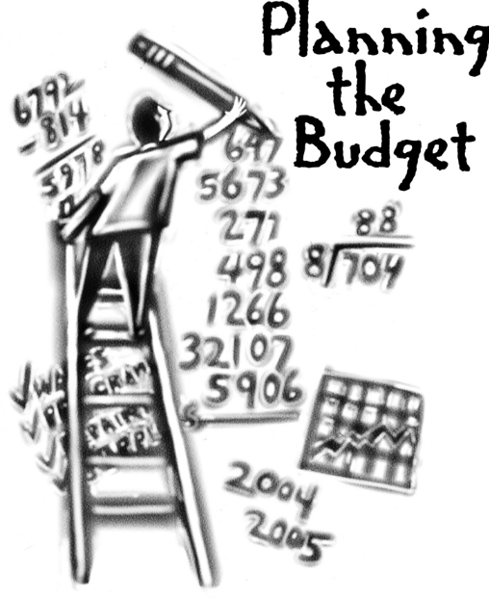
Overview of FY ‘24 GO Team Budget Process
Step 1 Review and Update Strategic Plan and Rank Strategic Priorities
By end of Fall Semester
Step 6 Principals: HR Staffing Conferences Begin
Late February – Early March
Step 3 GO Team Initial Budget Session: Allocation
January 24 – early February
Step 7 GO Team Final Budget Approval Meeting
Budgets Approved by March 17
Step 5
GO Team Feedback Session: Draft Budget Presented & Discussed February – multiple meetings, if necessary
Step 4 Principals: Associate Supt. Discussions and Review
February (supports needed, specific challenges, coaching)
Step 2 Principals: Workshop FY 24 Budget
January 24
GO Teams are encouraged to have ongoing conversations

Slide 5
Budget Feedback Meetings
What
The GO Team feedback session(s) should be scheduled for the principal to provide an overview of the school’s draft budget for the GO Team members and the general public.
Why
This meeting provides an opportunity for GO Teams to discuss how the school’s budget has been allocated to support the programmatic needs and key strategic priorities.
When
Meetings must be held in February before staffing conferences. May be combined with the allocation meeting (as needed), if the GO Team has completed strategic plan updates and ranked strategic priorities.
Notes:
Looking for general consensus prior to Staffing Conferences

Slide 6
FY24 Budget Parameters
FY24 School Priorities | Rationale
Increase mastery of core content knowledge for all scholars grades 9-12. | Data indicates there is a need to increase the percentage of students in grades in 9 -12 scoring proficient or above in all tested subject areas.
Improve teacher quality and improve delivery of instruction. | There is a need to provide teachers with professional learning opportunities that promote student growth and achievement.
Provide increased learning opportunities that offer customized instruction creating exposure, expression, and global awareness. | Since Early College has adopted STEM as the signature program, we will need the support of personnel and professional learning opportunities that align with the standards of practice.
Notes:
Review the priorities that the GO Team has developed and the rationale for these priorities. Feel free to copy this slide if you have more than 3 priorities to account for.

Slide 7
FY24 Budget Parameters
FY24 School Priorities | Rationale
Prepare all students for post-secondary and career experiences. | There is a need to increase the number of scholars participating in the early college model and the number of scholars being retained in the program.
Maximize and align partnerships, policies, and procedures to support school needs. | As we aim to prepare to implement Signature Programming and increase student achievement, partnerships will benefit the staff with professional learning and scholars and parents with increased opportunities
Notes:
Review the priorities that the GO Team has developed and the rationale for these priorities.

Slide 8
Descriptions of Strategic Plan
Breakout Categories
Priorities: FY24 funding priorities from the school’s strategic plan, ranked by the order of importance.
APS Five Focus Area: What part of the APS Five is the priority aligned to?
Strategies: Lays out specific objectives for schools improvement.
Request: “The Ask” What needs to be funded in order to support the strategy?
Amount: What is the cost associated with the Request?

Slide 9
FY24 Strategic Plan Break-out
Priorities | APS FIVE Focus Area | Strategies | Requests | Amount
Improve teacher quality and improve delivery of instruction. | Equipping and empowering leaders and staff | Provide professional learning opportunities in instruction and resources | Professional learning sessions Contracted services for professional learning
Increase student mastery of core content knowledge | Fostering Academic Excellence for All | Provide instructional resources | Professional learning sessions Curriculum resources
Provide increased learning opportunities that offer customized instruction creating exposure, expression, and global awareness. | Building a culture of student support | Develop a school program that prepares students to interact effectively with a variety of school business audiences. | Purchase additional teachers
Prepare all students for post-secondary and career experiences | Fostering Academic Excellence for All | Engage student in inquiry studies and project-based learning | PBL supplies, field trips, student transportation
Maximize and align partnerships, policies, and procedures to support school needs. | Creating a system of school support | Develop and align funding for school resources and internships and field trips | Allocate funding for professional learning and partnership development
Notes:
For the next few slides, I will show you how I have allocated the budget to support our strategic priorities.
Based on our strategic priorities and funds we received, here is a break-out of the priorities, which focus area it addresses, the strategies that will be implemented, the purchase request, which funding source was used and the amount.

Slide 10
Plan for FY24 CARES Allocation $199,251
Priorities | APS FIVE Focus Area | Strategies | Requests | Amount
Improve teacher quality and improve delivery of instruction. | Equipping and empowering leaders and staff | Provide professional learning opportunities in instruction and resources | Professional learning sessions Contracted services or PD | $25000
Increase student mastery of core content knowledge | Fostering Academic Excellence for All | Provide instructional resources | Professional learning sessions for teachers After school tutorial | 40000
Provide restorative practices | Building a culture of student support | Develop a school program that prepares students to interact effectively with a variety of school business audiences. | Purchase restorative practices coach | 128502
Prepare all students for post-secondary and career experiences | Fostering Academic Excellence for All | Engage student in inquiry studies and project-based learning | PBL supplies, field trips, student transportation | 3249
Maximize and align partnerships, policies, and procedures to support school needs. | Creating a system of school support | Develop and align funding for school resources and internships and field trips | Allocate funding for professional learning and partnership development | 2500
Notes:
For the next few slides, I will show you how I have allocated the budget to support our strategic priorities.
Based on our strategic priorities and funds we received, here is a break-out of the priorities, which focus area it addresses, the strategies that will be implemented, the purchase request, which funding source was used and the amount.

Slide 11
Plan for FY24 Title I Family Engagement Funds
11,000
Priorities | APS FIVE Focus Area | Strategies | Requests | Amount
Increase number of parents accessing the center | Fostering Academic Excellence for all | Create a reserved space in the media center for the parent resource center | Parent center resources | 3,500
Providing trainings to parents and access to resources | Creating a system of school support | Create a Parent University with partnerships for parents to develop job skills, trainings, etc. | Computer equipment and parent incentives | 7,500
Notes:
For the next few slides, I will show you how I have allocated the budget to support our strategic priorities.
Based on our strategic priorities and funds we received, here is a break-out of the priorities, which focus area it addresses, the strategies that will be implemented, the purchase request, which funding source was used and the amount.

Slide 12
Budget by Function (Required)
*Based on Current Allocation of School Budget
School | Carver Early College
Location | 0106
Level | HS
Principal | Christina Rogers
Projected Enrollment | 618
Account | Account Description | FTE | Budget | Per Pupil
1000 | Instruction | 50.15 | $4,993,751 | $8,081
2100 | Pupil Services | 9.75 | $861,930 | $1,395
2210 | Improvement of Instructional Services | 1.00 | $128,643 | $208
2213 | Instructional Staff Training | - | $4,500 | $7
2220 | Educational Media Services | 1.00 | $109,306 | $177
2400 | School Administration | 9.00 | $933,445 | $1,510
2600 | Maintenance & Operations | 4.50 | $328,879 | $532
2700 | Transportation | - | $19,117 | $31
Total |  | 75.40 | $7,379,571 | $11,941
Notes:
I am passing out the definitions for these funding categories. You will see what makes up each category. Although the school’s total budget amount will not change, allocation per function may change depending on our conversations and school needs.

Slide 13
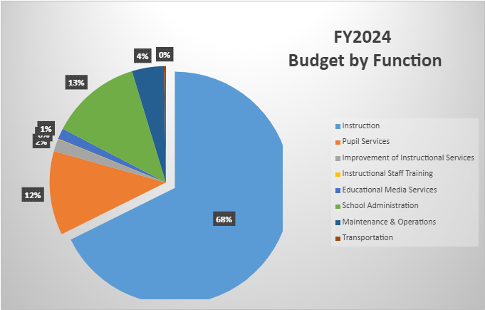
Budget by Function (Required)
*Based on Current Allocation of School Budget
Notes:
Explain the pie chart and allocations

Slide 14
Discussion of reserve and Holdback funds

Slide 15
Plan for FY24 Leveling Reserve
297,593
Priorities | APS FIVE Focus Area | Strategies | Requests | Amount
Improve teacher quality and improve delivery of instruction. | Equipping and empowering leaders and staff | Provide professional learning opportunities in instruction and resources | Professional learning sessions Contracted services for professional learning | 10,000
Increase student mastery of core content knowledge | Fostering Academic Excellence for All | Provide instructional resources (Human Resources) | Hire paraprofessional | 44,199
Provide increased learning opportunities that offer customized instruction creating exposure, expression, and global awareness. | Building a culture of student support | Develop a school program that prepares students to interact effectively with a variety of school business audiences. | Purchase hourly instructional coaches and teachers (Math and ELA) | 210,012
Prepare all students for post-secondary and career experiences | Fostering Academic Excellence for All | Engage student in inquiry studies and project-based learning | field trips, student transportation Student incentives | 10,000
Increase staffing to support attendance team | Creating a system of school support | Allocate resources for the overall operations of the school support | Add additional clerk | 49,230
Notes:
For the next few slides, I will show you how I have allocated the budget to support our strategic priorities.
Based on our strategic priorities and funds we received, here is a break-out of the priorities, which focus area it addresses, the strategies that will be implemented, the purchase request, which funding source was used and the amount.

Slide 16
Plan for FY24 Title I Holdback $_0__
Priorities | APS FIVE Focus Area | Strategies | Requests | Amount
Notes:
For the next few slides, I will show you how I have allocated the budget to support our strategic priorities.
Based on our strategic priorities and funds we received, here is a break-out of the priorities, which focus area it addresses, the strategies that will be implemented, the purchase request, which funding source was used and the amount.

Slide 17
Questions for the GO Team to Consider and Discuss
Are our school’s priorities (from your strategic plan) reflected in this budget?
Are new positions and/or resources included in the budget to address our major priorities?
Do we know (as a team) the plan to support implementation of these priorities beyond the budget (ex. What strategies will be implemented)?
What tradeoffs are being made in order to support these priorities?
How are district and cluster priorities reflected in our budget?
Cluster priorities- what staff, materials, etc. are dedicated to supporting our cluster’s priorities?
Signature programs- what staff, materials, etc. are dedicated to supporting our signature program?
Are there positions our school will share with another school, i.e. nurse, counselor?
Notes:
CHAIR - Our final task for today! Here are questions that we need to consider to ensure we have a good working draft budget. Let’s walk through them together.

Slide 18
Where We’re Going?
Our next meeting is the Budget Approval Meeting
What:
During this meeting we will review the budget, which should be updated based on feedback from the staffing conference, Associate Superintendents, and key leaders. After review, GO Teams will need to take action (i.e., vote) on the FY24 Budget.
Why:
Principals will present the final budget recommendations for GO Team approval.
When:
All approval meetings must be held after staffing conferences. Budgets must be approved by March 17th.

Slide 19
What’s Next?
February
HR Staffing Conferences (Late February)
March
Final GO Team Approval Meeting (AFTER your school’s Staffing Conference and BEFORE Friday, March 17th)
Notes:
In February, we will meet again to discuss how the school’s budget has been allocated to support the programmatic needs and FY23 key strategic priorities.
If think we need to continue our budget conversations, we will schedule additional meetings. My goal is to make sure your voices are reflected in our school’s budget.
I will also be meeting with my Associate Superintendent, program managers and other key leaders to go over our budget and to make sure the school is meeting the standards of service and appropriately staffing.
During the week of Feb. 24th -March 2nd , HR Staffing Conferences will be held. At this meeting, I will present my plan for staff utilization, resource distribution and plan for staffing implications.
We will need to approve the budget at the ________ meeting.

