Slide 1
Woodson Park Academy (Douglas Cluster)
District Mission & Vision
Cluster Mission & Vision
School Mission & Vision
With a caring culture of trust and collaboration, every student will graduate ready for college and career.
A high-performing school district where students love to learn, educators inspire, families engage and the community trusts the system
The Douglass Cluster will inspire scholars to love learning and will provide every student with the academic foundation that assures they are college and career ready.
Our vision is to provide rigorous instruction and customized support to prepare all students for academic achievement, graduation and successful career options.
With a caring culture of trust and collaboration, every student will enter middle school competent and prepared to engage in rigorous learning.
A high-performing elementary school where students love to learn, educators inspire, families engage and the community trusts the system
Signature Program: ___Science, Technology, Engineering and Mathematics (STEM)__
School Priorities
School Strategies
Key Performance
Measures
Focus on Literacy and Writing as foundational skills for success
Strengthen Math skills
Implement STEM program model
1A. Increase the availability of and use of informational text to connect literacy across curriculum.
1B. Implement a balanced literacy framework.
2A. Develop cluster implementation plan for STEM certification.
2B. Implement integrated, project, and problem-based learning projects for grade-level and school wide implementation.
2C. Embed career exposure and real-life connections.
3A. Provide professional development and support in performance-based assessment.
2E. Create a Douglass Instructional Coach collaboration meeting to create assessments and support instruction.
Seek/maintain funding sources for STEM lab to provide all students hands-on learning experience and access
Increase ELA and Math Performance in Developing and Above
Increase Student Attendance
Improve Culture Climate Star Rating
Academic
Program
Uses of Flexibility/Innovation
4A. Develop instructional staff’s content-specific knowledge.
4B. Offer PD for coaches on content and how to support teachers.
5A. Use a “Pathway Towards Leadership” to recruit and train leaders within the building and community.
Seek funding sources to increase endorsements & certifications for staff in STEM areas
4. Build capacity within content areas while preparing for future professional opportunities for all staff.
Talent
Management
Uses of Flexibility/Innovation
6. Resources aligned with our data based needs.
7. Attain strategic partnerships that support school wide vision for students achievement.
6A. Leverage partnerships to provide rich, authentic STEM learning experiences.
6B Identify STEM lab and resources in each school to ensure access to materials that support learning.
7A Develop a program that meets the needs of WPA students through extended days, additional course offerings, and SEL programs.
Seek/maintain resources and budget to support STEM curriculum & extended learning opportunities.
Systems &
Resources
Uses of Flexibility/Innovation
8. Improve communication and engagement with parents and community.
9.. Create a positive school culture.
8A. Develop school-based SEL plan to improve student behavior and self-management strategies.
8B. Provide wrap-around services for our students and families.
9A. Create a community engagement plan that establishes communication between stakeholders, families, and school.
9B. Inform parents and students about STEM program benefits, expectations, and requirements.
9C-Organize events to facilitate the emergence of the cluster’s identity and facilitate collaboration.
Culture

Slide 2
Academic Program

Slide 3
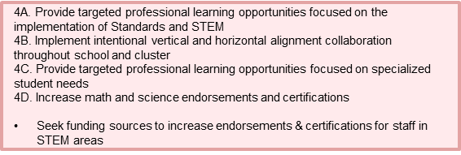
Talent Management
4. Build teacher capacity in core content areas, particularly math and science

Slide 4
Systems & Resources

Slide 5
Culture

