Slide 1
Barack & Michelle Obama Academy
GO TEAM MEETING
Wednesday, August 24, 2022 @ 5pm

Slide 2
Meeting Agenda
(agenda may be amended)
This meeting [will not] allow for Public Comment
I
Action Items
A. Approval of Agenda
B. Fill Vacant Positions
i. Staff Position
C. Fill Open Community Member Seat
D. Approval of Previous Minutes
E. Election of Officers
i. Chair
ii. Vice-Chair
iii. Secretary
iv. Cluster Representative
F. Review and Approve Public Comment Protocol
G. Set GO Team Meeting Calendar
H. Review, Confirm/Update, and Adopt GO Team Meeting Norms
II. Information Items
A. Principal’s Report
i. Enrollment and/or Leveling Update
ii. Strategic Plan and Performance Measures Update
iii. BaMO Year at a Glance

Slide 4
TOPICS
School Start Update
Current Enrollment & Leveling
School Strategic Plan
Strategic Plan Overview
SMART Goals
GMAS Results

Slide 5
SCHOOL START UPDATE

Slide 6
ENROLLMENT
Projected Enrollment | 290
Current Enrollment | 232
Difference | -58
LEVELING
Leveling is the process the District uses to adjust school budget allocations to match student enrollment.
Budget Impact | -$265,544 - Budget Impact No loss of current personnel Costs offset by carryover funds & banked or vacant positions

Slide 7
2021-2025 STRATEGIC PLAN

Slide 8
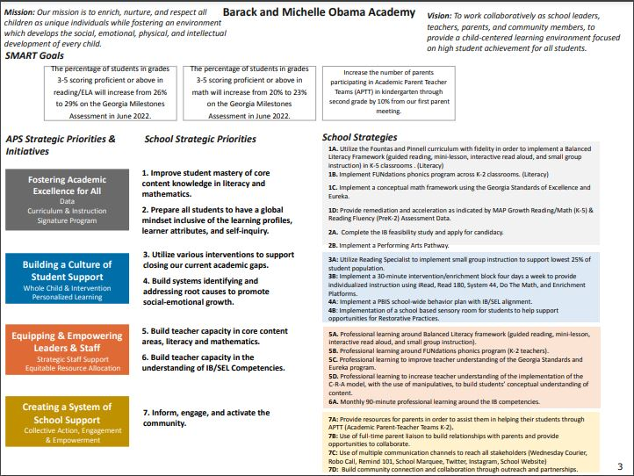
Notes:
https://www.atlantapublicschools.us/cms/lib/GA01000924/Centricity/Domain/11671/School%20Strategic%20Plan%20Workbook%20and%20Template_BAMO_Updated%201.12.21.pdf

Slide 9
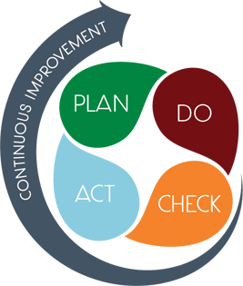
STRATEGIC PLAN SMART GOALS
Overview
‹#›
Priorities
Key Aspects
SMART GOALS

Slide 10
GEORGIA MILESTONES ASSESSMENT RESULTS

Slide 11
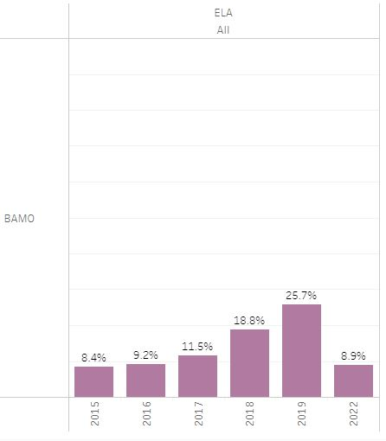
GMAS RESULTS

Slide 12
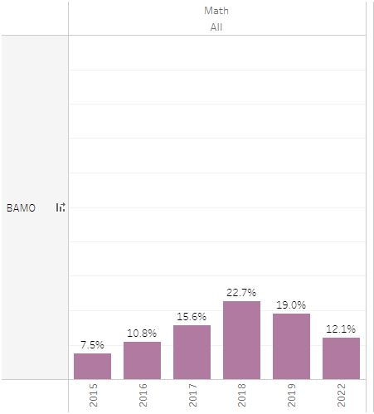
GMAS RESULTS

Slide 13
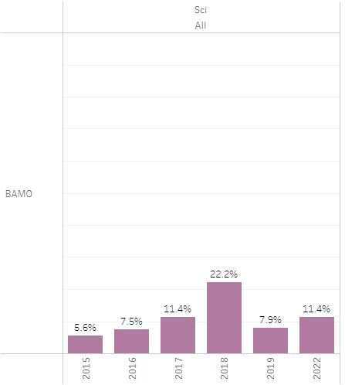
GMAS RESULTS

Slide 14
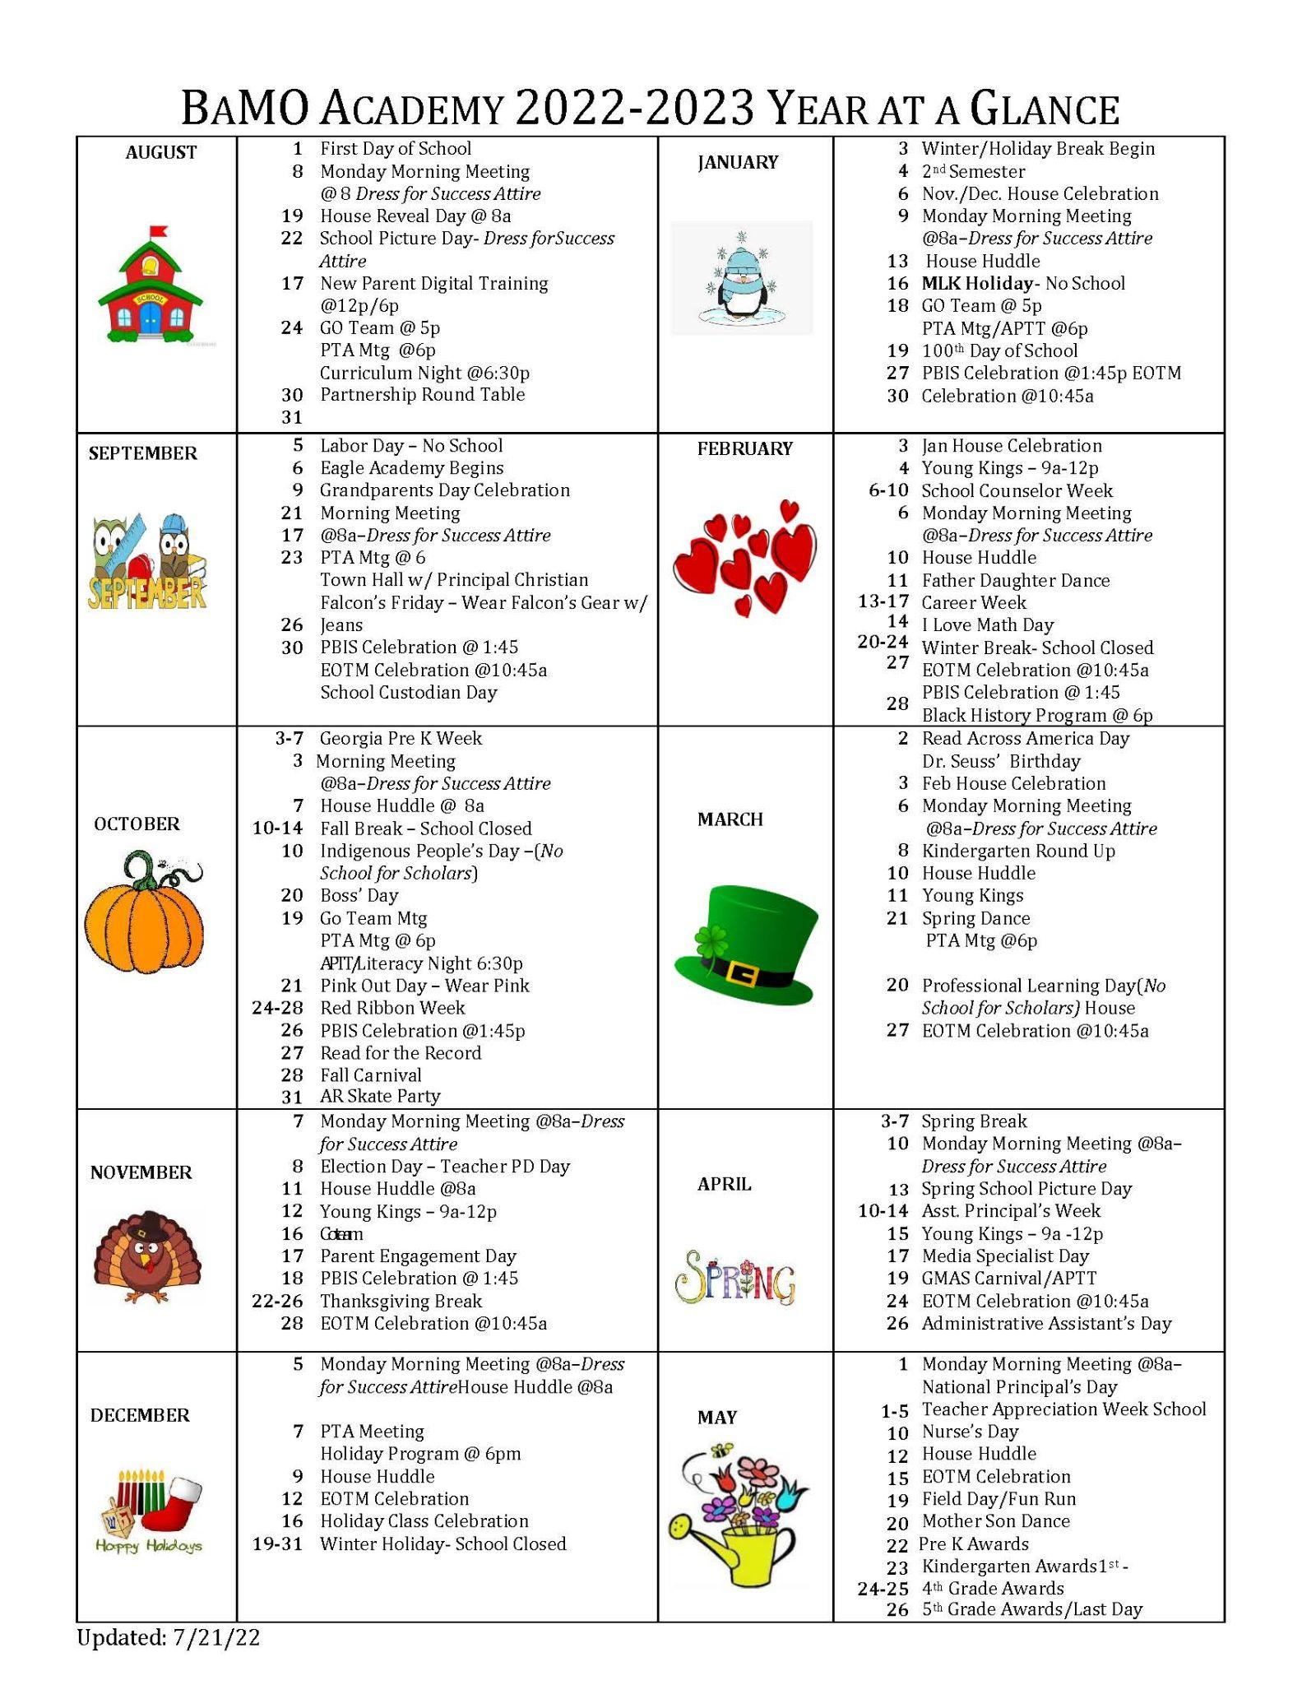
YEAR @ A GLANCE

Slide 15
QUESTIONS

