Slide 1

Jean Childs Young Middle School
Notes:
Good Morning/Afternoon! Today we begin the process of planning our school’s budget for FY20. I know we are all here for the same reason and that is ensuring success for all (enter school name) students. This meeting is to provide an overview of the draft budget and for you to give feedback on the draft budget.

Slide 2

GO Team Budget Development Process
YOUR SCHOOL STRATEGIC PLAN…
is your roadmap and your role. It is your direction, your priorities, your vision, your present, your future.
Step 1: Data Review
Step 2: Strategic Plan Review
Step 3: Budget Parameters
Step 4: Budget Choices
Notes:
Today I will provide an overview of the budget allocations for FY20. We will begin the work of funding the strategic priorities we agreed upon during our strategic review meeting. (IF YOU HAVE NOT DECIDED ON YOUR PRIORITIES, YOU WILL SAY – WE WILL DECIDE ON OUR PRIORITIES AND THEN DISCUSS ALLOCATING FUNDS TO ADDRESS THOSE PRIORITIES).

Slide 3
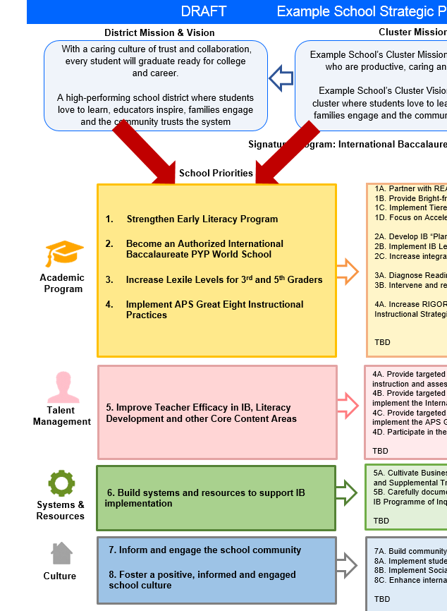
FY20 Budget Development Process
Principal’s Role
Design the budget and propose operational changes that can raise student achievement
Flesh out strategies, implement and manage them at the school level
Focus on the day-to-day operations
Serve as the expert on the school
Hire quality instructional and support personnel
The GO Team’s Role:
Focus on the big picture (positions and resources, not people)
Ensure that the budget is aligned to the school’s mission and vision and that resources are allocated to support key strategic priorities

Slide 4
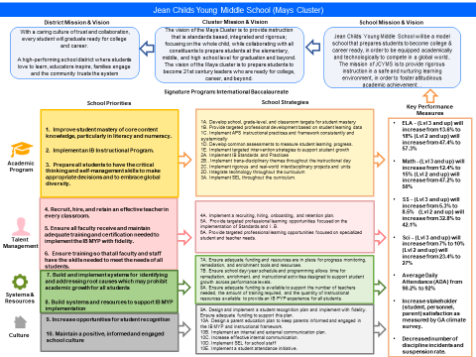

Young MS Strategic Plan
Notes:
You should have a copy of our updated strategic plan (please make copies to be distributed to team).

Slide 5
FY20 Priorities & SMART Goals
(From your Strategic Plan, insert your Top 2 Priorities & SMART Goals for FY20 here)
School Priorities
SMART Goals
Recruit, hire, and retain an effective teacher in every classroom.
Fill all vacancies for FY ‘20 by May 2019 with teachers who have evidence of implementing effective Tier 1 instruction as evidenced through student learning data.
Support teacher effectiveness by providing more direct behavioral, intervention, and instructional support by reducing the ratio of support personnel: teacher.
Build and implement systems for identifying and addressing root causes which may prohibit academic growth for all students
Reduce the caseloads of support personnel so that more direct support is provided to teachers and students.
Provide training to all support personnel on effective behavior and academic interventions.
Streamline and reorganize support services so that direct support is timely, supportive, and monitored.
Notes:
Discuss priorities and rationale

Slide 6
Discussion of Budget Summary
(Step 4: Budget Choices)

Slide 7
Executive Summary
This budget represents an investment plan for our school’s students, employees and the community as a whole.
The budget recommendations are tied directly to the school’s strategic vision and direction.
The proposed budget for the general operations of the school are reflected at $8,815,813.
This investment plan for FY20 accommodates a student population that is projected to be 810 students, which is a increase/decrease of 63 projected students from FY19.
Notes:
Here’s a few highlights for our budget this year – read executive summary

Slide 8
Allocation Summary

Slide 9
School Allocation
Notes:
For FY20, APS is continuing to increase equity within the District and the flexibility principals have in regards to our schools budgeted funds. The new Student Success Funding Model (SSF) allocates dollars to schools based on the number of enrolled students and receives a funding "weight" based on need. This year, student characteristics were weighted based on:
Grade Level –
K
1st through 3rd
6th
9th
Poverty – Weighted for all Direct Certification enrolled students.
Beginning Performance – Weighted Middle School and High School students entering with beginner’s performance on milestones.
ESOL – Weighted for all ESOL designated students in order to supplement due to ESOL staff being locked.
Special Education - Weighted for all Special Education students.
Gifted – Weighted and measured by number of students in the Gifted Program
Small School Supplement – Weighted for low enrollment schools
ES – 500
MS – 600
HS – 700
As you can see, our projected enrollment for FY19 is _______, we increased/decreased by __________ from last year.
We received the following weights for our student characteristics: (Below is just for the script, principals need to insert their school’s characteristics)
Grade Level
Poverty
Special Education
Gifted
Gifted Supplement
ELL
Small School Supplement

Slide 10
School Allocation
Notes:
Additionally, we received money for signature programming, turnaround, Title I and FTE Allotments.

Slide 11
What’s Next?
January:
  GO Team Initial Budget Session (Jan. 22nd-31st)
February:
  One-on-one Associate Superintendent discussions
  Cluster Planning Session (positions sharing, cluster alignment, etc.)
  Program Manager discussions and approvals
  GO Team Feedback Session
  HR Staffing Conferences (February 25th - March 1st)
• March:
  Final GO Team Approval (March 1st - March 15th)
Notes:
In February, we will meet again to discuss how the school’s budget has been allocated to support the programmatic needs and FY20 key strategic priorities.
If think we need to continue our budget conversations, we will schedule additional meetings. My goal is to make sure your voices are reflected in our school’s budget.
I will also be meeting with my Associate Superintendent, program managers and other key leaders to go over our budget and to make sure the school is meeting the standards of service and appropriately staffing.
During the week of Feb. 25th -March 1st , HR Staffing Conferences will be held. At this meeting, I will present my plan for staff utilization, resource distribution and plan for staffing implications.
We will need to approve the budget at the ________ meeting.

Slide 12
FY20 Priorities & SMART Goals
(From your Strategic Plan, insert your Top 2 Priorities & SMART Goals for FY20 here)
School Priorities
SMART Goals
Recruit, hire, and retain an effective teacher in every classroom.
Fill all vacancies for FY ‘20 by May 2019 with teachers who have evidence of implementing effective Tier 1 instruction as evidenced through student learning data.
Support teacher effectiveness by providing more direct behavioral, intervention, and instructional support by reducing the ratio of support personnel: teacher.
Build and implement systems for identifying and addressing root causes which may prohibit academic growth for all students
Reduce the caseloads of support personnel so that more direct support is provided to teachers and students.
Provide training to all support personnel on effective behavior and academic interventions.
Streamline and reorganize support services so that direct support is timely, supportive, and monitored.
Notes:
Discuss priorities and rationale

Slide 13
Key Proposals in FY 2020 budget allocations
-Keep number of classes per grade the same BUT (move to 2-person teams on 6th/7th to provide more support to students)
-Keep number of Connections courses offered the same (bring back CTAE: Engineering/STEAM)

Slide 14
Key Proposals in FY 2020 budget allocations: Positions
-Add New Targeted Support Positions
  Engagement Specialist (Student, Staff, Parents, Community)
  Full time Turnaround Social Worker
  BCBA and Behavior Technician
  6 Master Teacher Leaders (2 per grade level)
  Hands on Atlanta tutors

Slide 15
Key Proposals in FY 2020 budget allocations: Curriculum
-Add a viable, researched-based, rigorous and relevant ELA curriculum with teacher training and support
  Wit and Wisdom
-Fund Reading materials for Advisory Reading block
-Funds hands on Science kits
-Fund requested academic subscriptions

Slide 16
Key Proposals in FY 2020 budget allocations: Talent Development
-Fund IB development via dues and training
-Fund RELAY training and support

Slide 17
Key Proposals in FY 2020 budget allocations: Other
-Fund enhancement to technology (updated boards in classrooms)
-Fund Student Engagement via sponsor stipends
  Debate, Robotics, Yearbook, Chess, Student Council, NJHS, Beta Club

Slide 18
Questions to Consider
Are our school’s priorities (from your strategic plan) reflected in this budget?
  Are new positions and/or resources included in the budget to address our major priorities?
  Do we know (as a team) the plan to support implementation of these priorities beyond the budget (ex. What strategies will be implemented)?
  What tradeoffs are being made in order to support these priorities?
2. How are district and cluster priorities reflected in our budget?
  Cluster priorities- what staff, materials, etc. are dedicated to supporting our cluster’s priorities?
  Signature programs- what staff, materials, etc. are dedicated to supporting our signature program?
  Are there positions our school will share with another school, i.e. nurse, counselor?
Notes:
CHAIR - Our final task for today! Here are questions that we need to consider to ensure we have a good working draft budget. Let’s walk through them together.

