Slide 1
Principal’s Report
GO Team Meeting #1
8/16/2022

Slide 2
TOPICS
School Start Update
Current Enrollment & Leveling
School Strategic Plan
Strategic Plan Overview
Priorities
GMAS Results

Slide 3
School start UPDATE

Slide 4
General Information about Start of School
Notes:
Principals – please provide a general update as to how the school year is going

Slide 5
Enrollment
Projected Enrollment | 725
Current Enrollment | 727
Difference | +2
Leveling
Leveling is the process the District uses to adjust school budget allocations to match student enrollment.
Budget Impact | + $9000
Notes:
Principals: Based on your enrollment, please give your GO Team the information on how you plan to account for any budget changes due to leveling.

Slide 6
2021-2025 Strategic Plan

Slide 7
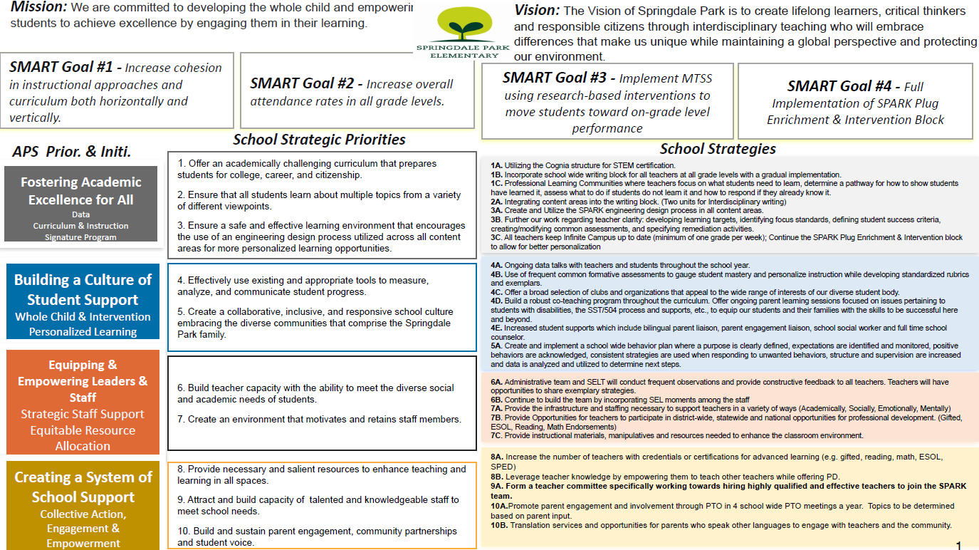
School Name
Mission
Vision
SMART Goals
TBD
TBD
TBD
TBD
APS Strategic Priorities & Initiatives
School Strategic Priorities
School Strategies
1A. tbd
1B. tbd
1C. tbd
Insert School’s Current Strategic Plan
Fostering Academic Excellence for All Data
Curriculum & Instruction Signature Program
Building a Culture of Student Support
Whole Child & Intervention Personalized Learning
TBD: tbd
TBD: tbd
4.
Equipping & Empowering Leaders & Staff
Strategic Staff Support Equitable Resource Allocation
6.
7.
TBD: tbd
Creating a System of School Support
Strategic Staff Support
Equitable Resource Allocation
8.
9.
TBD: tbd
14

Slide 8
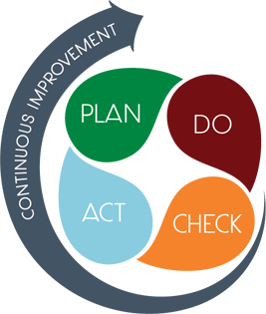
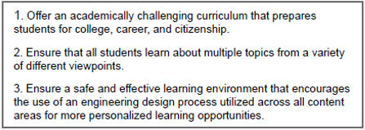
District & SPARK Priorities

Slide 9
Strategic Plan Smart Goals
Smart Goals

Slide 10
Georgia Milestones Assessment Results

Slide 11
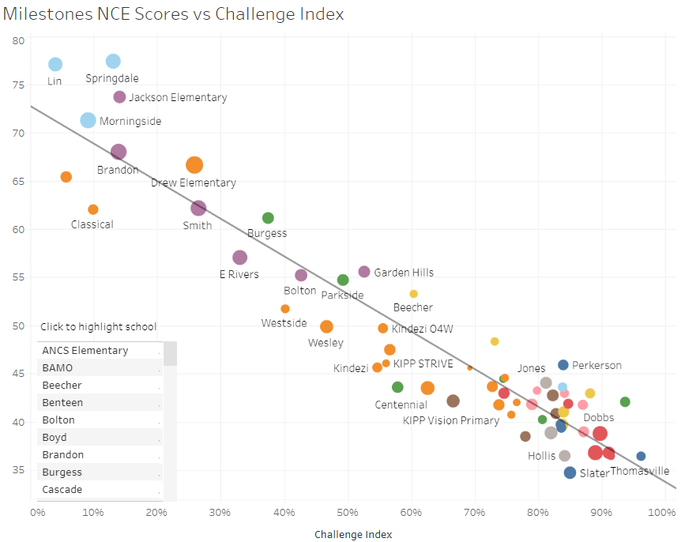
GMAS Results
Insert School’s 2022 GMAS Results – use as many slides as necessary

Slide 12
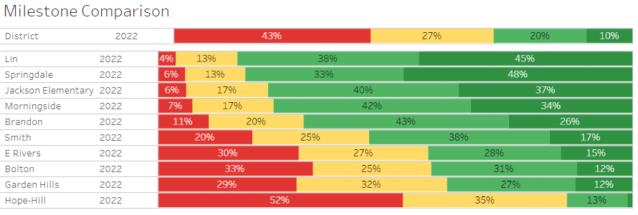
Midtown & North Atlanta Reading & Math Combined

Slide 13
Midtown & North Atlanta Reading – 3rd, 4th, 5th

Slide 14
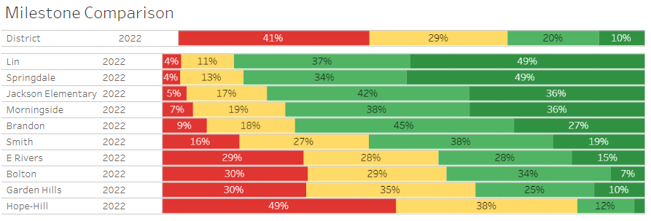
Midtown & North Atlanta Math – 3rd, 4th, 5th

Slide 15
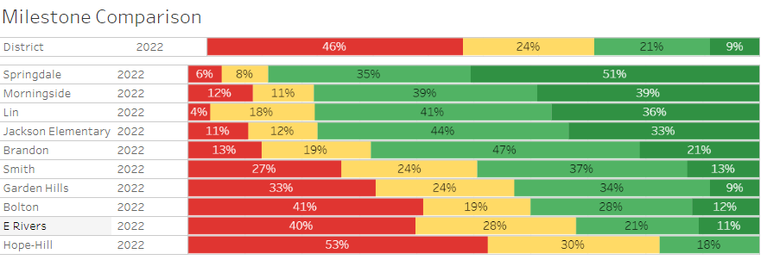
Midtown & North Atlanta Science – 5th

Slide 16
Glows - Math
More Springdale students scored Proficient or Distinguished on the EOG than other district elementary school students (83% vs 31%, respectively)
4% of Springdale students earned a Beginning Learner status, compared to 40% of district elementary school students and 10% of Midtown cluster elementary school students
Black student proficiency rate at Springdale was higher than the district rate for Black students (40% vs. 14%), as well as higher than the cluster rate (28%)
Students with disabilities had higher proficiency rates than their district peers (57% vs. 10%)
EL students at Springdale a higher proficiency rate than other district elementary school EL students (58% vs. 21%)
Students who were directly certified had a higher proficiency rate than other directly certified elementary school students in the district (48% vs. 11%)
All other subgroups also had higher proficiency rates than their respective subgroup in district elementary school students. They were also higher than the cluster proficiency rates
3rd and 5th grade students had the highest proficiency rates (86%), followed by 4th grade students (78%)
Hispanic students had higher proficiency rates than Black students at Springdale (74% vs. 40%). Both were lower than the school’s White proficiency rate (93%)
Males had higher proficiency rates than Females (85% vs. 81%)

Slide 17
Glows - REading
More Springdale students scored Proficient or Distinguished on the EOG than other district elementary school students (79% vs 32%, respectively)
8% of Springdale students earned a Beginning Learner status, compared to 44% of district elementary school students and 12% of Midtown cluster elementary school students
Black student proficiency rate at Springdale was higher than the district rate for Black students (38% vs. 15%), as well as higher than the cluster rate (29%)
Students with disabilities had higher proficiency rates than their district peers (62% vs. 10%)
Students who were directly certified had a higher proficiency rate than other directly certified elementary school students in the district (48% vs. 12%)
All other subgroups also had higher proficiency rates than their respective subgroup in district elementary school students.
5th grade students had the highest proficiency rate (84%), followed by 3th grade students (82%), and 4th grade (72%)
Females had higher proficiency rates than Males (81% vs. 77%)

Slide 18
Grows
Grows in Math & Science
Grows In Reading
Black student proficiency rate at Springdale was higher than the district rate for Black students (40% vs. 14%), as well as higher than the cluster rate (28%)
Hispanic students had higher proficiency rates than Black students at Springdale (74% vs. 40%). Both were lower than the school’s White proficiency rate (93%)
Black student proficiency rate at Springdale was higher than the district rate for Black students (36% vs. 16%). It was similar to the Black elementary school cluster rate (35%)
Black student proficiency rate at Springdale was higher than the district rate for Black students (38% vs. 15%), as well as higher than the cluster rate (29%)
EL students at Springdale a modestly higher proficiency rate than other district elementary school EL students (21% vs. 16%)
Hispanic students had modestly higher proficiency rates than Black students at Springdale (44% vs. 38%). Both were lower than the school’s White proficiency rate (95%)

Slide 19
Questions?

