Slide 1
GO Team Meeting
Springdale Park
April 11, 2023

Slide 2
Agenda
Call to Order
Roll Call; Establish Quorum
Action Items
Approval of Agenda
Approval of Previous Minutes:
Additional Action Item 1
Discussion Items
2023 Spring MAP results
Needs Assessment
Information Items
Principal’s Report
2022-2023 Family Engagement and/or Partnership Highlights
Cluster Advisory Team Report
GO Team Elections
Announcements
Public Comment
Adjournment

Slide 3
2023 Spring MAP Results
Data Points to Consider
Fall to Spring Comparison
Literacy
Numeracy

Slide 4
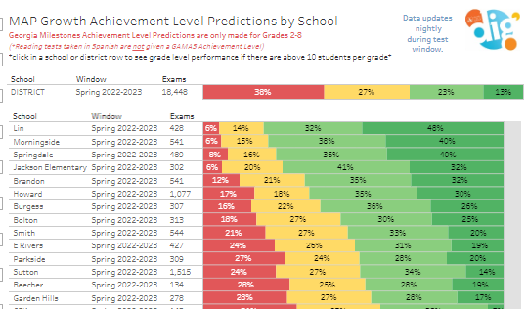
Literacy

Slide 5
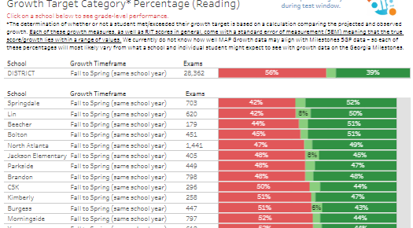
Literacy

Slide 6
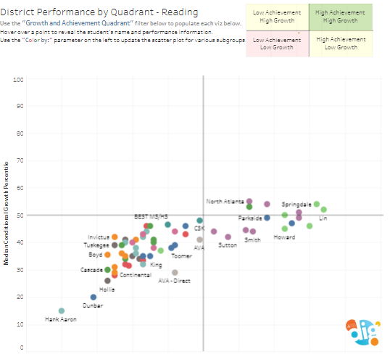
Literacy

Slide 7
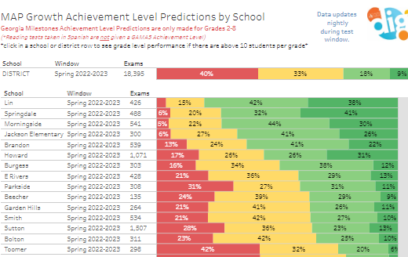
Math

Slide 8
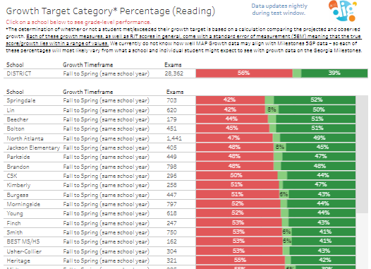
Math

Slide 9
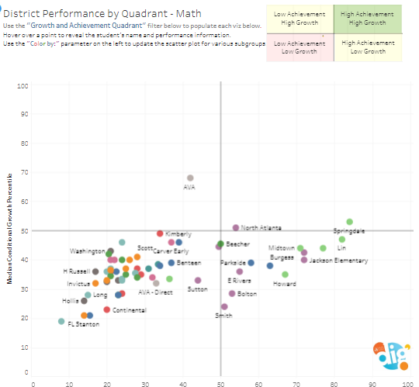
Math

Slide 10
Needs Assessment
Needs Assessment
During this Needs Assessment, we will look at data from the Spring MAP administration and identify 2-3 potential needs for the 2023-2024 school year.
This discussion will help school leadership as they begin developing the school’s 2023-2024 Continuous Improvement Plan this summer.
ACTIVITY

Slide 11
Needs Assessment: Guiding Questions
What does this data tell us?
What good news is there to celebrate?
Where are growth opportunities?
What trends do we see in the data?

Slide 12
Needs Assessment:
What are two to three (2-3) needs we can identify based our data?
 | Needs
1
2
3

Slide 13
Information Items

Slide 14
Principal’s Report

Slide 15
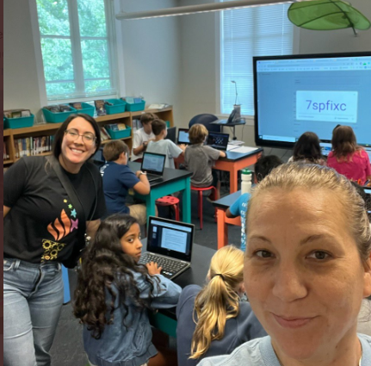
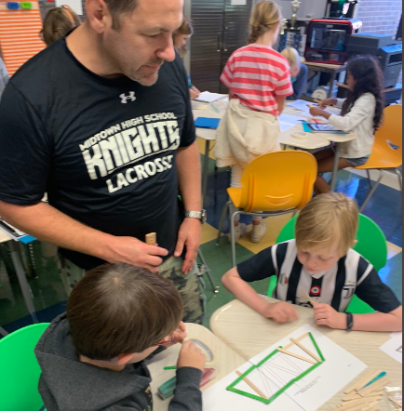
Family Engagement
STEAM Night
Fine Arts Night
International Night
Volunteer Opportunities
Library Shelving
Math Club
Science Olympiad
Gardening

Slide 16
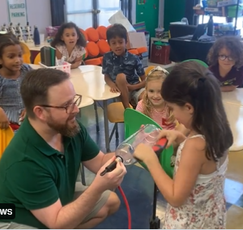
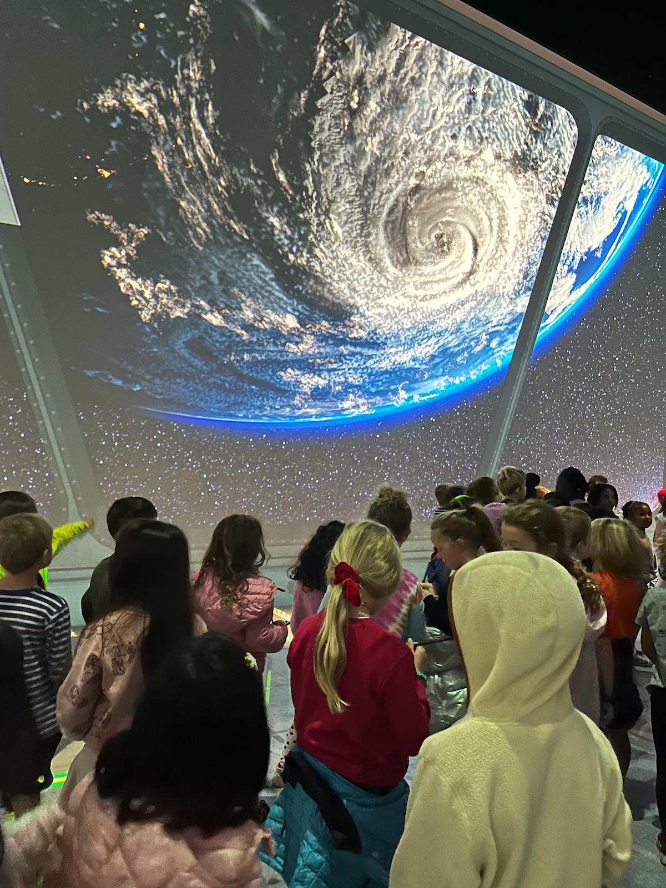
Partnerships
EXPERIENCES

Slide 17
Additional Information Items
Cluster Advisory Team Report
GO Team Elections
Find candidates at apsstrongschools.com
Vote APRIL 18-27
Households are sent a unique link based upon information in Infinite Campus
School Staff will be sent a link to their APS email address

Slide 18
Announcements
GO Team Members
Check your email starting May 1 for end of year survey links
GO Team Satisfaction Survey
Principal Feedback Survey
Complete your required trainings ASAP
Contact the GO Team Office with any questions

