Slide 1
FY24 Budget Approval Meeting

Slide 2
Norms
This is a meeting of the GO Team. Only members of the team may participate in the discussion. Any members of the public present are here to quietly observe.
We will follow the agenda as noticed to the public and stay on task.
We invite and welcome contributions of every member and listen to each other.
We will respect all ideas and assume good intentions.

Slide 3
Agenda
Action Items Approval of Agenda
Approval of Previous Minutes
Budget Approval (after final presentation/review and discussion)
Discussion Items
Presentation of the final budget
Information Items
Principal’s Report
BASC-3 Results
Spring ACES Presentation
Announcements

Slide 4
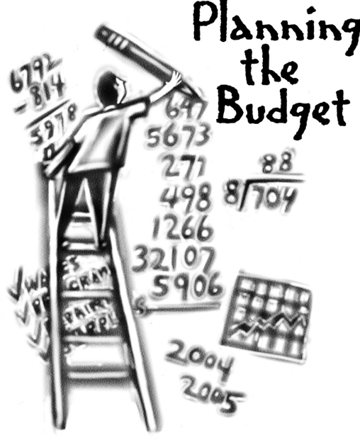
Overview of FY ‘24 GO Team Budget Process
Step 1 Review and Update Strategic Plan and Rank Strategic Priorities
By end of Fall Semester
Step 6 Principals: HR Staffing Conferences Begin
Late February – Early March
Step 3 GO Team Initial Budget Session: Allocation
January 24 – early February
Step 7 GO Team Final Budget Approval Meeting
Budgets Approved by March 17
Step 5
GO Team Feedback Session: Draft Budget Presented & Discussed
February – multiple meetings, if necessary
Step 4 Principals: Associate Supt. Discussions and Review
February (supports needed, specific challenges, coaching)
Step 2 Principals: Workshop FY 24 Budget
January 24, 2023
GO Teams are encouraged to have ongoing conversations about the school’s budget.

Slide 5
Budget Approval Meeting
What
During this meeting GO Teams will review the budget, which should be updated based on feedback from the staffing conference, Associate Superintendents, and key leaders. After review, GO Teams will need to take action (i.e., vote) on the FY24 Budget.
Why
Principals will present the final budget recommendations for GO Team approval.
When
All approval meetings must be held after staffing conferences. Budgets must be approved by March 17th.

Slide 6
Budget Review

Slide 7
Staffing Conference Changes
There were not any changes made to the draft budget we discussed at our last meeting.

Slide 8
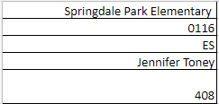
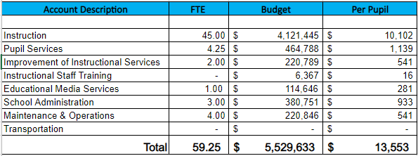
Budget by Function (Required)
*Based on Current Allocation of School Budget

Slide 9
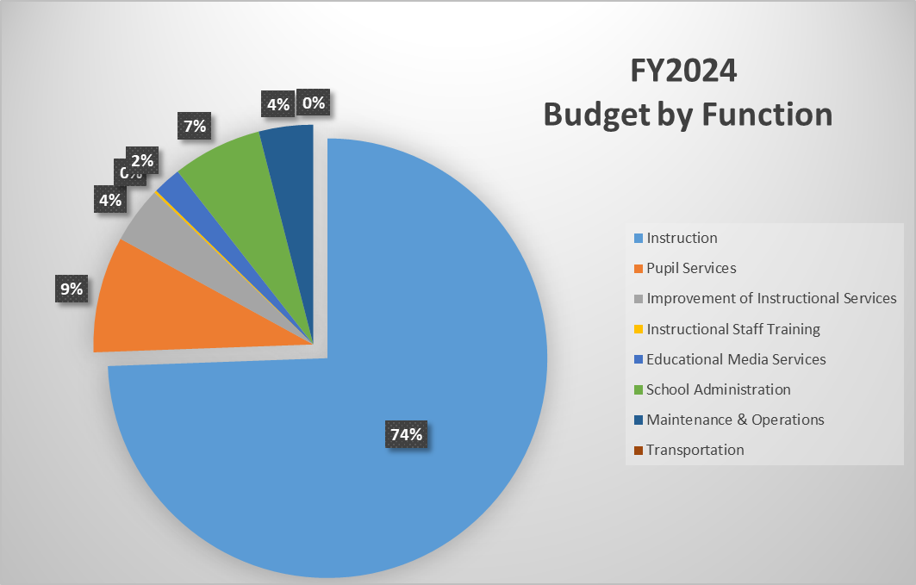
Budget by Function
*Based on Current Allocation of School Budget

Slide 10
Questions?

Slide 11
The GO Team needs to TAKE ACTION (vote) on the presented budget. After the motion and a second, the GO Team may have additional discussion. Once discussion is concluded, the GO Team will vote.
Action on the Budget

Slide 12
BASC-3 Data

Slide 13
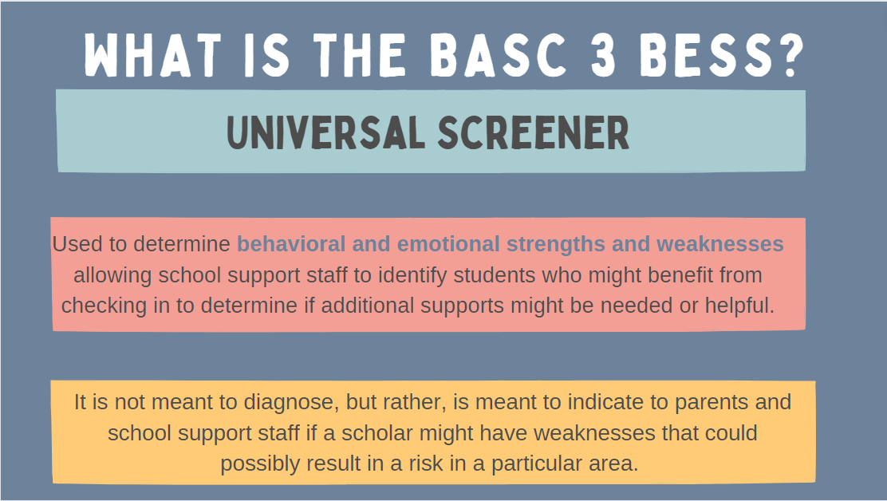

Slide 17
2023 Spring ACES
Accountability
Collaboration
Equity
Support

Slide 18
STEM
2

Slide 19
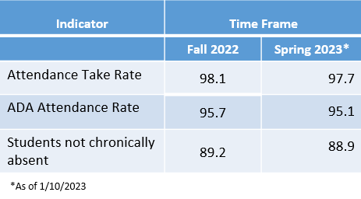
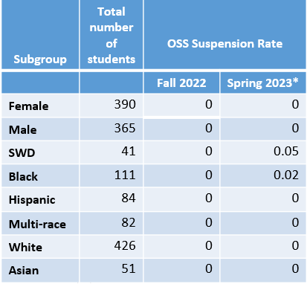
0.00**
**A suspension rate of 1 indicates that the average student in the school (including all students, not just those ever suspended) will be suspended for one day over the course of the year. A suspension rate of 0.5 is equivalent to 50% of students suspended for one day over the course of the year.

Slide 21
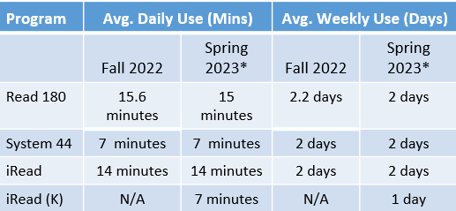

Slide 22
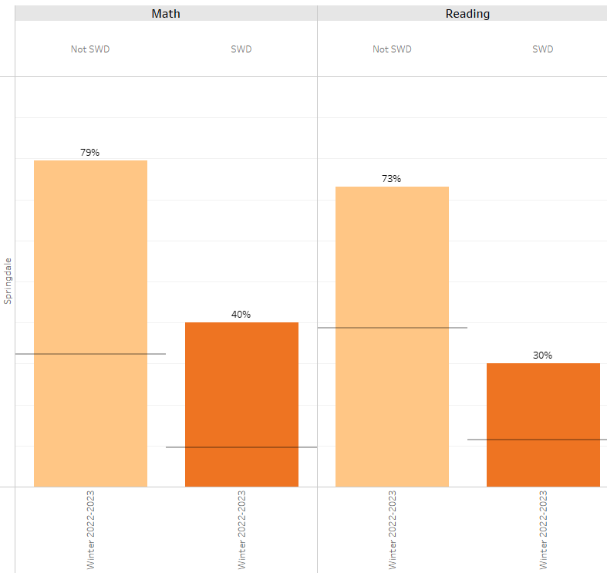
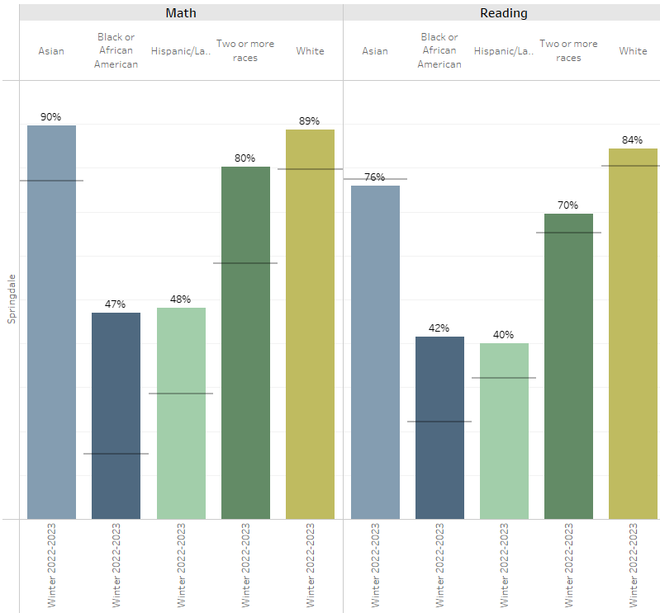

Slide 23
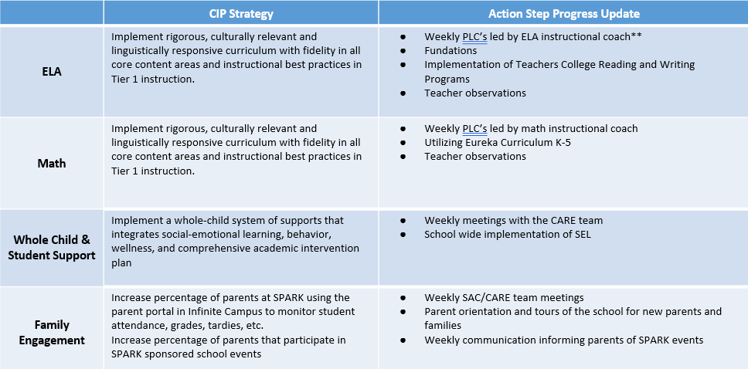

Slide 25
Questions?

Slide 26
Thank you

