Slide 1
45 Day Check-in
GO Team Meeting #3

Slide 2
Agenda
CIP-45 Day Check-in &
School Strategic Plan Alignment

Slide 3
Timeline for GO Teams
You are HERE
Fall 2021
GO Team Developed 2021-2025 Strategic Plan
1
Summer 2022
School Leadership completed Needs Assessment and defined overarching needs for SY22-23
2
August 2022
School Leadership completed 2022-2023 Continuous Improvement Plan
3
Sept. – Dec. 2022
Utilizing current data, the GO Team will review & possibly update the school strategic priorities and plan
4
Before Winter Break
GO Team will take action (vote) on the school’s strategic plan and vote on the ranked strategic plan priorities for SY23-24 budget discussions.
5
1
2
3
4
5

Slide 4
Strategic Plan Progress

Slide 5
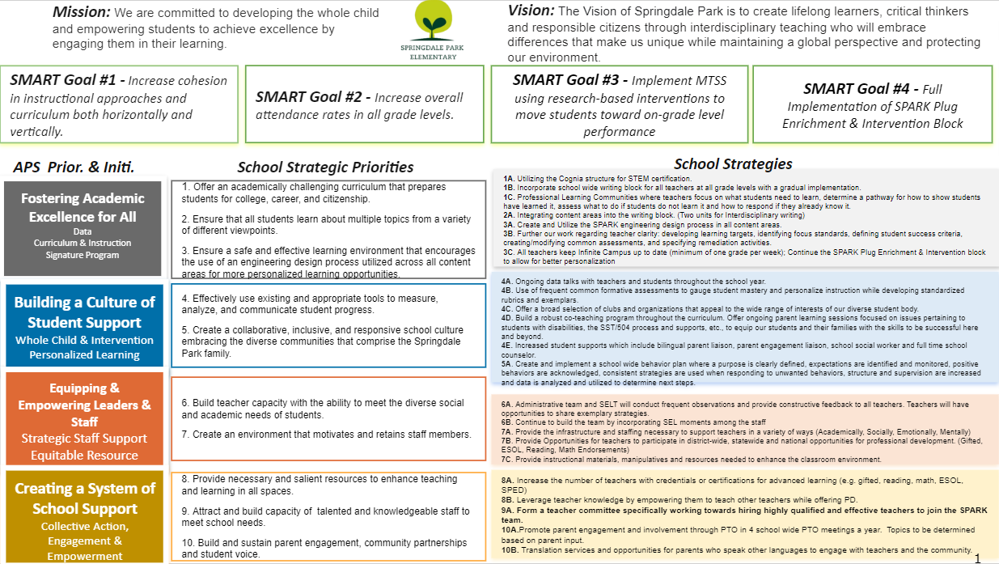
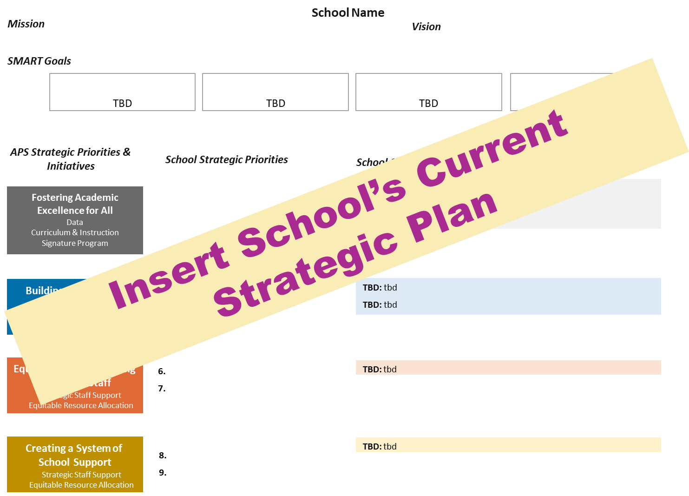
Our Strategic Plan

Slide 6
Quarterly CIP Check-in
As part of the Continuous Improvement process, all APS schools are completing a quarterly check-in for the Continuous Improvement Plans.
Questions to Consider
Based on our year long CIP plan, what are the actions that the school has already completed?​
What data supports the completion of an action step and success criteria (both implementation and student achievement)?

Slide 7
 |  | Associate Superintendent:
Continuous Improvement Plan Goal # 1
Completed Action Steps | Evidence of Completed Actions Steps (Implementation or Student /Teacher progress data) | Evidence of Completed Actions Steps (Implementation or Student /Teacher progress data) | Artifacts available | Artifacts available
1.
2.
3.
Summary of next steps and district support needed to continue progress:
Action Steps in Progress | Anticipated Date of Completion | Anticipated Date of Completion | Necessary Resources to Complete Step | Necessary Resources to Complete Step
1.
2.
3.
Summary of next steps and district support needed to complete action steps currently in progress:
Pending Action Steps | Anticipated Start Date | Anticipated Start Date | Necessary Resources to Begin/Complete Step | Necessary Resources to Begin/Complete Step
Summary of next steps and district support needed to start action steps:
Springdale Park Elementary

Slide 8
Springdale Park Elementary
 |  | Associate Superintendent:
Continuous Improvement Plan Goal # 1 – Literacy - By May of 2023 for grades 3-5, SPARK will see a decrease of 5% in students scoring at the beginning/developing level.​ (2022 – 8% Beginning, 13% Developing)
Completed Action Steps | Evidence of Completed Actions Steps (Implementation or Student / Teacher progress data) | Evidence of Completed Actions Steps (Implementation or Student /Teacher progress data) | Artifacts available | Artifacts available
1. Orton Gillingham and HMH Trainings over the summer. | Funding Source; Attendance Check In
2. District Led ESOL – Team Teacher Training | Sign-In
Summary of next steps and district support needed to continue progress:
Action Steps in Progress | Anticipated Date of Completion | Anticipated Date of Completion | Necessary Resources to Complete Step | Necessary Resources to Complete Step
1.PLC meetings on a weekly basis with grade levels for Reading. | PLC Plans; Schedule
2. SPARK Plug Enrichment & Intervention; Training on Aimsweb | Schedule; Class Rosters; HMH Data Trackers
3. Personalized Learning; Differentiated Small Group; Cohort 3 with district | Project Based Learning; Data Talks
Summary of next steps and district support needed to complete action steps currently in progress:
Pending Action Steps | Anticipated Start Date | Anticipated Start Date | Necessary Resources to Begin/Complete Step | Necessary Resources to Begin/Complete Step
1. PLC Meetings on a weekly basis with IRR, SPED and EIP.
2. Principal Led Data Talks | December 2023
Summary of next steps and district support needed to start action steps:

Slide 9
Springdale Park Elementary
 |  | Associate Superintendent:
Continuous Improvement Plan Goal # 2 – Math - By May of 2023 for grade 3-5, SPARK will see a decrease of 3% in students scoring at the beginning/developing level. ​ (2022 – 4% Beginning, 13% Developing)​
Completed Action Steps | Evidence of Completed Actions Steps (Implementation or Student /Teacherprogress data) | Evidence of Completed Actions Steps (Implementation or Student /Teacher progress data) | Artifacts available |  | Artifacts available
1. Engineering Design Process; STEAM Ambassadors | Created and Used; EDP STEM Journals
2. Signature Programming – STEAM | Declared interest in STEM Certification through the state
3. Kennesaw State Project Based Learning
Summary of next steps and district support needed to continue progress:
Action Steps in Progress | Anticipated Date of Completion | Anticipated Date of Completion | Necessary Resources to Complete Step | Necessary Resources to Complete Step
1. PLC meetings on a weekly basis with grade levels for Reading. | PLC Plans; Schedule
2. STEM Student and Teacher Ambassadors | Ambassadors wall; STEM Leadership Team
3. SPARK Plug Enrichment & Intervention | Schedule; Class Rosters; HMH Data Trackers
Summary of next steps and district support needed to complete action steps currently in progress:
Pending Action Steps | Anticipated Start Date | Anticipated Start Date | Necessary Resources to Begin/Complete Step | Necessary Resources to Begin/Complete Step
1. PLC Meetings on a weekly basis with IRR, SPED and EIP.
2. Principal Led Data Talks | December 2022
Summary of next steps and district support needed to start action steps:

Slide 10
 |  | Associate Superintendent:
Continuous Improvement Plan Goal # 3 - For the 2022.23 school year, Springdale Park will identify and monitor attendance of students whose attendance fell below 90% in the 2021.22 school year and increase each student attendance by a minimum of 3%.
Completed Action Steps | Evidence of Completed Actions Steps (Implementation or Student /Teacher progress data) | Evidence of Completed Actions Steps (Implementation or Student /Teacher progress data) | Artifacts available | Artifacts available
1. Back to School Night, STEM Night | Master Calendar
2. Parent Tours; Parent Portal Access to All | 3 Tours to date
Summary of next steps and district support needed to continue progress:
Action Steps in Progress | Anticipated Date of Completion | Anticipated Date of Completion | Necessary Resources to Complete Step | Necessary Resources to Complete Step
1. Weekly Care Team & Student Attendance Committee Meetings | Agenda, Minutes
2. SEL Lessons with School Counselor & Social Worker | Schedule
3. SPARK Plug Enrichment & Intervention Block | Schedule; Class Rosters; HMH Data Trackers
Summary of next steps and district support needed to complete action steps currently in progress:
Pending Action Steps | Anticipated Start Date | Anticipated Start Date | Necessary Resources to Begin/Complete Step | Necessary Resources to Begin/Complete Step
1. PLC Meetings on a weekly basis with IRR, SPED and EIP.
2. Monitoring Parent portal usage | 10/22
3. La Amistad Partnership | 10/22
Summary of next steps and district support needed to start action steps:
Springdale Park Elementary

Slide 11
Activity & Discussion
Review the priorities and goals in your strategic plan and reflect on if the expected progress is being made. These guiding questions will help you determine what, if any, updates are needed for your school’s strategic plan.
Are all CIP Goals reflected in our Strategic Plan Priorities? If not, which CIP Goal(s) are missing and should be added to the Strategic Plan?
What progress has been made towards the priorities identified in our Strategic Plan? What evidence/data do we have?
Based upon available data, are there any other adjustments we need to make to the Strategic Plan?

Slide 12
Updates to the
Strategic Plan
Enter all changes/updates to your plan – be sure to include accountability measures, as appropriate.

Slide 13
Be prepared for our next meeting:
At our NEXT meeting
Fall 2021
GO Team Developed 2021-2025 Strategic Plan
1
Summer 2022
School Leadership completed Needs Assessment and defined overarching needs for SY22-23
2
August 2022
School Leadership completed 2022-2023 Continuous Improvement Plan
3
Sept. – Dec. 2022
Utilizing current data, the GO Team will review & update the school strategic priorities and plan, as needed
4
Before Winter Break
GO Team will take action (vote) on the school’s strategic plan and vote on the ranked strategic plan priorities for SY23-24 budget discussions.
5
1
2
3
4
5

Slide 14
Questions?
Wonderings?
Comments?

