Slide 1
Preparing for Budget Development
GO Team Meeting #4

Slide 2
Agenda
Fall ACES Presentation
Review of Strategic Plan and priorities progress
Preparing for the Budget Development
Rank Strategic Priorities

Slide 3
Accountability
Collaboration
Equity
Support
Fall 2022 ACES Presentation

Slide 4
7 years
1
7 years
2 Vacancies
STEAM Signature Program
STEM Certified(Cognia); Declared for GADOE
xxx
xxx
50 students
747
38 students
732
172 students
15

Slide 5
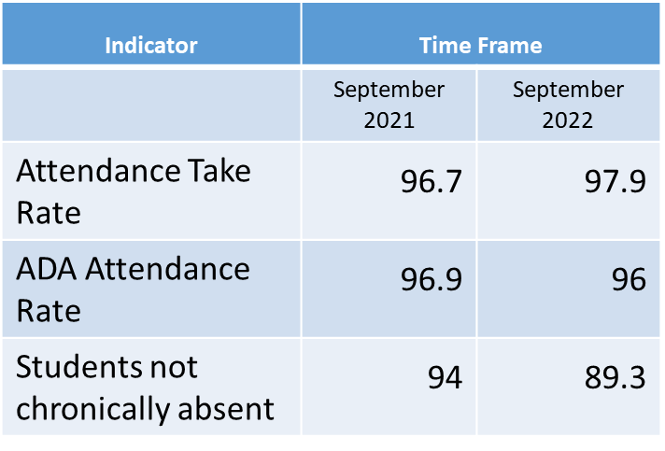
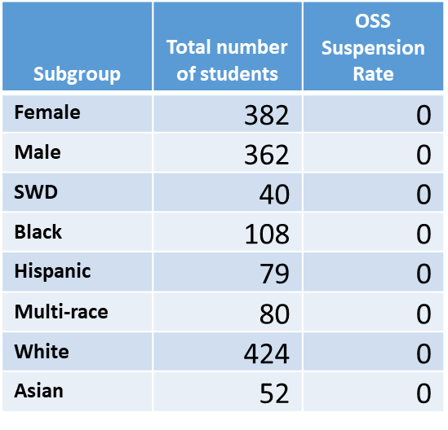
*As of 09/30/2022
*As of 10/12/2022
Notes:
ACES 2.0 School culture
Restorative practices
Family engagement

Slide 7
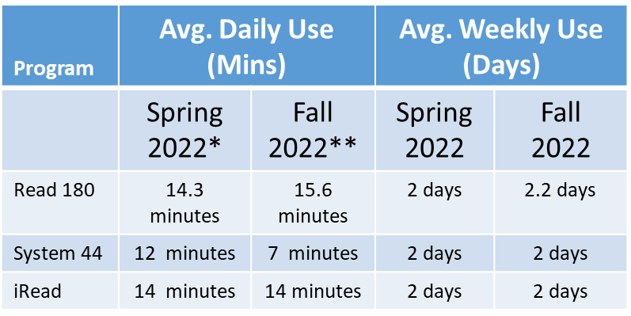
*Spring 2022: From the Spring ACES presentation
**Fall 2022: As of October 13, 2022
Please note that HMH averages might be adversely affected by Fall break week.

Slide 8
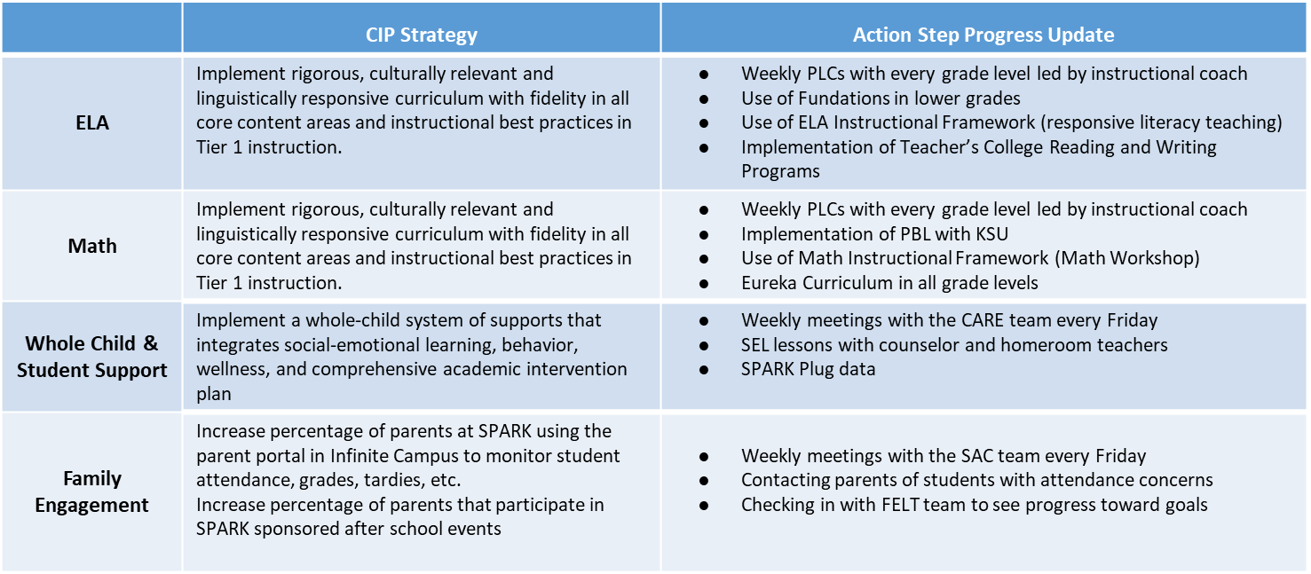

Slide 11
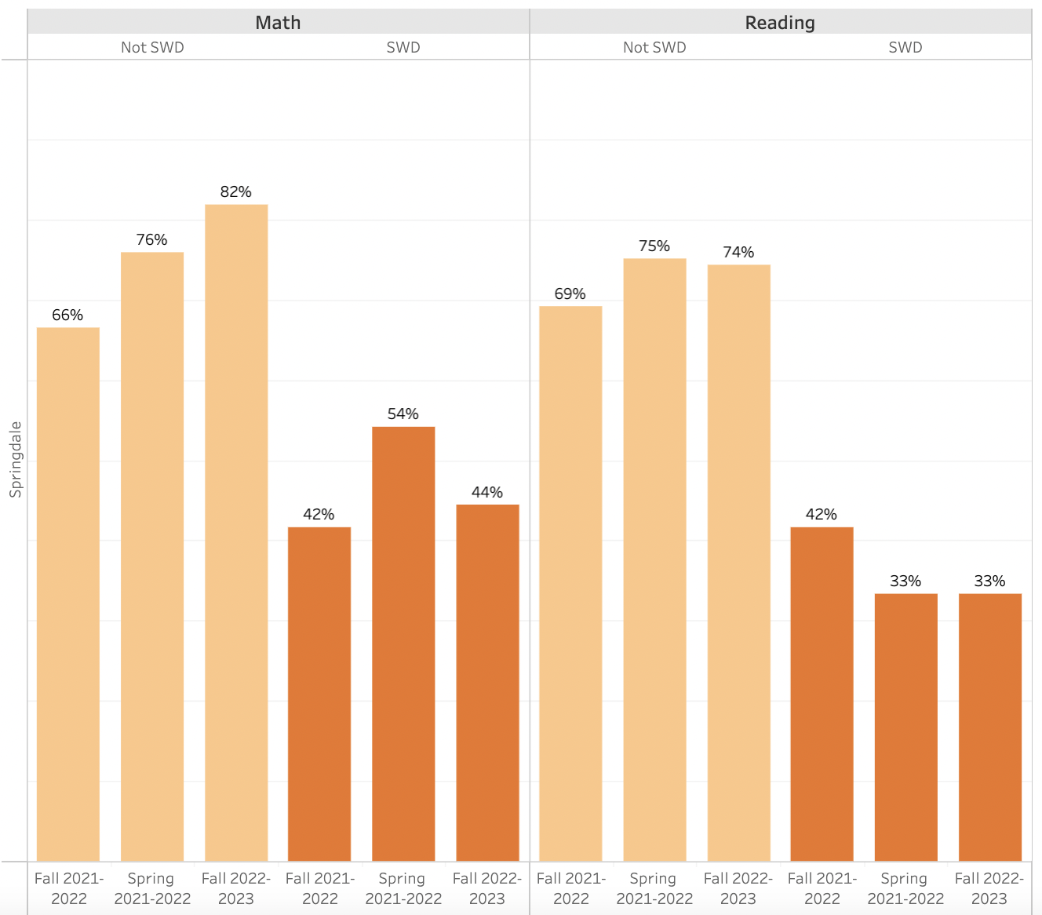

Slide 12
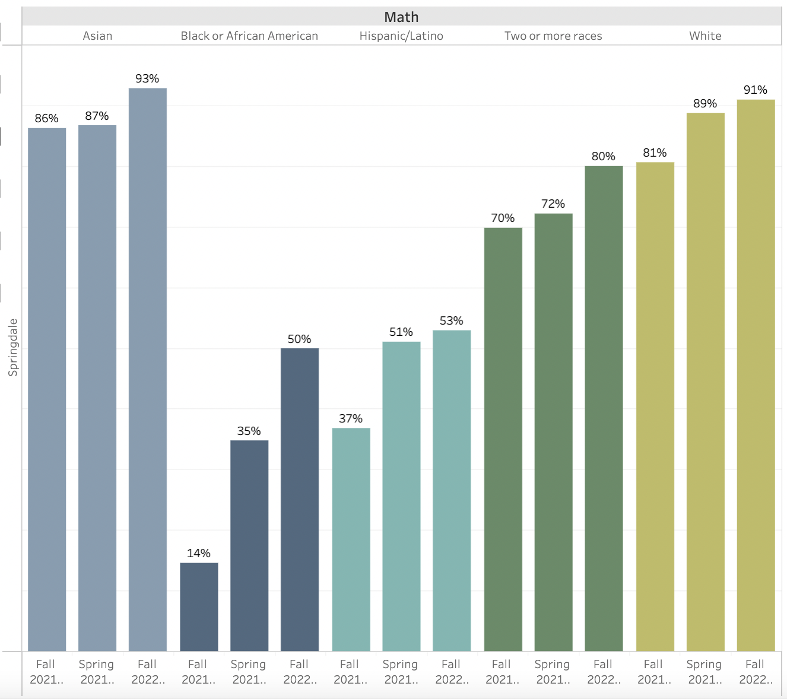
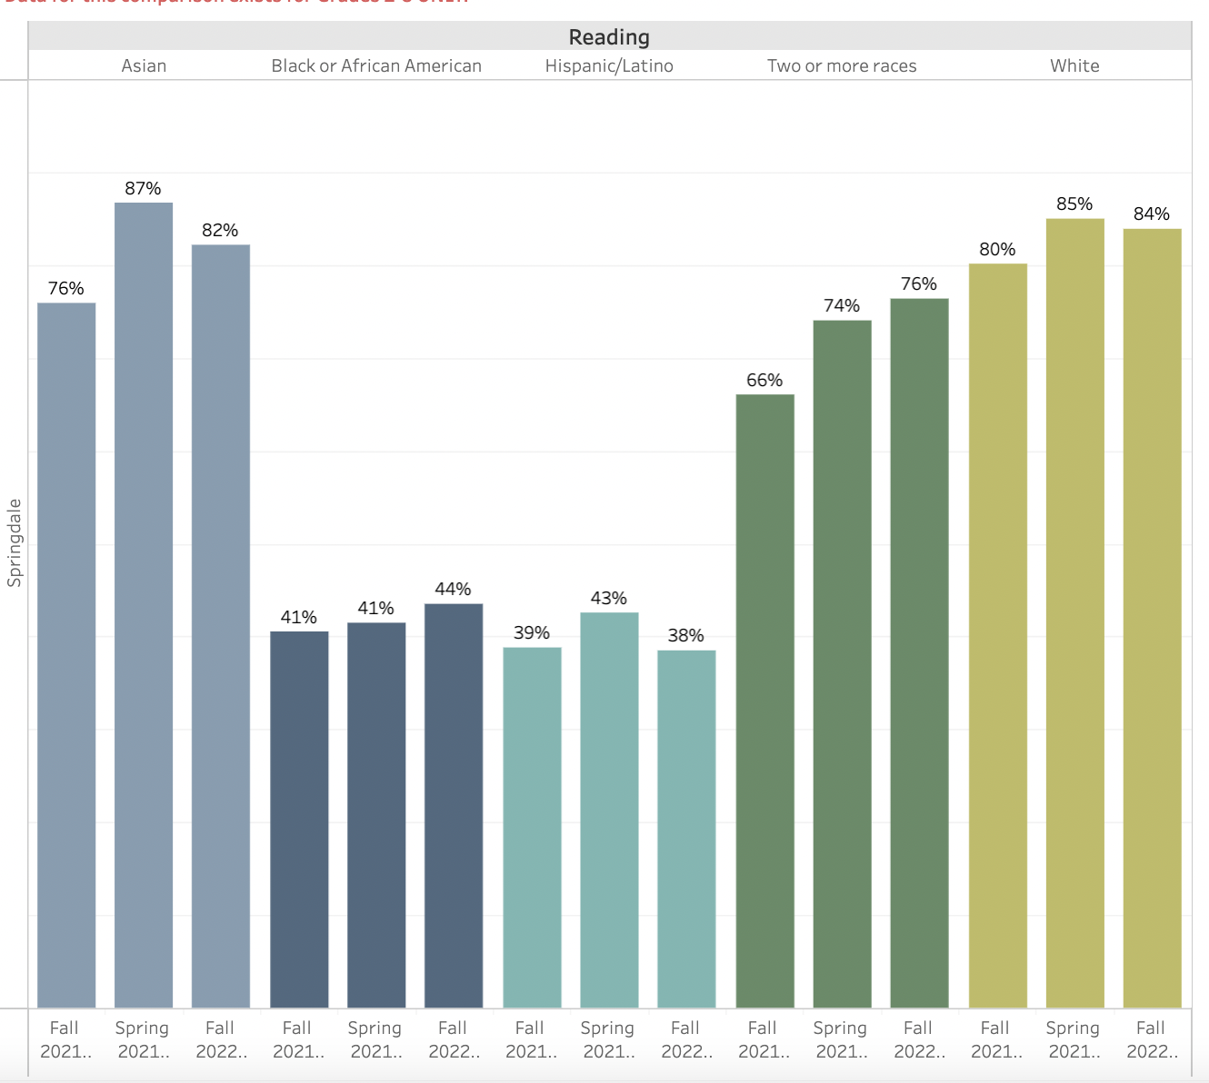

Slide 13
Strategic Plan Progress

Slide 14
Mission: We are committed to developing the whole child and empowering students to achieve excellence by engaging them in their learning.
Vision: The Vision of Springdale Park is to create lifelong learners, critical thinkers and responsible citizens through interdisciplinary teaching who will embrace differences that make us unique while maintaining a global perspective and protecting our environment.
SMART Goal #1 - Increase cohesion in instructional approaches and curriculum both horizontally and vertically.
SMART Goal #2 - Increase overall attendance rates in all grade levels.
SMART Goal #3 - Implement MTSS using research-based interventions to move students toward on-grade level performance
SMART Goal #4 - Full Implementation of SPARK Plug Enrichment & Intervention Block
School Strategic Priorities
School Strategies
APS Prior. & Initi.
1. Offer an academically challenging curriculum that prepares students for college, career, and citizenship.
2. Ensure that all students learn about multiple topics from a variety of different viewpoints.
3. Ensure a safe and effective learning environment that encourages the use of an engineering design process utilized across all content areas for more personalized learning opportunities.
1A. Utilizing the Cognia structure for STEM certification.
1B. Incorporate school wide writing block for all teachers at all grade levels with a gradual implementation.
1C. Professional Learning Communities where teachers focus on what students need to learn, determine a pathway for how to show students have learned it, assess what to do if students do not learn it and how to respond if they already know it.
2A. Integrating content areas into the writing block. (Two units for Interdisciplinary writing)
3A. Create and Utilize the SPARK engineering design process in all content areas.
3B. Further our work regarding teacher clarity: developing learning targets, identifying focus standards, defining student success criteria, creating/modifying common assessments, and specifying remediation activities.
3C. All teachers keep Infinite Campus up to date (minimum of one grade per week); Continue the SPARK Plug Enrichment & Intervention block to allow for better personalization
Fostering Academic Excellence for All
Data
Curriculum & Instruction
Signature Program
Building a Culture of Student Support
Whole Child & Intervention
Personalized Learning
4. Effectively use existing and appropriate tools to measure, analyze, and communicate student progress.
5. Create a collaborative, inclusive, and responsive school culture embracing the diverse communities that comprise the Springdale Park family.
4A. Ongoing data talks with teachers and students throughout the school year.
4B. Use of frequent common formative assessments to gauge student mastery and personalize instruction while developing standardized rubrics and exemplars.
4C. Offer a broad selection of clubs and organizations that appeal to the wide range of interests of our diverse student body.
4D. Build a robust co-teaching program throughout the curriculum. Offer ongoing parent learning sessions focused on issues pertaining to students with disabilities, the SST/504 process and supports, etc., to equip our students and their families with the skills to be successful here and beyond.
4E. Increased student supports which include bilingual parent liaison, parent engagement liaison, school social worker and full time school counselor.
5A. Create and implement a school wide behavior plan where a purpose is clearly defined, expectations are identified and monitored, positive behaviors are acknowledged, consistent strategies are used when responding to unwanted behaviors, structure and supervision are increased and data is analyzed and utilized to determine next steps.
Equipping & Empowering Leaders & Staff
Strategic Staff Support
Equitable Resource Allocation
6. Build teacher capacity with the ability to meet the diverse social and academic needs of students.
7. Create an environment that motivates and retains staff members.
6A. Administrative team and SELT will conduct frequent observations and provide constructive feedback to all teachers. Teachers will have opportunities to share exemplary strategies.
6B. Continue to build the team by incorporating SEL moments among the staff
7A. Provide the infrastructure and staffing necessary to support teachers in a variety of ways (Academically, Socially, Emotionally, Mentally)
7B. Provide Opportunities for teachers to participate in district-wide, statewide and national opportunities for professional development. (Gifted, ESOL, Reading, Math Endorsements)
7C. Provide instructional materials, manipulatives and resources needed to enhance the classroom environment.
Creating a System of School Support
Collective Action, Engagement & Empowerment
8A. Increase the number of teachers with credentials or certifications for advanced learning (e.g. gifted, reading, math, ESOL, SPED)
8B. Leverage teacher knowledge by empowering them to teach other teachers while offering PD.
9A. Form a teacher committee specifically working towards hiring highly qualified and effective teachers to join the SPARK team.
10A.Promote parent engagement and involvement through PTO in 4 school wide PTO meetings a year. Topics to be determined based on parent input.
10B. Translation services and opportunities for parents who speak other languages to engage with teachers and the community.
8. Provide necessary and salient resources to enhance teaching and learning in all spaces.
9. Attract and build capacity of talented and knowledgeable staff to meet school needs.
10. Build and sustain parent engagement, community partnerships and student voice.

Slide 15
Action on the Updated Strategic Plan
The GO Team needs to TAKE ACTION (vote) on its updated Strategic Plan. After the motion and a second, the GO Team may have additional discussion. Once discussion is concluded, the GO Team will vote.

Slide 16
Preparing for Budget Development

Slide 17
Discussion
Strategic Plan Priority Ranking
In preparation for the 2023-2024 Budget Development (January–March 2023), the GO Team needs to rank its Strategic Plan Priorities. Use the next slide to capture the priority ranking.

Slide 18
Strategic Plan
Priority Ranking
SPARK’s priorities from Higher to Lower
Higher
Lower

Slide 19
Action on the Strategic Plan Priorities
The GO Team needs to TAKE ACTION (vote) on its ranked Strategic Plan Priorities. After the motion and a second, the GO Team may have additional discussion. Once discussion is concluded, the GO Team will vote.

Slide 20
Where we’re going
At our next meeting we will begin the discussion of the 2023-2024 budget.
Let me or the Chair know of any additional information you need for our future discussion.

Slide 21
Thank you

