Slide 1
(Springdale Park)
Notes:
Good Morning/Afternoon! Today we begin the process of planning our school’s budget for FY21. I know we are all here for the same reason and that is ensuring success for all (enter school name) students. This meeting is to provide an overview of the draft budget and for you to give feedback on the draft budget.

Slide 2
Norms
This is a meeting of the GO Team. Only members of the team may participate in the discussion. Any members of the public present are here to quietly observe.
We will follow the agenda as noticed to the public and stay on task.
We invite and welcome contributions of every member and listen to each other.
We will respect all ideas and assume good intentions.

Slide 3
GO Team Budget Development Process
YOUR SCHOOL STRATEGIC PLAN…
is your roadmap and your role. It is your direction, your priorities, your vision, your present, your future.
Step 1: Data Review
Step 2: Strategic Plan Review
Step 3: Budget Parameters
Step 4: Budget Choices
Notes:
Today I will provide an overview of the budget allocations for FY21. We will begin the work of funding the strategic priorities we agreed upon during our strategic review meeting. (IF YOU HAVE NOT DECIDED ON YOUR PRIORITIES, YOU WILL SAY – WE WILL DECIDE ON OUR PRIORITIES AND THEN DISCUSS ALLOCATING FUNDS TO ADDRESS THOSE PRIORITIES).

Slide 4
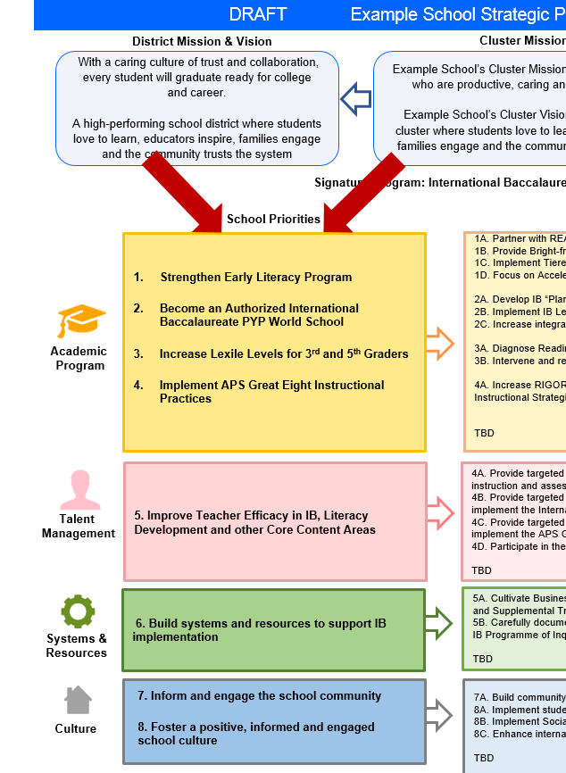
FY21 Budget Development Process
Principal’s Role
Design the budget and propose operational changes that can raise student achievement
Flesh out strategies, implement and manage them at the school level
Focus on the day-to-day operations
Serve as the expert on the school
Hire quality instructional and support personnel
The GO Team’s Role:
Focus on the big picture (positions and resources, not people)
Ensure that the budget is aligned to the school’s mission and vision and that resources are allocated to support key strategic priorities

Slide 5
Discussion of Budget Summary
(Step 4: Budget Considerations)

Slide 6
Executive Summary
This budget represents an investment plan for our school’s students, employees and the community as a whole.
The budget recommendations are tied directly to the school’s strategic vision and direction.
The proposed budget for the general operations of the school are reflected at $6,754,029
This investment plan for FY22 accommodates a student population that is projected to be 796 students, which is a decrease of 13 students from FY21.
Notes:
Here’s a few highlights for our budget this year – read executive summary

Slide 7
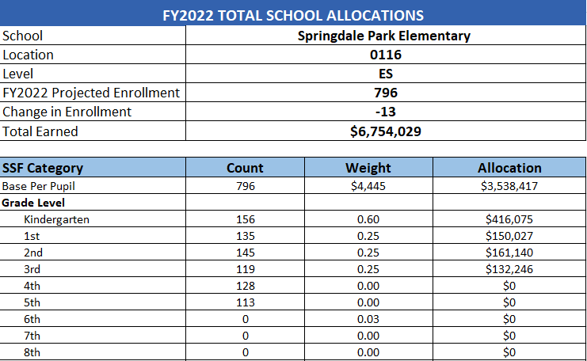
School Allocation
Emple
Notes:
For FY22, APS is continuing to increase equity within the District and the flexibility principals have in regards to our schools budgeted funds. The new Student Success Funding Model (SSF) allocates dollars to schools based on the number of enrolled students and receives a funding "weight" based on need. This year, student characteristics were weighted based on:
Grade Level –
K-12
Poverty – Weighted for all Direct Certification enrolled students.
Beginning Performance – Weighted Middle School and High School students entering with beginner’s performance on milestones.
ESOL – Weighted for all ESOL designated students in order to supplement due to ESOL staff being locked.
Special Education - Weighted for all Special Education students.
Gifted – Weighted and measured by number of students in the Gifted Program
Small School Supplement – Weighted for low enrollment schools
ES – 500
MS – 600
HS – 700
As you can see, our projected enrollment for FY22 is _______, we increased/decreased by __________ from last year.
We received the following weights for our student characteristics: (Below is just for the script, principals need to insert their school’s characteristics)
Grade Level
Poverty
Special Education
Gifted
Gifted Supplement
ELL
Small School Supplement

Slide 8
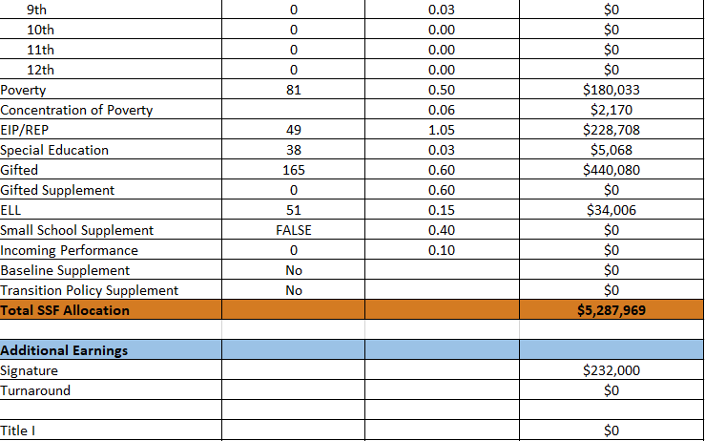
School Allocation
Emple
Notes:
For FY22, APS is continuing to increase equity within the District and the flexibility principals have in regards to our schools budgeted funds. The new Student Success Funding Model (SSF) allocates dollars to schools based on the number of enrolled students and receives a funding "weight" based on need. This year, student characteristics were weighted based on:
Grade Level –
K-12
Poverty – Weighted for all Direct Certification enrolled students.
Beginning Performance – Weighted Middle School and High School students entering with beginner’s performance on milestones.
ESOL – Weighted for all ESOL designated students in order to supplement due to ESOL staff being locked.
Special Education - Weighted for all Special Education students.
Gifted – Weighted and measured by number of students in the Gifted Program
Small School Supplement – Weighted for low enrollment schools
ES – 500
MS – 600
HS – 700
As you can see, our projected enrollment for FY22 is _______, we increased/decreased by __________ from last year.
We received the following weights for our student characteristics: (Below is just for the script, principals need to insert their school’s characteristics)
Grade Level
Poverty
Special Education
Gifted
Gifted Supplement
ELL
Small School Supplement

Slide 9
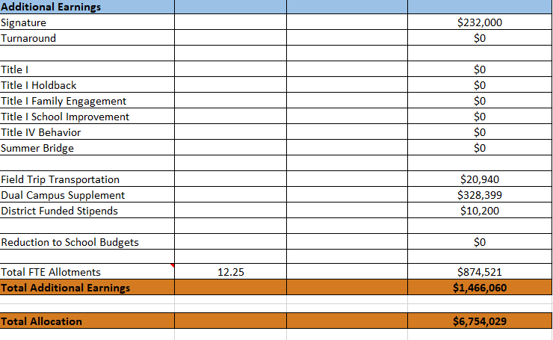
School Allocation
Notes:
For FY22, APS is continuing to increase equity within the District and the flexibility principals have in regards to our schools budgeted funds. The new Student Success Funding Model (SSF) allocates dollars to schools based on the number of enrolled students and receives a funding "weight" based on need. This year, student characteristics were weighted based on:
Grade Level –
K-12
Poverty – Weighted for all Direct Certification enrolled students.
Beginning Performance – Weighted Middle School and High School students entering with beginner’s performance on milestones.
ESOL – Weighted for all ESOL designated students in order to supplement due to ESOL staff being locked.
Special Education - Weighted for all Special Education students.
Gifted – Weighted and measured by number of students in the Gifted Program
Small School Supplement – Weighted for low enrollment schools
ES – 500
MS – 600
HS – 700
As you can see, our projected enrollment for FY22 is _______, we increased/decreased by __________ from last year.
We received the following weights for our student characteristics: (Below is just for the script, principals need to insert their school’s characteristics)
Grade Level
Poverty
Special Education
Gifted
Gifted Supplement
ELL
Small School Supplement

Slide 10
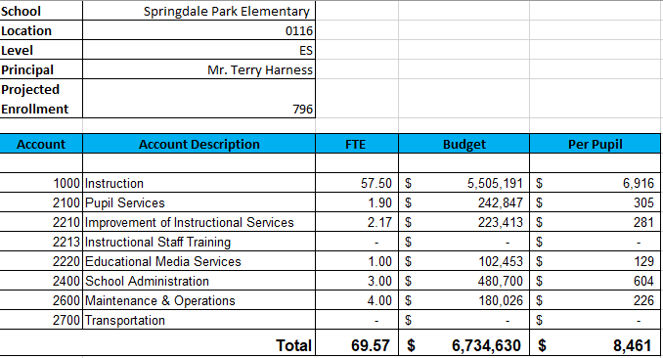
Budget by Function (Required)
Example
Notes:
I am passing out the definitions for these funding categories. You will see what makes up each category. Although the total amount will not change, allocation per function may depending on our conversations and school needs.

Slide 11
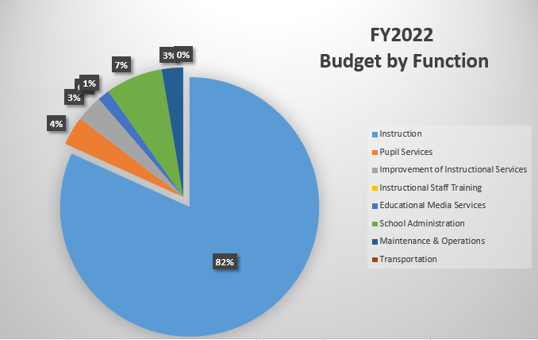
Budget by Function (Required)
Notes:
Explain the pie chart and allocations

Slide 12
Next Year
Focus on Class Size Reductions
K – 8 Teachers – 20 students
1st – 7 Teachers – 20 students
2nd – 7 Teachers – 21 students
3rd – 5 Teachers + 1 EIP Teacher = 20 students
4th – 5 Teachers + 1 EIP Teacher = 21 students
5th – 5 Teachers + 1 EIP Teacher = 19 students
1 – Art
1 – Music
2 – PE Teachers
3 – Gifted Teachers
1 – EIP Teacher
1.5 – ESOL Teachers
Notes:
In February, we will meet again to discuss how the school’s budget has been allocated to support the programmatic needs and FY21 key strategic priorities.
If think we need to continue our budget conversations, we will schedule additional meetings. My goal is to make sure your voices are reflected in our school’s budget.
I will also be meeting with my Associate Superintendent, program managers and other key leaders to go over our budget and to make sure the school is meeting the standards of service and appropriately staffing.
During the week of Feb. 24th -March 2nd , HR Staffing Conferences will be held. At this meeting, I will present my plan for staff utilization, resource distribution and plan for staffing implications.
We will need to approve the budget at the ________ meeting.

Slide 13
Questions to Consider
Are our school’s priorities reflected in this budget?
2. How are district and cluster priorities reflected in our budget?
Cluster priorities- what staff, materials, etc. are dedicated to supporting our cluster’s priorities?
Signature programs- what staff, materials, etc. are dedicated to supporting our signature program?
Are there positions our school will share with another school, i.e. nurse, counselor?
Notes:
CHAIR - Our final task for today! Here are questions that we need to consider to ensure we have a good working draft budget. Let’s walk through them together.

Slide 14
Things to Think About!
Optimistic Budget not a Conservative Budget (30 student difference)
At the end of next year (2021.22) We will lose the Kindergarten Center & the additional $330K – Dual Campus Supplement
At the end of next year, the Inman Middle School Building may open as something “new” in 2022.23 – this will impact our budget.
Notes:
CHAIR - Our final task for today! Here are questions that we need to consider to ensure we have a good working draft budget. Let’s walk through them together.

Slide 15
Next Year – Additions & Abolishments
Combining the SELT & SST Intervention Specialist
Abolishing the .5 SST Intervention Specialist - $50K savings
Abolishing the .5 Art Teacher
K Center - $45K savings
Reducing School Clerk from 211 days to 202 days
$1500 savings
Abolishing the STEM Lab Teacher – Technology & Rolling this responsibility into the Media Specialist position
$90K savings
Abolishing .17 – College & Career Program Specialist Position
$18K savings
Earned an additional Gifted Teacher
Use that FTE to add a 7th second grade teacher
Full Time Counselor – Increase from .5 to 1.0
Reducing Social Worker to 2 days a week
Full Time Media Specialist – Increase 1.0
EIP Teacher – Adding another EIP teacher to support .8
Notes:
In February, we will meet again to discuss how the school’s budget has been allocated to support the programmatic needs and FY21 key strategic priorities.
If think we need to continue our budget conversations, we will schedule additional meetings. My goal is to make sure your voices are reflected in our school’s budget.
I will also be meeting with my Associate Superintendent, program managers and other key leaders to go over our budget and to make sure the school is meeting the standards of service and appropriately staffing.
During the week of Feb. 24th -March 2nd , HR Staffing Conferences will be held. At this meeting, I will present my plan for staff utilization, resource distribution and plan for staffing implications.
We will need to approve the budget at the ________ meeting.

Slide 16
Cares Act Funds - $178,898
$13,689 – Hourly Social Worker – 2 Days a week
$18,018 - .2 EIP Teacher – to make a 1.0 EIP teacher
$90,093 – 1.0 EIP Teacher – Additional
$49,758 - .5 SST Intervention Specialist – Carey Rogers
$7431 – Remaining for Instructional Resources
Notes:
In February, we will meet again to discuss how the school’s budget has been allocated to support the programmatic needs and FY21 key strategic priorities.
If think we need to continue our budget conversations, we will schedule additional meetings. My goal is to make sure your voices are reflected in our school’s budget.
I will also be meeting with my Associate Superintendent, program managers and other key leaders to go over our budget and to make sure the school is meeting the standards of service and appropriately staffing.
During the week of Feb. 24th -March 2nd , HR Staffing Conferences will be held. At this meeting, I will present my plan for staff utilization, resource distribution and plan for staffing implications.
We will need to approve the budget at the ________ meeting.

Slide 17
Intervention Block in 2021.22
SELT & Intervention Specialist
Intervention Block schedule
3 EIP teachers total to support all tier 2 & tier 3 students.
These teachers will be responsible for providing interventions to students as well as entering that data into Infinite Campus
Students identified to receive this support will participate in Intervention Block 3-5 days a week.
Notes:
In February, we will meet again to discuss how the school’s budget has been allocated to support the programmatic needs and FY21 key strategic priorities.
If think we need to continue our budget conversations, we will schedule additional meetings. My goal is to make sure your voices are reflected in our school’s budget.
I will also be meeting with my Associate Superintendent, program managers and other key leaders to go over our budget and to make sure the school is meeting the standards of service and appropriately staffing.
During the week of Feb. 24th -March 2nd , HR Staffing Conferences will be held. At this meeting, I will present my plan for staff utilization, resource distribution and plan for staffing implications.
We will need to approve the budget at the ________ meeting.

Slide 18
Certified Staff
Focus on Class Size Reductions
K – 8 Teachers – 20 students
1st – 7 Teachers – 20 students
2nd – 7 Teachers – 21 students
3rd – 5 Teachers + 1 EIP Teacher = 20 students
4th – 5 Teachers + 1 EIP Teacher = 21 students
5th – 5 Teachers + 1 EIP Teacher = 19 students
1 – Autism Unit Teacher
1 – Art
1 – Music
.5 Band/Orchestra Teacher
2 – PE Teachers
1 - Hourly Spanish Teacher
3 – Gifted Teachers
3 – EIP Teacher
1.5 – ESOL Teachers
1 – Media Specialist
1 – Guidance Counselor
1.5 – SELT/SST
2 – Instructional Coaches (Humanities & Stem)
1 – Assistant Principal
1 – Program Administrator
Notes:
In February, we will meet again to discuss how the school’s budget has been allocated to support the programmatic needs and FY21 key strategic priorities.
If think we need to continue our budget conversations, we will schedule additional meetings. My goal is to make sure your voices are reflected in our school’s budget.
I will also be meeting with my Associate Superintendent, program managers and other key leaders to go over our budget and to make sure the school is meeting the standards of service and appropriately staffing.
During the week of Feb. 24th -March 2nd , HR Staffing Conferences will be held. At this meeting, I will present my plan for staff utilization, resource distribution and plan for staffing implications.
We will need to approve the budget at the ________ meeting.

Slide 19
Classified Staff
1 – School Nurse
Hourly School Nurse at K Center
1 - School Secretary
Front Desk Clerk – Kindergarten Center - 7:30 – 3:30
AM Front Desk Clerk(Hourly) – Main Campus – 6:30 – 11:30
PM Front Desk Clerk(Hourly) – Main Campus – 11 - 4
Kid Concierge – 15 hours per week/new student enrollment
1 Environmental Education Hourly Para
2 Full Time SPED Paras
Autism Unit
One to One para with student
1 Hourly SPED Para
10 – Hourly Instructional Paraprofessionals
7 – K Center
3 – Main Campus
Notes:
In February, we will meet again to discuss how the school’s budget has been allocated to support the programmatic needs and FY21 key strategic priorities.
If think we need to continue our budget conversations, we will schedule additional meetings. My goal is to make sure your voices are reflected in our school’s budget.
I will also be meeting with my Associate Superintendent, program managers and other key leaders to go over our budget and to make sure the school is meeting the standards of service and appropriately staffing.
During the week of Feb. 24th -March 2nd , HR Staffing Conferences will be held. At this meeting, I will present my plan for staff utilization, resource distribution and plan for staffing implications.
We will need to approve the budget at the ________ meeting.

Slide 20
Non-Staffing Items
Reserve - $105,759
Stipends
$10,200 for Grade Chairs
Substitutes - $57,200 – 10 days of subs per teacher
Teaching/Other Supplies, Resources - $25,452
Textbooks – PTO to purchase new books
Eureka Math & Science - $57,312
I-Ready for EIP/SPED - $42,188
Notes:
In February, we will meet again to discuss how the school’s budget has been allocated to support the programmatic needs and FY21 key strategic priorities.
If think we need to continue our budget conversations, we will schedule additional meetings. My goal is to make sure your voices are reflected in our school’s budget.
I will also be meeting with my Associate Superintendent, program managers and other key leaders to go over our budget and to make sure the school is meeting the standards of service and appropriately staffing.
During the week of Feb. 24th -March 2nd , HR Staffing Conferences will be held. At this meeting, I will present my plan for staff utilization, resource distribution and plan for staffing implications.
We will need to approve the budget at the ________ meeting.

Slide 21
What’s Next?
• March:
Final GO Team Approval
Approve Budget on March 3rd @6:30pm
Notes:
In February, we will meet again to discuss how the school’s budget has been allocated to support the programmatic needs and FY21 key strategic priorities.
If think we need to continue our budget conversations, we will schedule additional meetings. My goal is to make sure your voices are reflected in our school’s budget.
I will also be meeting with my Associate Superintendent, program managers and other key leaders to go over our budget and to make sure the school is meeting the standards of service and appropriately staffing.
During the week of Feb. 24th -March 2nd , HR Staffing Conferences will be held. At this meeting, I will present my plan for staff utilization, resource distribution and plan for staffing implications.
We will need to approve the budget at the ________ meeting.

Slide 22
Questions?
Thank you for your time and attention.
Notes:
IF YOU FEEL YOUR TEAM IS READY TO APPROVE THE DRAFT BUDGET, PLEASE DO SO. PLEASE REMIND THEM THAT YOU MAY NEED TO MEET WITH THEM AGAIN, IF THERE ARE CHANGES FROM YOUR MEETINGS WITH DISTRICT LEADERSHIP. LET THEM KNOW YOU WILL KEEP THEM INFORMED!!

