Slide 1
Parkside Elementary school FY26 Budget Feedback Meeting Feb. 10, 2025

Slide 2
AGENDA
Action Items
Approval of Agenda
Approval of Previous Minutes
Discussion Items
Budget Development Presentation
ACTION ITEM: GO Team vote on Draft Budget
Information Items
CCRPI Subgroup Data
Announcements
A. Next Meeting 03/10/2025
Public Comments
Adjournment

Slide 3
Meeting Norms
This is a meeting of the GO Team. Only members of the team may participate in the discussion. Any members of the public present are here to quietly observe.
We will follow the agenda as noticed to the public and stay on task.
We invite and welcome contributions of every member and listen to each other.
We will respect all ideas and assume good intentions.

Slide 4
Budget Feedback presentation & Discussion

Slide 5
GO Team Budget Development Process
YOUR SCHOOL STRATEGIC PLAN…
is your roadmap and your role.
It is your direction, your priorities, your vision, your present, your future.
Step 1: Data Review
Step 2: Strategic Plan Review
Step 3: Budget Parameters
(Strategic Priorities)
Step 4: Budget Choices

Slide 6
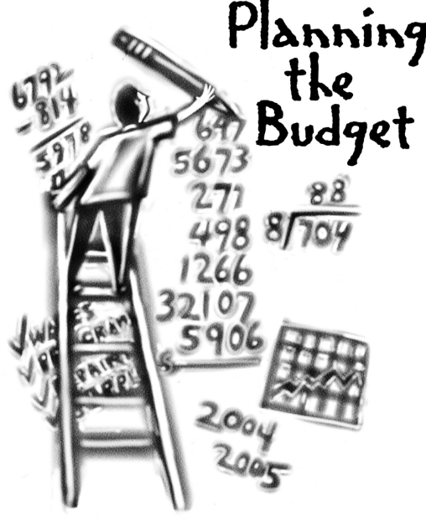
Overview of FY26 GO Team Budget Process
Step 2 Principals Workshop FY 26 Budget
January 15
Step 4 Principals Cluster Supt. Discussions
Step 1 Update Strategic Plan & Rank Priorities
Step 7 Principals HR Staffing Conferences Begin
Feb. 24-27
Step 3 GO Team Initial Budget Session
January 15-31
Step 8* GO Team Final Budget Approval Meeting
Budgets Approved by March 14
Step 6 Cluster Supt. Review February 17-21
Step 5* GO Team Feedback Mtg. February 10-14
GO Teams are encouraged to have ongoing conversations
* GO Teams will need to take ACTION on the budget at these meetings.

Slide 7
Budget Feedback Meeting
What
During the GO Team Feedback meeting the principal will share the 25-26 Strategic Plan Breakout, provide an overview of the school’s draft budget, share updated tabs from the Excel template, and review/collaborate with the GO Team on the comments/notes to explain the use of school-level flexibility in budget allocations.
Why
This meeting provides an opportunity for GO Teams to discuss the principal’s proposed budget and how it supports the school's programmatic needs and key strategic priorities for the 25-26 school year. It also provides the GO Team the opportunity to review and provide feedback on proposed use of school-level flexibility.
When
Early February 10 - February 14th, before Cluster Superintendent review.

Slide 8
Parkside ES
Mission: Grounded in self-awareness and diverse perspectives, every student will be an empathetic critical thinker ready to succeed academically, socially, and creatively.
Vision: A beloved community school where a diverse population of students are inspired by their teachers and peers, who together build a foundation for lifelong learning and engagement in their community and world.
SMART Goals
To increase the number of students in grades 3-5 scoring at the proficient and above levels in reading from 30% in 2019 to 47% in 2025 on the Georgia Milestones assessment.
To increase the number of students in grades 3-5 scoring at the proficient and above levels in math from 29% in 2019 to 45% in 2025 on the Georgia Milestones assessment.
To increase the number of students absent less than 10% of the days enrolled to 85% by spring of 2025.
To increase the number of positive rating each year over the prior year based on the student/parent climate survey.
APS Strategic Priorities & Initiatives
School Strategic Priorities
School Strategies
1. Increase the number of students reading on grade level by the end of 3rd grade.
2. Increase the number of students in grades 1-2 scoring at the proficient level and above by 10% from fall administration of the MAP assessments to the spring administration of the MAP assessments in reading and math.
Fostering Academic Excellence for All
Data
Curriculum & Instruction
Signature Program
Implement & monitor guided reading in grades K-3.
Implement Fundations in grades K-3.
Small group needs based daily in reading & math using the RIT band data from MAPs.
Implement math fluency goals for students.
1. Enhance our Student Support Team (SST) process.
2. Increase access to the gifted program to make the program more diverse.
3. Enhance opportunities for student leadership in a range of intra & extra school activities.
Update current SST/RTI process to model the district’s MTSS process.
Provide professional learning opportunities for teachers about the MTSS process.
Develop a communication plan around the Gifted program that targets under-represented ethnic groups.
Reinstate clubs, student government, safety patrols etc.
Building a Culture of Student Support
Whole Child & Intervention
Personalized Learning
Teachers attend targeted on-going PL to develop and implement the IB PYP and yearly IB-sponsored training.
Provide dedicated time for collaborative planning and reflection.
Math teachers will attend district level professional learning opportunities for math and SEL.
Equipping & Empowering Leaders & Staff
Strategic Staff Support
Equitable Resource Allocation
1. Provide professional learning opportunities for teachers and staff in the areas of mathematics, SEL and IB.
1. Align personnel and resources to support the school’s strategic plan and priorities.
2. Create a foundation in collaboration with the community that will support and enhance the school’s continued growth.
Review and revise work assignments based on the need of the school yearly.
Establish a Foundation Committee to research the creation of a foundation to determine feasibility.
Creating a System of School Support
Collective Action, Engagement & Empowerment

Slide 9
Parkside ES
Mission: Grounded in self-awareness and diverse perspectives, every student will be an empathetic critical thinker ready to succeed academically, socially, and creatively.
Vision: A beloved community school where a diverse population of students are inspired by their teachers and peers, who together build a foundation for lifelong learning and engagement in their community and world.
SMART Goals
To increase the number of students in grades 3-5 scoring at the proficient and above levels in reading from 30% in 2019 to 47% in 2025 on the Georgia Milestones assessment.
To increase the number of students in grades 3-5 scoring at the proficient and above levels in math from 29% in 2019 to 45% in 2025 on the Georgia Milestones assessment.
To increase the number of students absent less than 10% of the days enrolled to 85% by spring of 2025.
APS Strategic Priorities & Initiatives
School Strategic Priorities
School Strategies
Fostering Academic Excellence for All
Data
Curriculum & Instruction
Signature Program
3. Strengthen students conceptual understanding of math.
4. Increase Lexile levels for all students.
E. Use math manipulatives effectively.
F. Allow more practice time for students in math.
G. Daily sustained silent reading.
Building a Culture of Student Support
Whole Child & Intervention
Personalized Learning
4. Develop a plan to address attendance
5. Develop and administer a climate survey for students and parents in grades K-5.
E. Implement Attendance Contracts for chronic absenteeism.
F. Implement weekly Attendance Trophy for homeroom with highest attendance for the week.
G. Daily Robo calls to families when students are out.
H. Monthly CARE Team meetings to address attendance issues.
Equipping & Empowering Leaders & Staff
Strategic Staff Support
Equitable Resource Allocation
TBD: tbd
Creating a System of School Support
Collective Action, Engagement & Empowerment
TBD: tbd

Slide 10
Parkside ES
Strategic Plan
Priority Ranking
Insert the school’s priorities from High to Low
Higher
Enhance opportunities for student leadership in a range of intra and extra school activities.
Develop a plan to address attendance.
Increase access to the gifted program to make the program more diverse.
Lower

Slide 11
Review of FY26 Signature and Turnaround Program Funding Process
Overview
* The district is piloting a zero-based budgeting (ZBB) process for Signature and Turnaround Program Funds this year.
* Zero-based budgeting (ZBB) is a budgeting process that allocates funding based on program efficiency and necessity rather than budget history. As opposed to traditional budgeting, no item is automatically included in the next budget.
* As such the initial allocation for these programs at all schools will be $0.
Process
* Principals will develop proposed requests for the personnel and non-personnel they need to support the Signature and/or Turnaround Programs at their schools.
* Principals will share and discuss their proposals and rationale for the proposals with their school GO Team for feedback.
* After discussing with their GO Team, principals will submit their request for review by January 31st. Funding for these programs will be provided the week of February 3rd.

Slide 12
Overview of Approved Signature Program Funds

Slide 13
Signature program funds requested vs. approved
Requested Signature Program Funds: $283,000
PRINCIPALS: Please update with the list of what you requested to support your signature program. Example: Signature Program Coach Signature Program Annual Fees Signature Program Professional Development/Training Signature Programming Supplies/Resources (Toddle)
APPROVED Signature Program Funds: $240,000
PRINCIPALS: Please update with the Staffing and Non-Staffing allocation of your updated Signature Program funds. Signature Program Coach (.5) Signature Programming Annual Fees Signature Programming Development/Training ( 10 staff members) Signature Programming Resources (Toddle)

Slide 14
Parkside Elementary School FY26 Summary of Proposed Staffing AND Non-Staffing
-

Slide 15
Summary Tab Overview
The Summary Tab provides a summary of the staff in our school. The columns show how many positions are:
Earned – positions allocated by district departments. There is no school-level flexibility with these positions.
Funded – District’s recommended staffing for positions where there is school-level flexibility with staffing the position.
Staffed – This shows how the principal plans to staff the position for the FY26 school year.
Difference—This shows the difference between the recommendation from the District and the Principal's proposed FY26 staffing plan.
Comments: The principal must provide comments if there is a difference in what is Funded and Staffed. Principals and GO Teams will discuss the rationale provided for the Comments section.
Position Title | Earned | Funded | Staffed | Dif | Comments
Teachers
Middle School Core |  | 49.50 | - | (49.50)
Middle Electives |  | 19.00 | - | (19.00)
Teacher Math 6-8 |  |  | 11.00 | 11.00
Teacher Science 6-8 |  |  | 10.00 | 10.00
Teacher Social Studies 6-8 |  |  | 10.00 | 10.00
Teacher ELA 6-8 |  |  | 9.00 | 9.00
Teacher Art 6-8 |  |  | 2.00 | 2.00
Teacher Band 6-8 |  |  | 1.00 | 1.00
Teacher Music 6-8 |  |  | 2.00 | 2.00
Teacher Orchestra 6-8 |  |  | 1.00 | 1.00
Teacher Physical Ed 6-8 |  |  | 7.00 | 7.00
Teacher Performing Arts 6-8 |  |  | 2.00 | 2.00
Teacher World Language 6-8 |  |  | 12.00 | 12.00
Teacher Gifted |  | 13.00 | 11.00 | (2.00)
Teacher Social Emotional Learning |  |  | - | -
EIP TEACHERS |  | 3.50 | 5.00 | 1.50
Teacher REP 6-12 |  |  | 5.00 | 5.00
Example

Slide 16
Teachers
Teacher Kindergarten |  | 5.00 | 6.00 | 1.00
Teacher 1st Grade |  | 6.00 | 5.00 | (1.00)
Teacher 2nd Grade |  | 4.00 | 4.00 | -
Teacher 3rd Grade |  | 4.00 | 4.00 | -
Teacher 4th Grade |  | 4.00 | 4.00 | -
Teacher 5th Grade |  | 4.00 | 4.00 | -
Teacher Stem Lab |  |  | - | -
Teacher Math K-5 |  |  | - | -
Teacher Reading K-5 |  |  | - | -
Teacher Science K-5 |  |  | - | -
Teacher Art 1-5 |  | 1.40 | 1.00 | (0.40)
Teacher Band 1-5 |  |  | 1.00 | 1.00
Teacher Music 1-5 |  | 1.40 | 1.00 | (0.40)
Teacher Orchestra 1-5 |  |  | - | -
Teacher Physical Ed 1-5 |  | 1.40 | 1.00 | (0.40)
Teacher Performing Arts 1-5 |  |  | - | -
Teacher World Language 1-5 |  | 1.40 | 1.00 | (0.40)
Teacher Gifted |  | 4.00 | 2.00 | (2.00)
Teacher Social Emotional Learning |  |  | - | -
EIP TEACHERS |  | 3.00 | 3.00 | -
Teacher EIP Kindergarten |  |  | - | -
Teacher EIP 1-3 |  |  | 2.00 | 2.00
Teacher EIP 4-5 |  |  | 1.00 | 1.00

Slide 17
PARAPROFESSIONALS
Paraprofessional Special Ed | 3.00 | 3.00 | 5.00 | 2.00 | $168,344
Paraprofessional Kindergarten |  | 5.00 | 6.00 | 1.00
ESOL Para |  |  | - | -
Paraprofessional |  |  | - | -
ISS Monitor |  | - | - | -
Paraprofessional Physical Ed |  |  | - | -
Paraprofessional Media |  |  | - | -
Non Instructional Aide |  |  | - | -
Special Ed Paraprofessional - School Funded |  |  | - | -

Slide 18
SCHOOL SUPPORT
Specialist Attendance 202 day |  |  | - | -
Specialist Attendance 211 day |  |  | - | -
AUTR Resident Teacher Relay |  |  | - | -
Board Certified Behavior Analyst |  |  | - | -
Specialist Behavior 202 days |  |  | - | -
Specialist Behavior 211 days |  |  | - | -
Therapist Clinical |  |  | - | -
Counselor Elementary |  | 2.00 | 1.00 | (1.00)
CREATE Teacher Intern |  |  | - | -
Specialist Engagement |  |  | - | -
Instructional Coach 202 day |  |  | - | -
Instructional Coach 211 day |  |  | 1.50 | 1.50
Instructional Coach Readers are Leaders 211 Day | 1.00 | 1.00 | - | (1.00) | $157,054
Master Teacher Leader |  |  | - | -
Media Specialist | 1.00 | 1.00 | 1.00 | - | $149,001
Parent Liaison |  |  | 1.00 | 1.00
Project Facilitator |  |  | - | -
Project Manager School Based |  |  | - | -
Restorative Practices Coach 202 Day |  |  | - | -
Restorative Practices Coach 211 Day |  |  | - | -
Community Liaison Bilingual |  |  | - | -
School Communication Liaison |  |  | - | -

Slide 19
School Nurse LPN | 1.00 | 1.00 | 1.00 | - | $81,711
School Nurse RN | - | - | - | - | $-
School Nurse RN School Funded |  |  | - | -
Signature Band Teacher |  |  | - | -
Signature IB Specialist |  |  | - | -
Signature Prgm Coach 202 day |  |  | 0.50 | 0.50
Signature Prgm Coach 211 day |  |  | - | -
Signature Orchestra Teacher |  |  | - | -
Signature Paraprofessional |  |  | - | -
Signature Program Support Specialist |  |  | - | -
Signature World Language Teacher |  |  | - | -
Social Emotional Learning Coach 211 Day |  |  | - | -
Social Worker | 1.00 | 1.00 | 1.00 | - | $142,858
Social Worker Lead | - | - | - | - | $-
Specialist SST Intervention |  |  | 1.00 | 1.00

Slide 20
Summary of position Changes to Support the fy26 bUDGET
CREATED | REMOVED
1st Grade Teacher | 4th Grade Teacher
 | 3 Instructional Paraprofessionals
Summary of Changes
PRINCIPALS: Please provide a summary of the impact these changes and how it relates to your strategic plan here.

Slide 21
Non-Staffing Tab Overview
The Non-Staffing Tab shows how funds are allocated for non-staff items in the school. There is school-level flexibility for most of these items. The tab has columns for:
Recommended—District’s recommended amount to spend on the line item.
Allocation – This shows how much the principal is proposing to allocate towards the line item in FY26.
Difference—This shows the difference between the recommended amount and the allocation.
Notes: The principal must provide comments if there is a difference in what is Recommended and what is Allocated. Principals and GO Teams will discuss the rationale for the notes section.
Description | Rec. | Allocation | Diff | Notes
Reserve | $ 291,149 | $ 291,149 | $ -
Teacher Stipends |  |  | $ -
Secretary Overtime |  |  | $ -
Contracted Services for Instruction |  |  | $ -
Contracted Services for Professional Development |  |  | $ -
Web-based Subscriptions and Licenses |  |  | $ -
Signature Program Communication/Shipping Fee |  |  | $ -
Computer Software |  | $ - | $ -
Mileage |  |  | $ -
Student Transportation-APS Buses |  |  | $ -
District Funded Field Trips | $ 60,886 | $ 60,886 | $ -
Teaching/Other Supplies | $ 81,900 |  | $ (81,900)
Signature Program Supplies |  |  | $ -
Computer Equipment |  |  | $ -
Media Supplies | $ 13,104 |  | $ (13,104)
Example

Slide 22
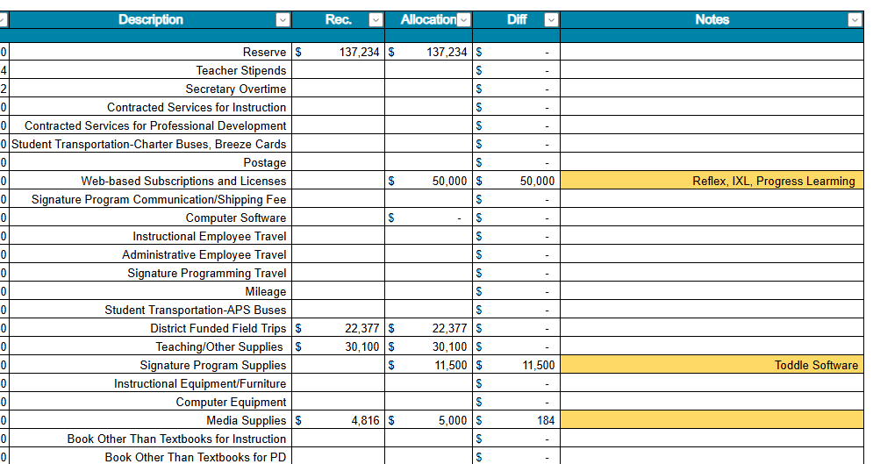

Slide 23
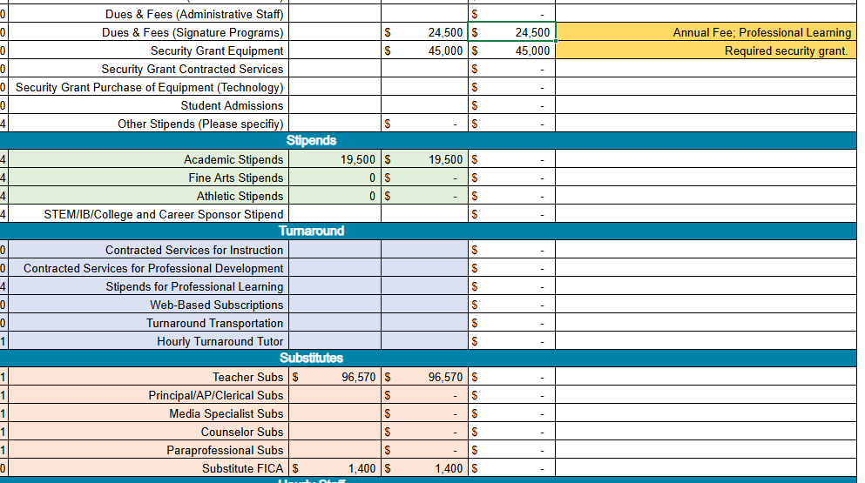

Slide 24
Descriptions of Strategic Plan Breakout Categories
Priorities: FY25 funding priorities from the school’s strategic plan, ranked by the order of importance.
Strategies: Lays out specific objectives for school’s improvement.
Request: “The Ask” What needs to be funded in order to support the strategy?
Amount: What is the cost associated with the Request?

Slide 25
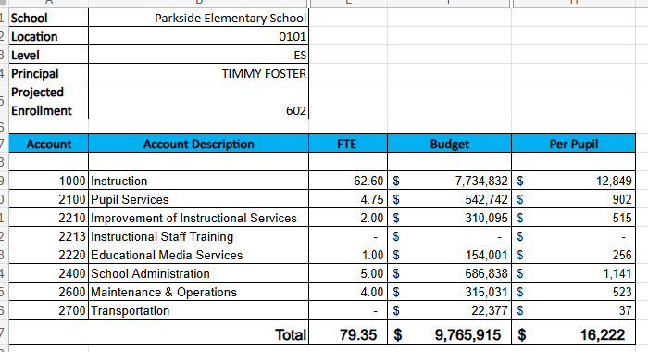
FY26 Budget by Function (required)
* Based on Current Allocation of School Budget

Slide 26
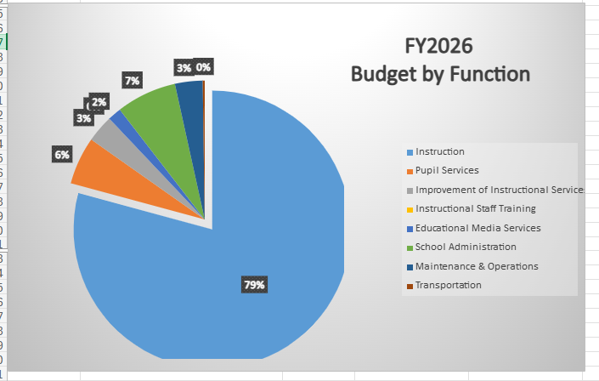
FY26 Budget by Function (required)
* Based on Current Allocation of School Budget

Slide 27
Questions for the GO Team to Consider and Discuss
Strategic Alignment and School-Level Flexibility
Does this budget proposal, as a whole, effectively support our school's strategic priorities?
How do the principal’s proposed changes directly support priorities in our strategic plan? Can we clearly connect each adjustment to a strategic goal?
If new positions, resources, or programs are being added, what data or feedback supports these changes? How will we measure their impact?
What trade-offs are involved? Are any current programs or resources being adjusted or reduced, and how will that affect our students and staff?

Slide 28
Discussion of Reserve & Holdback Funds

Slide 29
Plan for FY26 Leveling Reserve
$137,234
Priorities | Strategies | Requests | Amount
Increase student leadership opportunities. | Create clubs and extra curricular activities for students. | Pay stipends to teachers that sponsor afterschool activities and clubs. | $15,000
Increase the number of students reading on grade level. | Support students in subgroups with scheduled interventions in reading and math | Purchase 3 full-time paraprofessionals for grades 1-5 | $115,000

Slide 30
Plan for FY26 Title I Holdback
$21,692
Priorities | Strategies | Requests | Amount
Increase the number of students reading on grade level | Small group instruction | Supplemental reading materials to support the new ELA textbook adoption. | $21,000

Slide 31
Where We’re Going
Our next meeting is the Budget Approval Meeting
What:
During this meeting we will review the budget, which should be updated based on feedback from the staffing conference, Associate Superintendents, and key leaders. After review, GO Teams will need to take action (i.e., vote) on the FY26 Budget.
Why:
Principals will present the final budget recommendations for GO Team approval.
When:
All approval meetings must be held after staffing conferences. Budgets must be approved by March 15th.

Slide 32
What’s Next?
February
Cluster Superintendent Review (February 17-21)
HR Staffing Conferences (February 24– February 27)
March
Final GO Team Approval Meeting (AFTER your school’s Staffing Conference and BEFORE Friday, March 14th)
ACTION (i.e.- GO Team votes) on final budget recommendation before March 14

Slide 33
Thank you!

Slide 34
Milestones subgroup CCRPI Data

Slide 35
Content mastery

Slide 36
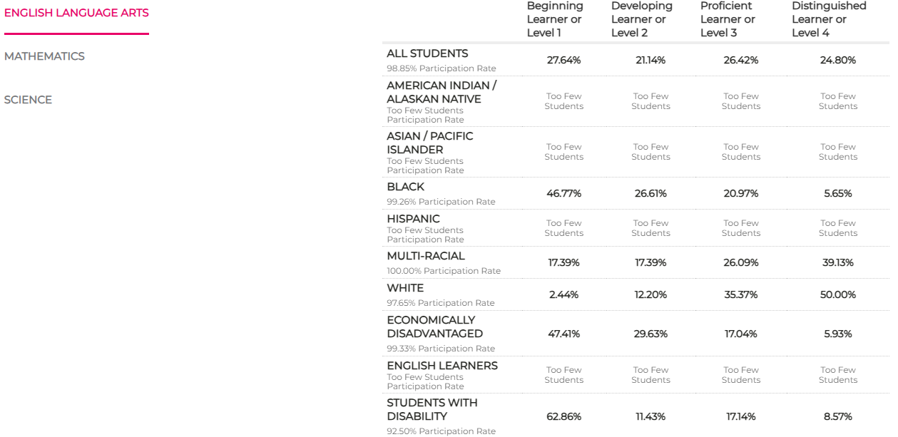

Slide 37
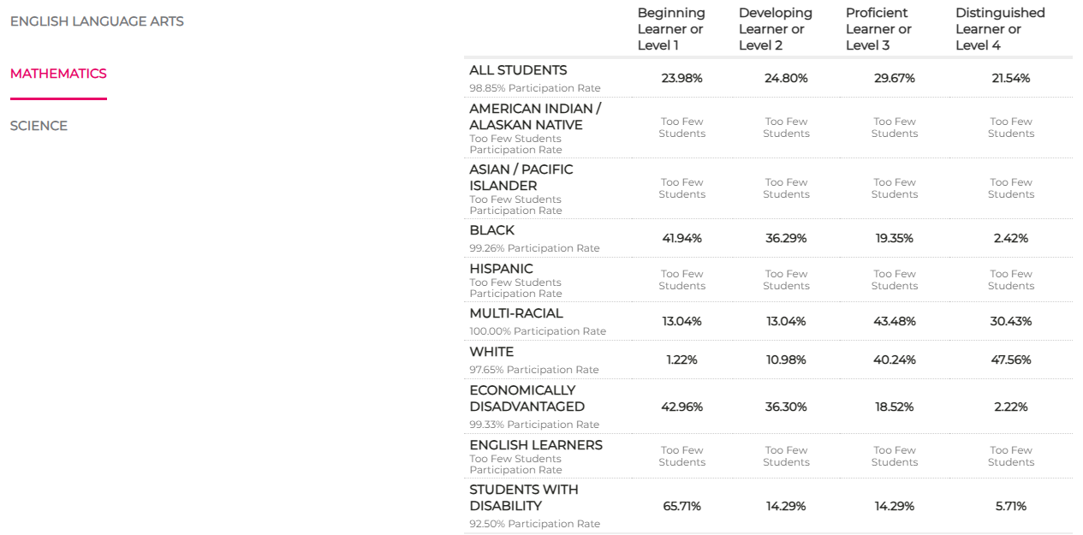

Slide 38
Readiness

Slide 39
Will be updated As soon as possible

