Slide 1
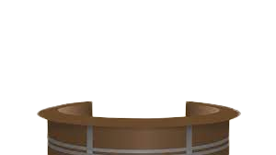
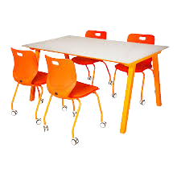
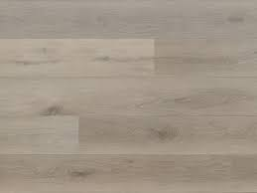
Welcome to J.W.
Dobbs ES
100
200
300
700
800
900
Hello
400
500
600
Twitter
Front side of the Media Center

Slide 2
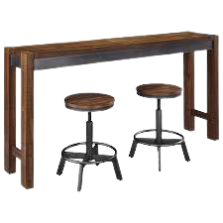
Teachers’ Resources
Teachers’ Online Resources
Curation
Ruby Bridges/George Washington Carver
OPAC
Destiny Follet
Cyberbullying Lesson
Digital Resource
Lesson (Hyperdoc)
Technology and Math Integration
Scratch Coding for Teachers
Scratch Coding Students
Fulton County Libraries
Real/Fake website lesson
Click white boxes for hyperlinks
Open Evaluation Record
Ebooks
EPIC
MyOn
Accelerated Reader
Race2Read
All approved District Instructional Apps
Copyrights Creativity Video (Screencast)
Twitter
Right Side of the Media Center

Slide 3
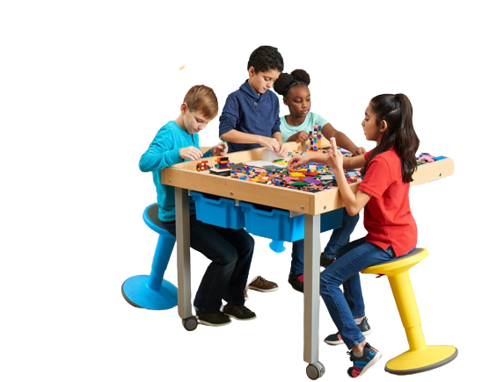
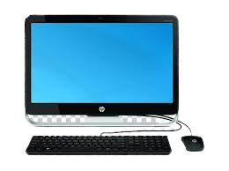
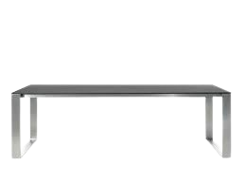
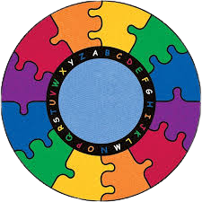
Click for Stemscope
Mine
craft
Study Island
HMH
Scratch
Jr.
Social Media Review
Students’ Section/Left Side of the Media Center

Slide 4
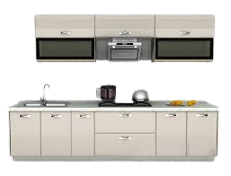
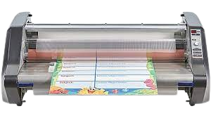
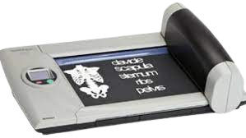
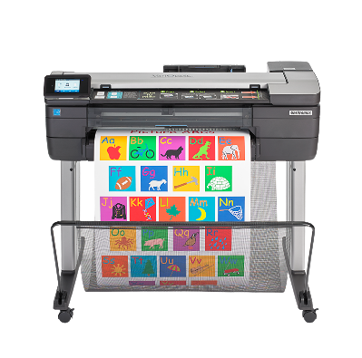
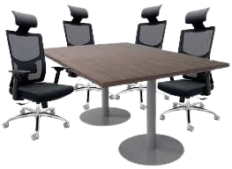
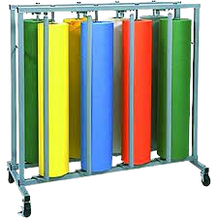
Teachers’/SLMS’ Workroom
Warning
Hot!
Click for Service Request

Slide 5
Addendum
Images/Clipart-
The owner of this document does not own any clipart, images, or photos. All credit is given to the owners.
*The bitmoji was created by the owner of the document.
Have an awesome day!
Twitter
Contact Information
tommy.tyson@apsk12.org
404 802 8064

