Slide 1
Research Paper: MLA Style
Notecards
mla format
Works Cited

Slide 2
Steps in the process
Locate sources of information
Links on library webpage
READ!!!
Create source cards
Create summary card and notecards for each source
Create outline
Notecards by topic
Write paper using parenthetical citations
Works Cited Page
Notes:
Distribute handouts

Slide 3
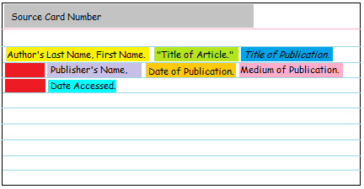
What are Source Cards?
First, you will need a source card. This is how you will keep track of where you got each piece of information.
*If any information is missing from your source, skip that portion of the citation and move onto the next available piece of information. See notes about “Publisher’s Name” and “Publication Date”.
Your source card should like something like this
Any line after the first line in your citation should be indented about a thumb space.
Refer to your handout from Ms. Taft for information on how to format your citation.
If this information isn’t available, use the abbreviations “n.p.” or “n.d.”
Notes:
A source card is the bibliographic information you need to collect for each source of information you use for your research. Basically, it is key information about your information- for example, author, title date, publisher, medium of publication (ie print, web, interview, etc.). Use your handout to decide which pieces of information you need. Each source card will be assigned a number in the top left corner.

Slide 4
Sources of Information
Grady High School Library Webpage
Hint: Google “Grady High School”, go to Media Center Tab.
Passwords:
GALILEO: acting
JSTOR: username:grady/ password:readmore
Gale Virtual: “grady” on campus/ “remote” from home.
Notes:
Most important step: READ!!!!
Open a WORD doc. Name it and save it. Use this to copy and paste citations.
GALILEO- search “minimum wage economic impact” limit to full text, magazines, date 2013-2014. Show email citation, audio.
Gale- search minimum wage.email, audio, citation at bottom of article
Web search “federal minimum wage increase history”

Slide 5
Sample Source Card GALILEO Article
#1
Gray, Eliza. "Wage Warrior." Time, vol. 183, no.9, 2014. p.38. Academic Search Complete. http://proxygsu- satl.galileo.usg.edu/login?url=http://searc h.ebscohost.com/login.aspx?direct=true&d b=khh&AN=94699223&site=eds- live&scope=site. Accessed 16 Apr. 2014.
Notes:
Notice the source card number at the top.

Slide 6
Sample Source Card with Summary
Your summary notecard should include the following information: Section title (in this case “summary”), Source Number, and a summary written in your own words.
#1
Summary
Rick Berman is the leading PR point person for the fight against raising the minimum wage. He argues that raising the minimum wage will cost jobs and hurt the economy

Slide 7
Sample Source Card eReference Book (Gale)
#2
"The Debate on Minimum Wage Laws." Open for Debate, vol. 27: Workers' Rights, Marshall Cavendish, 2009. Gale Virtual Reference Library, go.galegroup.com/ps/i.do?p=GV RL&sw=w&u=atla60761&v=2.1&id=GALE %7CCX4097000747&it=r&asid=0098b519 010ba75e6bb13bf4d71b40b7. Accessed 23 Feb. 2017.

Slide 8
Sample Source Card with Summary
Summary
#2
In 1938, Congress passed the Fair Labor Standards Act FLSA which established a federal minimum wage for all employees and also set standards for compensation for working more than 40 hours per week. Workers who worked longer than 8 hours are to be compensated “time and a half” or the minimum plus half for every hour over 8 hours. Workers who worked longer than 12 hours are to be compensated double minimum wage. These rules are exempt for management, executives, secretaries, and other administrative jobs. Consequently, many employers now reclassify jobs to avoid paying over-time.

Slide 9
Sample Source Card Website
#3
“History of Federal Minimum Wage Rates Under the Fair Labor Standards Act, 1938 – 2009”. United States Department of Labor. United States Department of Labor. n.d.
https://www.dol.gov/whd/minwage/chart.htm Accessed 23 Feb. 2017

Slide 10
Sample Source Card with Summary
Summary
#3
Table showing history of minimum wages increases 1938-2009

Slide 11
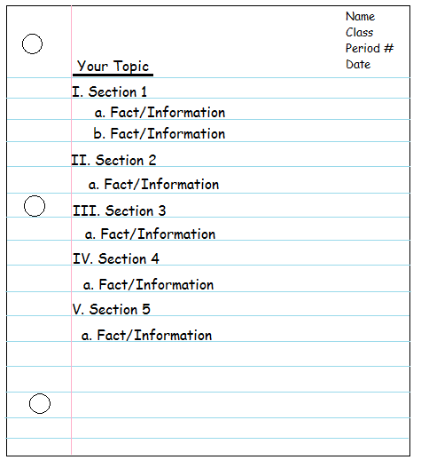
MLA Research Outline
Based on your preliminary reading and source summaries, create an outline for your paper.
It should look like this.

Slide 12
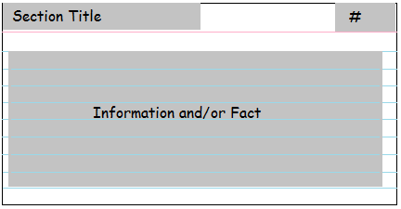
What should my notecards look like?
Your notecards should include the following information: Section Title, Source Number, and 1 Fact or Piece of Information from your source.
This should match the source card number.
This should match the section title from your outline
Only 1 fact per card.

Slide 13
Sample Note Card by Section Title
small business vs. government regulation
#1
Section title
Source number
Rick Berman is head of a PR firm that has ties to the restaurant industry and is responsible for many campaigns including the response to an e coli outbreak that attempted to reframe the issue as an example of existing standards that were working well. (Gray)
The parenthetical citation uses the “signal word” or first word for the citation on your works cited page. Include the page number if available. (Internet sources may not have a page number.)
Notes:
Note the section title, source #, and parenthetical citation.

Slide 14
Works Cited
"The Debate on Minimum Wage Laws." Open for Debate, vol. 27: Workers' Rights, Marshall Cavendish, 2009. Gale Virtual Reference Library, go.galegroup.com/ps/i.do?p=GV RL&sw=w&u=atla60761&v=2.1&id=GALE %7CCX4097000747&it=r&asid=0098b519010ba75e6bb13bf4d71b40b7. Accessed 23 Feb. 2017.
Gray, Eliza. "Wage Warrior." Time, vol. 183, no.9, 2014. p.38. Academic Search Complete. http://proxygsu-satl.galileo.usg.edu/login?url=http://searc h.ebscohost.com/login.aspx?direct=true&db=khh&AN=94699223&site=eds- live&scope=site. Accessed 16 Apr. 2014.
“History of Federal Minimum Wage Rates Under the Fair Labor Standards Act, 1938 – 2009”. United States Department of Labor. United States Department of Labor. n.d. https://www.dol.gov/whd/minwage/chart.htm .Accessed 23 Feb. 2017

